Slide 1
Aras Innovator on Microsoft Azure
The only Azure certified Product Lifecycle Management solution

Slide 2
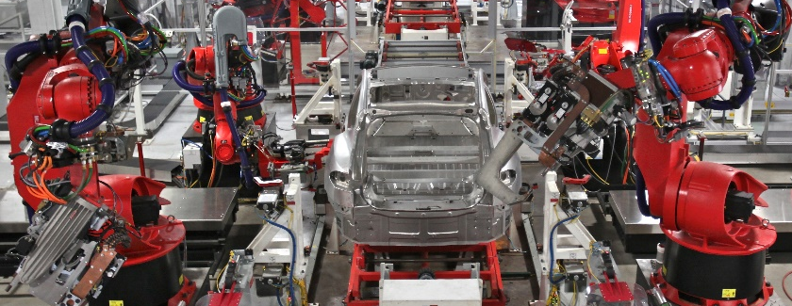
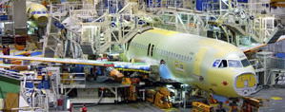
Keeping your business in order while managing your process: the power of Aras on Microsoft Azure
Industry Challenges
Ideal Solution
Desired Outcomes
Complex architectures slows cross-functional management requirements
Product complexity requires time consuming customization, impeding overall process
Enterprises can not keep up with changing business needs
Upgrades are expensive and difficult
Costs high and unpredictable
A flexible design built to meet customer needs quickly, evolving with business demands
Removing unnecessary barriers, allowing teams to collaborate freely
Flexible architecture of Open/Subscription business model to reduce cost and drive greater benefits in the future
Fast adaptation to global processes in accordance with the changing market conditions and customer demand
Develop consistent, repeatable processes that extend through the product lifecycle
Enable collaboration across mechanical, electrical, and software disciplines, as well as in the supply chain
Provide a highly flexible, allowing organizations to tailor business processes to their specific requirements
Notes:
50 word elevator pitch
Your business is evolving: increasing complexity and a changing global environment. Traditional approaches to PLM are failing so we built a better solution. One that adapts to your needs, removes barriers to collaboration, changes the economics of PLM and lets you start where you need and add capabilities over time.

Slide 3
Aras Innovator We’ve taken a different approach because we know traditional approaches to PLM are failing
Aras Innovator provides optimal product lifecycle management (PLM) software for global companies with complex products and fast changing process
Accelerates Integration
Hyper-Scale
Drives Low-cost
Advanced Security
New solutions can be implemented easily and quickly
Seamless integration to existing systems
Native XML Application
Complete system view of multidisciplinary products
Simple deployment (no local installation)
Straightforward handling of the customizing through “Model Based SOA” technology
Unmatched flexibility allows fast customizing at individual requirements
No upfront investment for software license
Flexible subscription offer reduce costs and eliminate risks
Step-by-step implementation minimizes risks and investment
Microsoft .NET based web application
The binary format of Aras Innovator protects Intellectual Property (IP)
Mutual trust for customer to deploy enterprise open source software without security and availability problems
“What really drove our selection of Aras was the comprehensive product lifecycle management functionality and advanced technology”
- Tony DeGregorio, CIO Textron Defense System

Slide 4
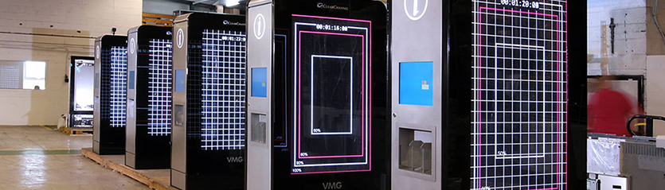
Aras Innovator + Microsoft Azure Aras on Azure provides fast-paced global companies with a new solution for challenging, complex PLM scenarios.
Aras on Azure is ideal for enterprises that need to be up and running quickly, offering a complete PLM environment for supply chain co-development initiatives, joint ventures, rapidly evolving product lines and other fast-paced environments.
Complete PLM on Azure
Comprehensive Control with Aras
Enterprise ready Solution
Flexible cloud and hybrid PLM deployments to drive global enterprises
Customized global product development, driving better product quality and acceleration to market
Complete and customizable suite for complex products that incorporate electronics, software and mechanical designs
Simple model-based SOA framework for customization without complex programming
Deploy and run securely in Azure, and switch to a hybrid or on-premises scenario at any time
Develop connected products with a system-centric approach
Easily adapt to changes without sacrificing performance
Partition easily to uniquely distribute services and layers with clear separation between data, presentation and business logic
Innovative security to ensure safety of intellectual property
Secure collaboration WW for greater speed and agility
Certified process of virtual machines on Microsoft Azure
Only Azure certified PLM solution
Highly secure web services for all data exchange and process integrations

Slide 5
Customer Success Story: Microsoft MDG Global PLM Backbone win at Microsoft with Aras
Win Strategy
Deliver better technology than competition which enabled Microsoft with greater agility
Microsoft deploys Aras for Nokia, XBOX, Surface, Surface Hub and More
Microsoft was looking to enable an end-to-end process with a PLM for product development, supply chain, and global manufacturing. In addition, it was critical that the PLM solution provided multi-site operations including extended enterprise locations
Enabled end-to-end process across geos and supply chain for Microsoft’s next generation device strategy
“We’re investing into the future to maintain this place where the best applications and games are on Windows”
- Terry Meyerson, EVP Microsoft Windows & Device Group
Outperformed and Replaced Siemens Teamcenter and Dassault ENOVIA

