Slide 1
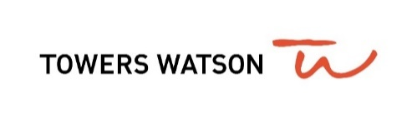

MoSes on Microsoft Azure for Compute Burst Scenarios
Benefits and Value Proposition

Slide 2


Insurance industry challenges
PREMIUM GROWTH
UNDERWRITING / PRICING
Dramatic changes are touching every portion of the insurance business
THE NATURE OF RISK
REGULATORY ENVIRONMENTS
COMPETITION
PRODUCT INNOVATION
YOUNGER POLICYHOLDERS & EMPLOYEES

Slide 3

Pursuing the digital economy
UNLOCK DIGITAL CUSTOMER & EMPLOYEE EXPERIENCES
LIBERATE DATA & DEMOCRATIZE ANALYTICS TO EMPOWER DECISION-MAKING
RELEASE BUSINESS AGILITY THROUGH MODERN CORES
(ON-PREMISE OR IN THE CLOUD)

Slide 4
Managing Constant Change in Risk …
Regulatory Pressures
  Stronger controls, more reporting, increased model requirements
Compute Capacity Need
  Increased capacity needs can be addressed with more agile infrastructure strategies
Business Impact
  Increasingly complex models need longer run times; faster runs improve risk insight
… Requires New & Innovative Solutions

Slide 5
HPC computing patterns
Varying compute requirement scenarios
Inactivity
Period
Compute
t
On and Off
Growing Fast
Unpredictable Bursting
Predictable Bursting
24x7 Steady
M&A activities
Regulatory changes
Quarterly and yearly financial reporting
Capacity Needed (Max + 20%)
Save
20-30%
Capacity Needed (Max + 20%)
Save
60-80%
S M T W T F S
J F M A M J J A S O N D
On and Off
(30%)
Growing Fast
(15%)
Unpredictable Bursting
(25%)
Predictable Bursting
(20%)
24x7 Steady
(10%)
What is your HPC utilization?
Does your grid stand unused between quarters? Do you have enough compute capacity during financial reporting periods, when demand is high? Do you have enough compute capacity to respond to changing regulations?

Slide 6







What Are Our Customers Concerns
Chief Compliance Officer
“How do I ensure that Risk & Compliance guidelines are being followed at all levels and are managed cost effectively?”
CFO or Chief Actuary
“How can I reduce the amount of time we spend each month ensuring we meet all the reporting requirements?”
Line of Business Manager
Impact
Lack of visibility into financial and operational parameters and no clear understanding of risk
Constant pressure to protect company reputation and competitive position
Difficulty to implement and adopt compliance guidelines easily, increasing costs
“I need access to the data quick and efficiently to ensure we stay on top of minimizing our risk exposure.”
Impact
Increased risk in an evolving business and regulatory environment
Incorrect reporting can lead to non-compliance which is costly
Manual processes result in inefficiency and are error-prone
Impact
Lack of accurate and responsive data can result in risk exposure above and organization’s policy
Time can be wasted trying to compile data manually
Data may be incorrect and untimely leading to inaccurate decisions.

Slide 7

Top Azure-Based Scenarios for Insurance
B2B/B2C
Applications
HIGH
>80% of new apps in the next 5 years will be distributed/deployed on clouds
Dev/Test
Cloud Platform
Simulation & Modeling
The strategic focus in the cloud
will shift
Core Systems
Departmental & Productivity Applications
Business Agility
from infrastructure to application platforms
Production
Cloud Infrastructure
34%
of CIOs say technology as a service (cloud) will have the most profound effect on the CIO role in the future
Storage
& Back-up
LOW
LOW
Cost Take Out
HIGH
Business
IT

Slide 8
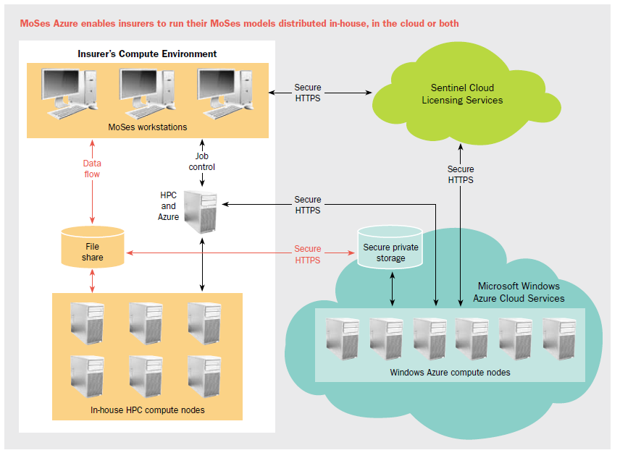
MoSes on Azure for Compute Burst Scenario

Slide 9
Computational Challenges
Basic Valuation
At the lowest level, large insurers have millions of separate policies to value, so even on normal valuation runs they now need more computing power
Asymmetric guarantees
Cannot just assume average interest rates, but instead have to average over a minimum of 1,000 possible future interest rate progressions (some are using 2,000) to calculate a realistic value for the guarantee
ICA Stresses
Take your asymmetric guarantee valuations and then create 50 “shocked” versions, of the above calculations
Nested stochastic
Look at the asymmetric guarantee values across a large number of possible futures. Solvency II asks how much money do you need to remain solvent if the 99.5% worst future happens

Slide 10
But what if you could:
Access Capacity On-Demand
  Rather than expanding your current infrastructure, use cloud-based high-performance computing grids to extend your Capacity as needed and only pay for what you use.
Deliver Results Faster
  Increase the number of cores for parallel processing; the more cores you deploy, the faster you receive results. Faster insight = faster decision making.
Manage Regulatory Needs
  Better capacity management and improved speed in risk modeling allows customers to better manage delivery of regulatory reports.

Slide 11
Benefits of Bursting MoSes to Azure
Same software and versions as on premises – Windows HPC, Towers Watson MoSes
Single point of contact for operational and engineering support
ISV committed to Azure platform as a core differentiator
  http://www.towerswatson.com/en/Services/Tools/moSes-azure
  http://www.microsoft.com/enterprise/partners/towers-watson.aspx?mtag=tw&q5222925=1#fbid=GfbzIc2qAXY
  http://azure.microsoft.com/en-us/case-studies/towers-watson-bigcompute/
Single management toolset
Billing and Provisioning integrated with other Insurance Azure workloads
Single identity management path

