Slide 1
Mobility & devices for the financial services

Slide 2
Financial services industry challenges
Increased regulation
Cost and margin pressures
Customer loyalty
Competition from new entrants

Slide 3
Windows in financial services
Devices and experiences users love
Enterprise-grade solutions financial services requires

Slide 4
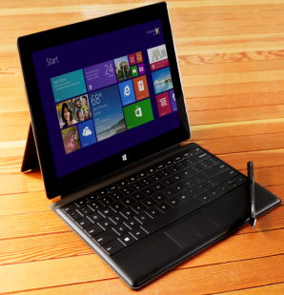
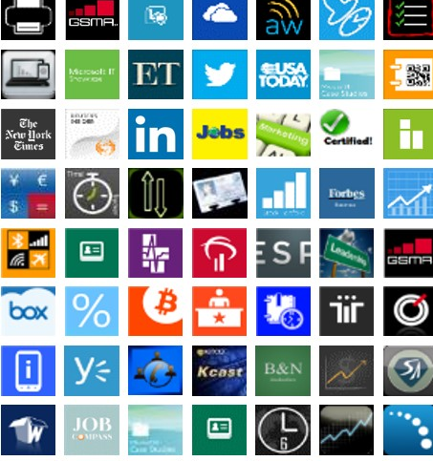
Windows: The right choice for financial services
Best business tablets and phones
Windows apps for business
Enterprise-grade security and manageability

Slide 5
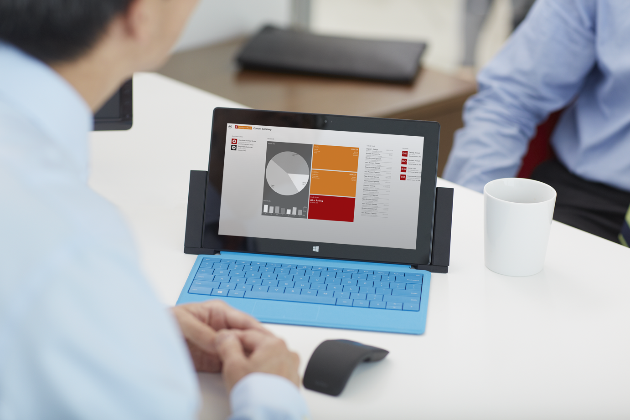
Windows: Best business tablets
Productivity and LOB support Intel Core and Intel Atom-based tablets with the power of a PC streamline access to desktop LOB applications.
Multi-touch and traditional input options Touch experiences streamline tasks and free hands; keyboard and mouse enable typing tasks.
Connectivity Access the corporate network, the Internet, and other devices through broadband, Wi-Fi, and NFC.
Battery life ARM and Intel Atom-based tablets can last a full day without recharging.

Slide 6
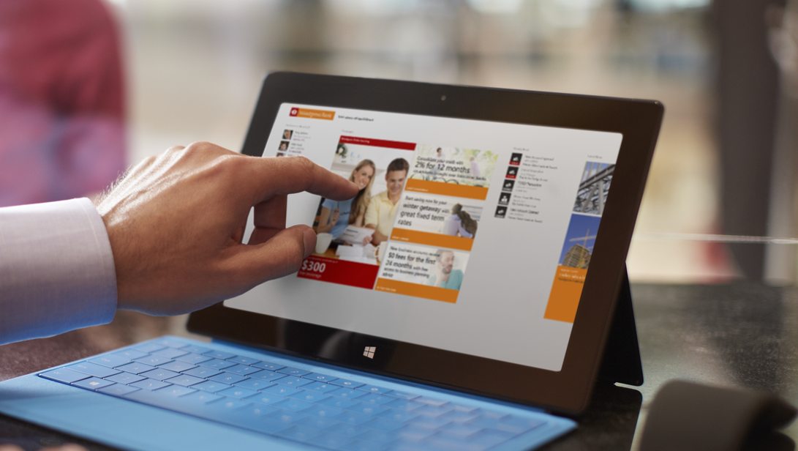
Windows: Great devices for financial services
Thin and light Portable, elegant ARM and Intel Atom-based tablets enhance client experiences.
Fully digitized Stylus
Pen input options enable signature capture from customers and mobile computing with gloved hands.
Peripheral extensibility Connect to card readers, receipt printers and check readers with ease through a variety of ports and connection options.
Security Robust security features including biometric access controls to protect sensitive information.

Slide 7
Windows: Best business phones
The right device at the right price Choose the right device for your organization with a suite of Windows-ready devices from Lumia.
Anywhere productivity Read and edit Office materials from anywhere with seamless integration to O365 and other products.
One converged apps platform With a unified app model and shared API set across Windows devices, easily access an app from across devices.
Unified, open device management IT can push updates, configure accounts, and assist users from anywhere and MDM support preserves consumer data.
Enterprise-grade security
Full-device encryption and trusted boot and Malware protection allows secure access to data from anywhere.

Slide 8
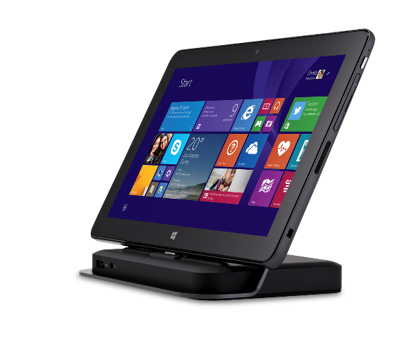
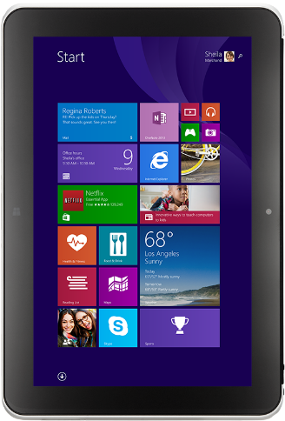
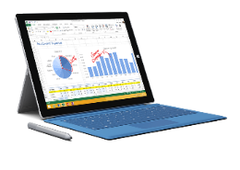
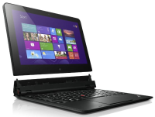
Windows tablets for every financial services scenario
Surface Pro 3
Dell Venue 11 Pro
(LTE Option)
HP ElitePad 1000
(LTE Option)
Lenovo ThinkPad Helix
Intel Core processor (Pro)
Any position kick stand
Type cover with magnetic fold
Soft-grade pen
Intel Corei7 processor
All-day battery life
“Rip & flip” detachable screen
Pen support
Intel Atom i5 processor
All-day battery life
Dock and keyboards for expansibility
Pen input support
Intel Atom processor
All-day battery life
Jackets for expansibility
Extra battery

Slide 9
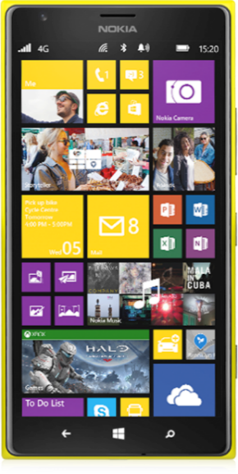
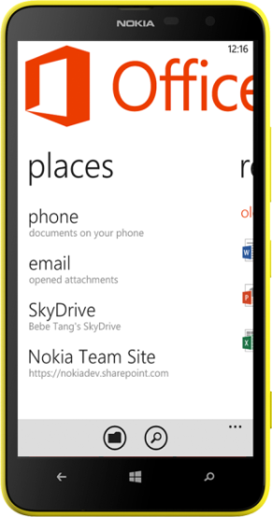
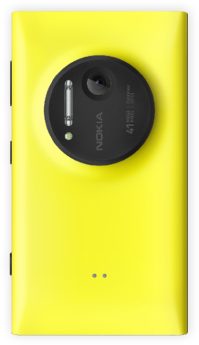
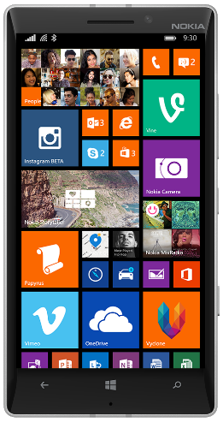
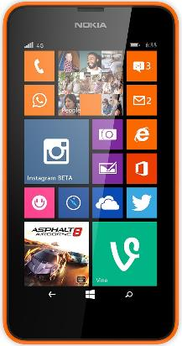
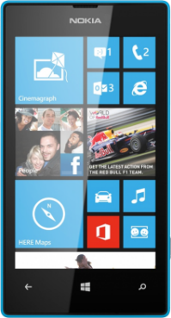
Windows phones for every financial services scenario
Lumia 1520
Lumia 1020
Lumia 1320
Lumia 930
Lumia 635
Lumia 520

Slide 10
Financial services scenarios

Slide 11
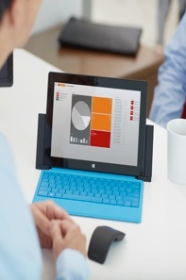
Financial services scenarios
Advisory services
Help financial advisors foster personal customer relationships
Branch transformation
Help branch employees improve customer service, boost productivity, and drive sales
Insurance claims adjuster
Use one device to streamline all claims adjusters’ tasks
Insurance customer acquisition
Provide an effective and efficient sales and service experience

Slide 12
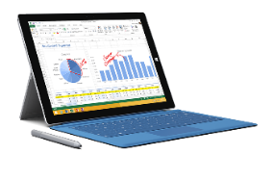
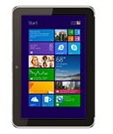
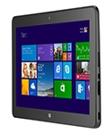
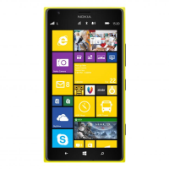
Advisory services
Help financial advisors foster personal customer relationships
Increase advisor mobility with thin, light tablets.
Arm advisors with fast, secure access to customer data, tailored insights, and the latest product recommendations.
Deliver financial information in visually engaging ways.
Secure device and LOB application experiences to help enable on-the-go client services.
Surface Pro 3 HP ElitePad 1000 Dell Venue 11 Pro Lumia 1520 Lenovo ThinkPad
(LTE Option) (LTE Option) & 930 Helix

Slide 13
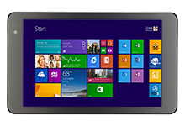
Branch transformation
Help branch employees improve customer service, boost productivity, and drive sales
Provide engaging and trusting banking experiences.
Deliver personalized banking solutions with secure access to customer data.
Encourage high-quality service through easier use of LOB apps, product data, and communications tools for specialists.
Maximize customer interactions and resolve issues faster.
Includes tellers, sellers, greeters, and digital signage and kiosks.
Dell Venue 8 Pro Dell Venue 11 Pro HP ElitePad 1000 Lumia 1520 Lenovo ThinkPad 8
(LTE Option) (LTE Option) (LTE Option) & 930

Slide 14
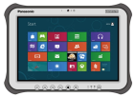
Insurance claims adjuster
Use one device to streamline all claims adjusters’ tasks
Capture data, complete forms, take photographs, record measurements and follow claims processes from a single device.
Access back-end systems from the scene, with 3G or 4G connectivity.
Improve customer experience by speeding up claim-processing time.
Maximize adjuster efficiency with on-the-go access to claims information.
Dell Venue 11 Pro HP ElitePad 1000 Panasonic ToughPad FZ-M1 Lumia 1520
(LTE Option) (LTE Option) & 980

Slide 15
Insurance customer acquisition and retention
Provide an effective and efficient sales and service experience
Enable greater customer intimacy through effective explanation of complicated insurance products.
Involve clients in the purchase decision.
Help clients better visualize the products they are reviewing.
Safeguard customer data while maximizing agent productivity.
Dell Venue 11 Pro HP ElitePad 1000 Surface Pro 3 ASUS Vivotab Note 8 Lenovo ThinkPad 8
(LTE Option) (LTE Option)

Slide 16
Apps for your business

Slide 17
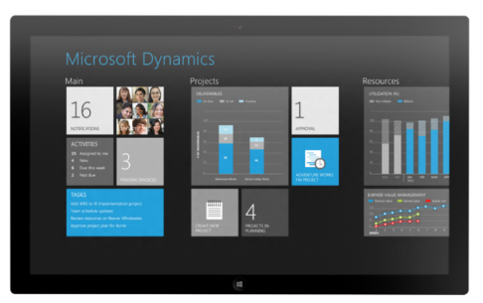
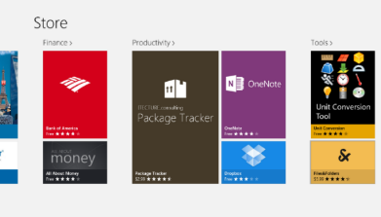
New Windows apps for business
Apps for your customers
Internal line of business apps
Leading 3rd-party
line of business apps

Slide 18
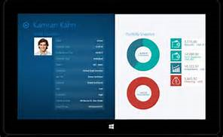
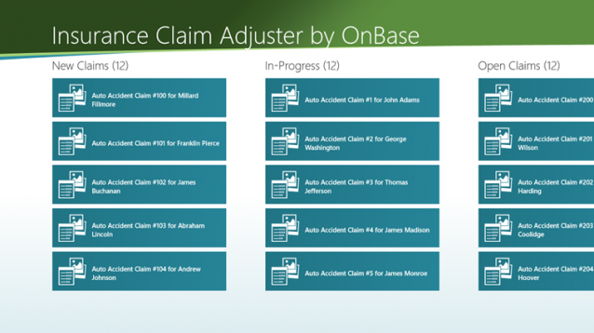
Go-to-market solution providers for financial services
Advisory Services
Veripark Direct Sales Agent Woodgrove Merlin
Avanade: Oltiva Financial Genie
Avanade: Investment Advisor
Microsoft Dynamics CRM
CitiDirect BE Client
Pershing: NetX360 Mobile
Branch Transformation
SunGard Ambit Concierge
Sungard Ambit MyMoney
Temenos Insight
Temenos Onboarding
Microsoft Dynamics CRM
Insurance Claims Adjuster
Hyland OnBase Field Adjuster
CSC Insurance RISKMASTER
Insurance Customer Acquisition & Retention
MCS Woodgrove Insurance

Slide 19
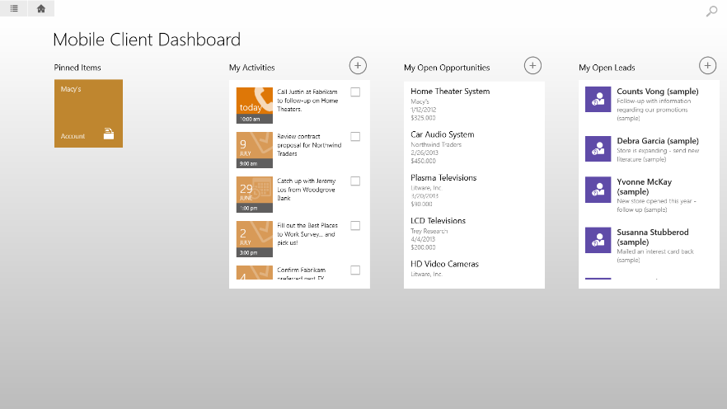
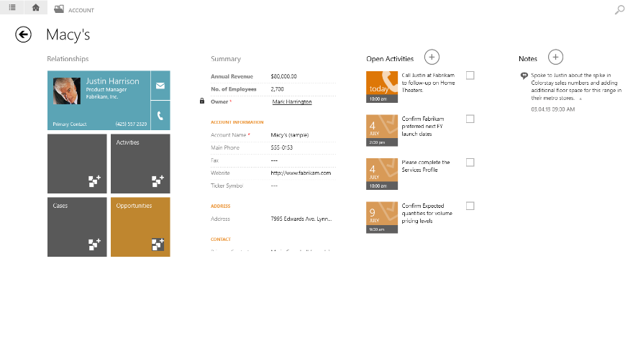
Microsoft Dynamics CRM
Increase customer satisfaction with real-time data
Maximize the potential of site visits with real-time reporting and analytics.
Provide field sales reps up-to-date account and sales data.
Help product managers make smart decisions and execute on them quickly.
Access rich contextual information including digital assets, availability, and pricing.

Slide 20
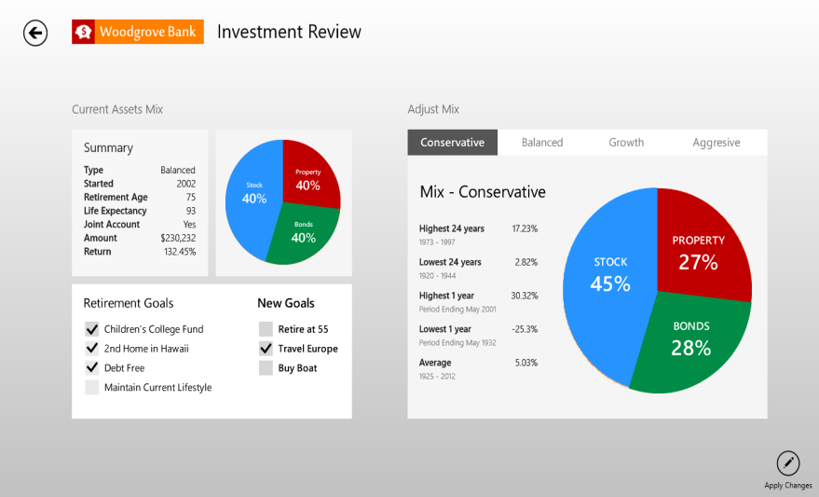
Microsoft Dynamics CRM Advisor 360 & Agent 360
Offer faster, better informed, more efficient services
Better understand your clients and build personalized relationships.
Deliver CRM in a familiar and intuitive Microsoft Outlook interface that encourages adoption.
Provide valuable advice using real-time data and rich reporting and analytical capabilities.
Offer products and services that truly match the needs/interest of your customers in real-time.

Slide 21
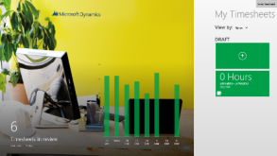
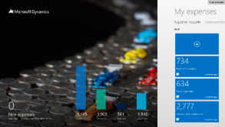
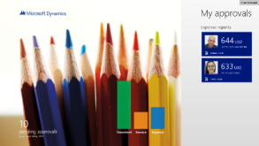
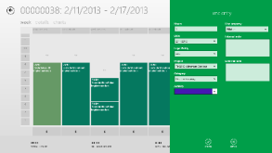
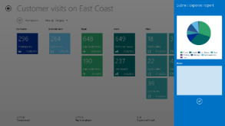
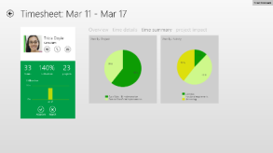
Time for Microsoft Dynamics AX
Expense for Microsoft Dynamics AX
Approvals for Microsoft Dynamics AX
Employee self-service: Record time sheets for staff while on-the-go.
Allocate time to development activities.
Improve working capital through decreased billing cycle times.
Employee self-service: Record and reconcile expenses while travelling.
Allocate expenses to projects and activities.
Helps retailers better integrate expense policies.
Manager self-service: Stay on top of approvals while on-the-go.
Reduce time spent on administrative processes like budget requests.

Slide 22
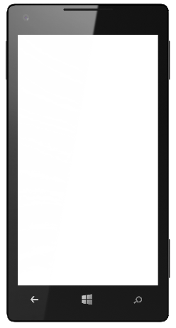
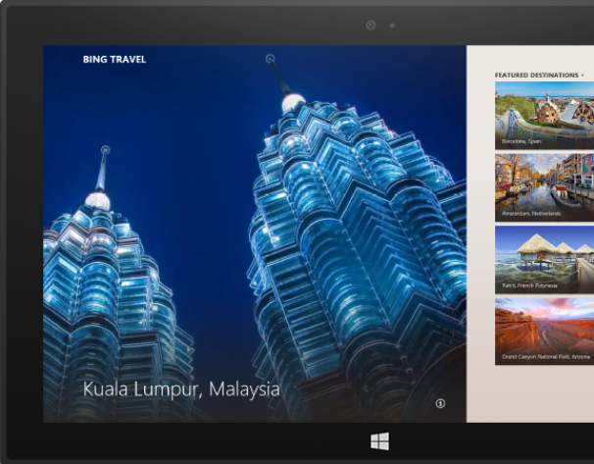
Use Windows apps across all devices
User Benefits:
Buy on any device and use on any device
More apps and faster app updates
Experience improvements in real time
Developer Benefits:
Windows API set and shared app model
Converged controls and unified toolset
One toolset to learn, one model to support

Slide 23
Enterprise-grade security and manageability

Slide 24
Financial services security challenges
Devices go "missing" Financial services institutions struggle to prevent devices from being taken. Devices open access to sensitive data Customer and financial data is sensitive and needs to be protected.
Unauthorized usage of apps Multi-user devices create vulnerabilities with increased risk of unauthorized usage or unsecure applications.

Slide 25
Stay protected with Windows security capabilities
Malware resistance
Protect corporate data
Modern access control
Built-in anti-malware solution
Secured system start-up
Core system hardening
Sandboxed Windows Store apps
Real time anti-phishing protection
Device Encryption all editions
Remote Business Data Removal
Corporate encryption enforcement
IP protection with Office IRM
Corporate compliance with Lync
Multifactor authentication
Virtual smartcard support
Biometrics
TPM key attestation
Certificate reputation
Dynamic access control
Trustworthy hardware

Slide 26
Managing Windows devices
Governance
Full control
Exchange ActiveSync
Mobile Device Management via OMA-DM
Enterprise Management
Windows provides choices
Choose a device based on the scenario or capabilities required
Enable employees to bring their own device

Slide 27
Offering a unified platform for modern business
Windows Azure Active Directory Premium
Windows Azure Rights Management
Windows Intune
Many apps, one identity repository
Manage identities and access to cloud apps
Monitor and protect access to enterprise apps
Unify your environment
Protect your data
Protect your data
No on-premise infrastructure required

Slide 28
Introducing the Enterprise Mobility Suite
Cloud/Hybrid Identity
Management
Enabled via Azure Active Directory Premium
Group management & security / audit reports
Self Service Password Reset & MultiFactor Authentication
Connection between AD / Azure AD
Enabled via Windows Intune
Mobile Device Management
Mobile device settings management
Mobile app management
Selective wipe
Enabled via Azure Rights Management Service
Information Protection
Information protection
Connection to on-premises assets
Microsoft Differentiation for EMS: One Vendor, One Contract, One SKU

Slide 29
Windows Embedded Industry
Offering a superset of Windows Pro with additional industry functionality.
Lockdown gestures, write access, and USB devices by serial number.
Enable more scenarios to support organizational needs.
Customize the lockdown to meet a variety of needs.
Windows Embedded Industry
(Pro, Enterprise)
Advanced Lockdown
Windows
(Pro, Enterprise)

Slide 30
Office in financial services

Slide 31
Enterprise grade cloud
Essential productivity services
Enterprise-grade cloud
Essential productivity services
Office Vision:
Flexibility and choice
Familiar and easy
Productivity Cloud
Flexibility and choice
Familiar and easy

Slide 32
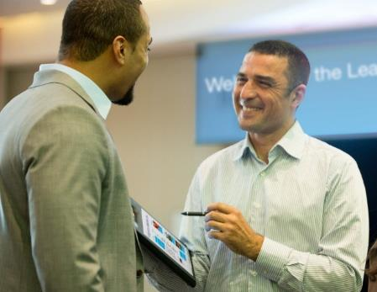
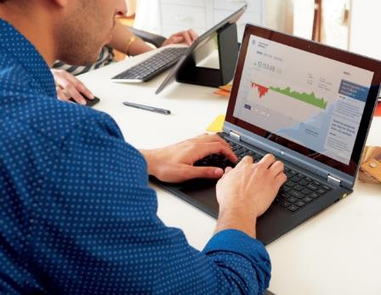
Office vision: Do your best work
Interactive
Expression
Enterprise
Social
Personalized
Insight
Responsible Empowerment
Office experiences on any device
Touch, ink, and voice
Live documents & data
Multi-media & HD presentations
Enterprise social
Cloud sharing
Real-time collaboration
Video, voice, and web conferencing
Small & Big Data access
Ad-hoc reporting and analysis
Natural language query
Visualization & geo-mapping
Device & Data Protection
DLP & Rights Management
Policy & compliance standards
eDiscovery

Slide 33
Windows devices in practice

Slide 34
Customer Evidence: Windows devices in financial services
City National Bank
Westpac
Glarner Kantonalbank
Caixa Bank

Slide 35
Customer Evidence: Windows devices in financial services
Banural
Erste Bank
Mirae Asset
“We’ve streamlined IT processes by eliminating Blackberry Enterprise Server. And with Windows Phone, we now have more control over devices and better protection for our people and data.”
Juancarlos Chacón Castro
IT Infrastructure Director
Banrural
“One of the wishes of our customers is to make banking transactions more comprehensible. The modern tablet and PC technology with Windows 8 offers us new ways to fulfill their expectations.”
Horst Weichselbaumer
Chief Information Officer,
Erste Bank AG
“We thought that it would be better in terms of work efficiency to provide the same user experience to our sales force in and outside the office, rather than have them experience different operating systems on different devices, like in having a desktop in the office and a tablet PC or smart phone outside. That really gave us the mandate we needed to move forward and adopt a Windows 8-based tablet PC.”
Park Myeonggu
Work Innovation Team Manager
Mirae Asset

Slide 36
Summary

Slide 37
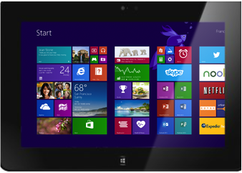
Windows mobile devices for financial services
The power of the Microsoft suite… in the palm of your hand
Engaging customers
Informing smart decisions
Increasing efficiencies

Slide 39
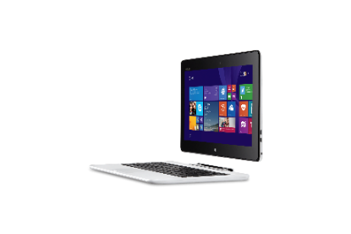
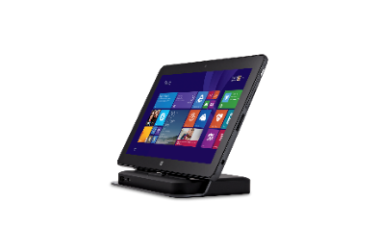
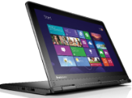
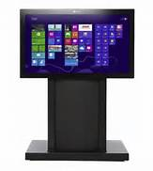
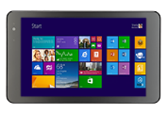
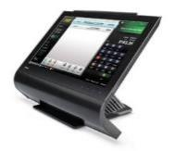
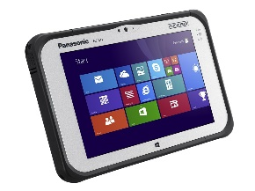
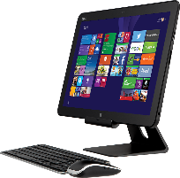
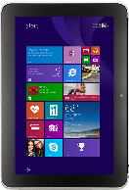
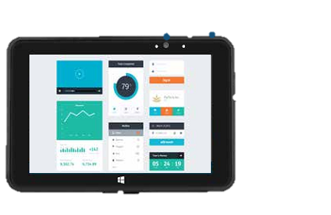
Range of Windows devices
Phones
2 in 1’s
Lumia 1020
Lumia 520
ASUS Transformer
Dell Venue 11 Pro
(LTE Option)
Lenovo ThinkPad Yoga
Surface Pro 3
Fujitsu LIFEBOOK T904
Small Tablets
Notebooks and All in Ones
Perceptive Pixel (PPI)
Dell Venue 8 Pro (LTE Option)
Lenovo ThinkPad 8
Toshiba Wave
Dell XPS 18
Panasonic ToughPad 4K
Dell XPS 27
Large Tablets
Embedded
Surface Pro 3
Dell Venue 11 Pro (LTE Option)
HP ElitePad 1000 (LTE Option)
Panasonic ToughPad FZ-G1
Winmate Durable
M101B
Partech Tablet 8
Bluebird PB30 & BM180
PolyTouch 22000
Availability and prices may vary by geography

Slide 40
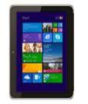
Windows devices for financial services
Scenario | Devices | Desirable Feature | Processor Preference
Advisory services |  | Performance, long battery life, security, manageability | Atom/Core
Branch transformation |  | Long battery life, security, manageability | RT/Atom/ Core/
Insurance claims adjuster |  | Long battery life, security, manageability, durability | Atom/Core
Insurance customer acq & retention |  | Performance, long battery life, security, manageability | Atom/Core
Surface Pro 3
HP ElitePad 1000 (LTE Option)
Dell Venue 11 Pro
(LTE Option)
Lumia 1520
& 930
Lenovo ThinkPad Helix
Dell Venue 8 Pro
(LTE Option)
Dell Venue 11 Pro
(LTE Option)
HP ElitePad 1000
(LTE Option)
Lumia 1520
& 930
Lenovo ThinkPad 8
ASUS VivoTab Note 8
Dell Venue 11 Pro
(LTE Option)
HP ElitePad 1000
(LTE Option)
Panasonic ToughPad FZ-M1
Lumia 1520
& 930
Dell Venue 11 Pro
(LTE Option)
HP ElitePad 1000
(LTE Option)
Surface Pro 3
ASUS VivoTab Note 8
Lenovo ThinkPad 8
Dell Venue 8 Pro
(LTE Option)
Lumia 1520
& 930

Slide 41
Range of embedded devices
Bluebird BM180
Dual-Core Cortex-A15 Processor
8 MP with LED flash
Barcode Scanner
5” HD display
1.2 m/4ft drop-ready
Bluebird BP30
Dual Core Coretex-A15
5” screen
2D barcode scanner and HF RFID reader
Long battery life
1.8m drop-ready
Empathy EM07
7” Screen with 8 hrs. Battery life
BT 4.0/ NFC/RFID/MSR/IC Reader
Bay Trail Support
IP-65 with PCI-PTS
Empathy EM10
E3800 Intel Atom processor
10.1” LCD display
Long battery life (up to 16 hours)
5 MP camera with LED flash
PARTech Tablet 8
Small, lightweight & reliable
Long battery life (up to 10 hours)
Supported and Backed by PAR
Software Partner Ecosystem Support
Winmate M101B
4G LTE
Intel ® Celeron N2920 Quad Core 1.86GHz processor
10.1” IPS LED display
IP65 water and dust proof

Slide 42
Choose the model that fits your business
 | Lumia 1520 | Lumia 1320 | Lumia 1020 | Lumia 930/ICON | Lumia 925 | Lumia 635 | Lumia 625 | Lumia 520
Business features across the range | Microsoft Office and Outlook, Word, PowerPoint, Excel, OneNote, HERE navigation apps with offline support, Internet Explorer, OneDrive, Lync, SharePoint, IBM Notes Traveler, security, device management, private apps, in-house & cloud support
Data network | 4G/LTE | 4G/LTE | 4G/LTE | 4G/LTE | 4G/LTE | 4G/LTE | 4G/LTE | 3G
Processor | 2.2 GHz Quad-Core | 1.7 GHz Dual-Core | 1.5 GHz Dual-Core | 2.2 GHz Quad-Core | 1.5 GHz Dual-Core | 1.2 GHz Quad-Core | 1.0 GHz Dual-Core | 1.0 GHz Dual-Core
Wireless charging | Built in | No | Accessory cover | Built in | Accessory cover | No | No | No
Changeable shells | Yes | No | No | Yes | No | Yes | Yes | Yes
NFC | Yes | No | Yes | Yes | Yes | No | No | No
Primary camera | 20 MP Zeiss dual led flash | 5 MP led flash | 41 MP Zeiss xenon flash | 20 MP Zeiss dual led flash | 8.7 MP Zeiss dual led flash | 5 MP | 5 MP led flash | 5 MP
Front camera | HD 1.2 MP wide angle | VGA | HD 1.2 MP wide angle | HD 1.2 MP wide angle | HD 1.2 MP wide angle | No | VGA | No
Display | 6” Clearblack Oled | 6” LCD | 4.5“ Clearblack Amoled | 5” Clearblack Oled | 4.5" Clearblack Amoled | 4.5" Clearblack LCD | 4.7“ LCD | 4“ Clearblack LCD
Supersensitive touch | Yes | Yes | Yes | Yes | Yes | Yes | Yes | Yes

Slide 43
Windows: Assigned Access
Enables a single Windows Store app experience on the device
User only experiences the specified app
Unable to access system files and other apps
Windows Embedded Industry – broader set of device lockdown capabilities (ATMs, etc.)

Slide 44
Advanced Lockdown with WE Industry
Multi App Lockdown
Multi Role Lockdown
Boot to Application

