Slide 1
Mobility & devices for manufacturing & resources

Slide 2
Manufacturing & resources challenges
Harnessing the power of data
Complying with complex regulations
Managing a mobile workforce
Collaborating in real-time

Slide 3
Windows in manufacturing & resources
Devices and experiences users love
Enterprise-grade solutions manufacturing requires

Slide 4
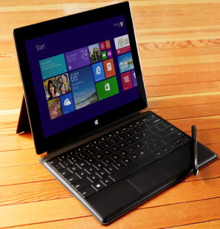
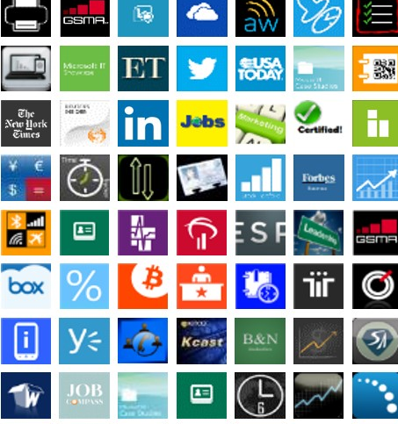
Windows: The right choice for manufacturing
Best business tablets and phones
Windows apps for business
Enterprise-grade security and manageability

Slide 5
Windows: Best business tablets
Productivity and LOB support Intel Core and Intel Atom-based tablets with the power of a PC streamline access to desktop LOB applications.
Multi-touch and traditional input options Touch experiences streamline tasks and free hands; keyboard and mouse enable typing tasks.
Connectivity Access the corporate network, the Internet, and other devices through broadband, Wi-Fi, and NFC.
Battery life ARM and Intel Atom-based tablets can last a full day without recharging.

Slide 6
Windows: Great devices for manufacturing & resources
Thin and light Portable ARM and Intel Atom-based tablets can go anywhere with the worker.
Fully digitized Stylus Pen input options enable mobile computing with gloved hands.
Rugged form factors Sturdy devices can withstand rough environments (water, heat and drop resistance).
Peripheral extensibility Connect to barcode scanners and mobile printers with ease through a variety of ports and connection options.

Slide 7
Windows: Best business phones
The right device at the right price Choose the right device for your organization with a suite of Windows-ready devices from Lumia.
Anywhere productivity Read and edit Office materials from anywhere with seamless integration to O365 and other products.
One converged apps platform With a unified app model and shared API set across Windows devices, easily access an app from across devices.
Unified, open device management IT can push updates, configure accounts, and assist users from anywhere and MDM support preserves consumer data.
Enterprise-grade security
Full-device encryption and trusted boot and Malware protection allows secure access to data from anywhere.

Slide 8
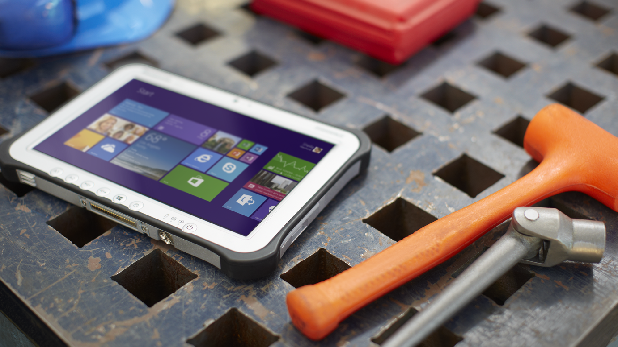
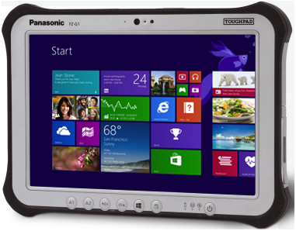
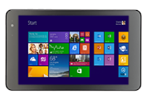
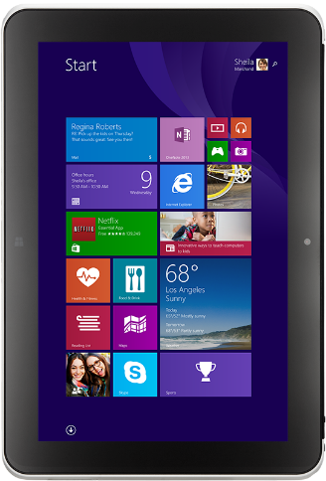
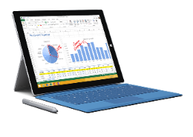
Windows tablets for every manufacturing scenario
Surface Pro 3
Panasonic ToughPad FZ-G1
Dell Venue 8 Pro
(LTE Option)
HP ElitePad 1000
(LTE Option)
Intel Core processor (Pro)
Any position kick stand
Type cover with magnetic fold
Soft-grade pen
Intel Core Processor
Ruggedized for 4 ‘ drops
Daylight readable screen
Ready for extreme conditions
Intel Atom processor
All-day battery life
Nonslip grip
Pen input support
Intel Atom processor
All-day battery life
Jackets for expansibility
Extra battery

Slide 9
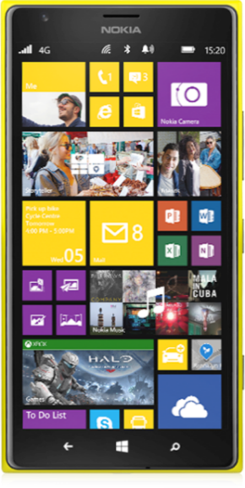
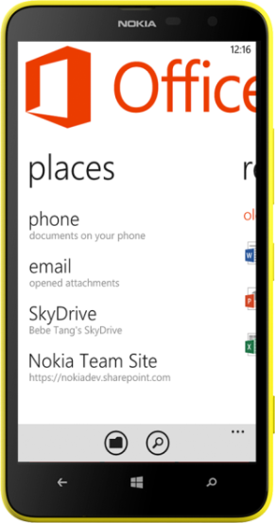
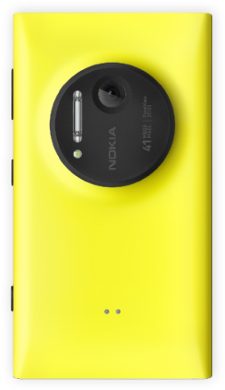
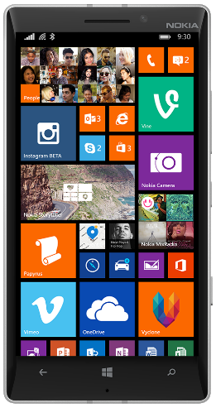
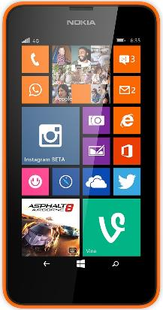
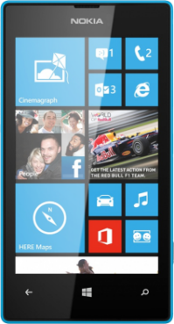
Windows Phones for every manufacturing scenario
Lumia 1520
Lumia 1020
Lumia 1320
Lumia 930
Lumia 635
Lumia 520

Slide 10
Manufacturing & resources scenario

Slide 11
Manufacturing & resources scenarios
Field service
& operations
Give field crews access to information they need to increase productivity and efficiencies
Design review
Help designers and line managers enhance the impact of design reviews
Electronic work instruction
Replace printed documentation with portable, interactive instructions
Sales & marketing
Enable real-time customer data to provide better service to customers

Slide 12
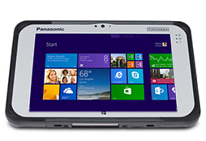
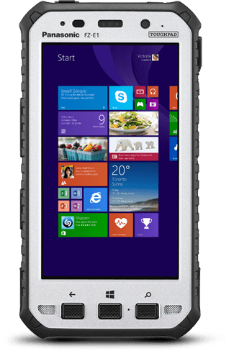
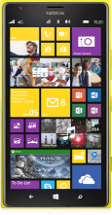
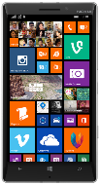
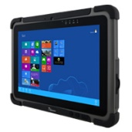
Field service & operations
Give field crews access to information they need to increase productivity and efficiencies
Securely access and update real-time data from any location.
Improve event response capabilities through enhanced connectivity.
Facilitate real-time collaboration among employees in the field or at the corporate office.
Provide light, sturdy devices for rugged conditions.
Panasonic ToughPad FZ-G1 | Panasonic ToughPad FZ-M1 | Panasonic ToughPad FZ-E1 | Lumia 1520 & 930 | Winmate M101B

Slide 13
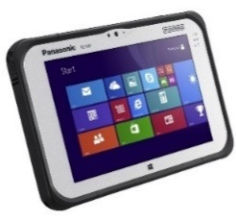
Help designers and line managers enhance the impact of design reviews
Enable teams from multiple locations securely access, share, and collaborate on designs in real-time.
Maintain fidelity of complex, 3D design files.
Access multiple LOB applications simultaneously.
Protect the security of confidential design files in compliance with regulatory requirements.
Provide instructions to enable quality inspection and assembly.
Design review
Panasonic ToughPad 4K | Surface Pro 3 | Fujitsu Arrows Tab Q704/H

Slide 14
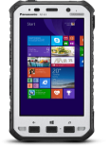
Electronic work instruction
Replace printed documentation to arm crews with portable, interactive instructions
Review 3D interactive virtualizations and animations of each assembly step.
Securely access centralized manuals on the go to reduce waste time in the field.
Facilitate real-time collaboration among employees in the field or at the corporate office.
Automate manual workstreams and consolidate tasks on one device.
Includes business architecture and production scheduling.
Panasonic ToughPad FZ-M1 | Panasonic ToughPad FZ-G1 | Panasonic ToughPad FZ-E1 | Winmate M101B

Slide 15
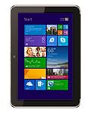
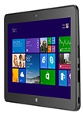
Enable real-time customer data to provide better service to customers
Empower staff to offer more personalized services with customer preferences, activities, and history.
Provide secure CRM access from the office or from the field.
Facilitate efficient collaboration between sales, marketing, and engineering teams.
Alert sales professionals of cross-sell/up-sell opportunities.
Track results of marketing campaigns to optimize spend.
Sales & marketing
Dell Venue 8 Pro | Surface Pro 3 | Lenovo ThinkPad 8 | HP ElitePad 1000 G2 | Dell 11 Venue Pro
Dell Venue 8 Pro Surface Pro 3 Lenovo ThinkPad 8 HP ElitePad 1000 Dell 11 Venue Pro
(LTE Option) (LTE Option) (LTE Option)

Slide 16
Apps for your business

Slide 17
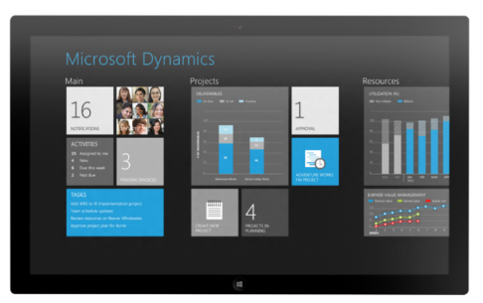
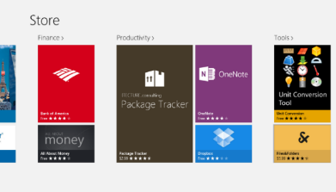
New Windows apps for business
Apps for your customers
Internal line of business apps
Leading 3rd-party
line of business apps

Slide 18
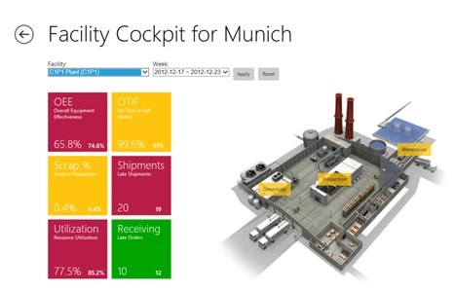
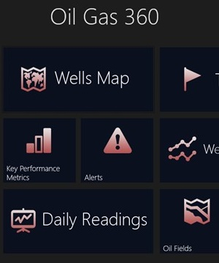
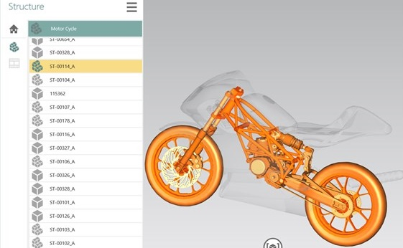
Go-to-market solution providers for manufacturing
Field Service & Operations
Accenture/Avanade Cloud Energy
Dassault Systèmes Delmia (Apriso)
Iconics– MobileHMI
iLink Systems Oil Gas 360
Invensys – SmartGlance
MCS Field Engineer
Schneider Electric Orbit
MPP/Windows 8 Operator Companion
Field Engineering and Operations Device
CGI: ProRail
Design Review
Nimbledev: 3D Viewer for JT
Siemens JT2Go
AutoDesk: AutoCAD 360
Electronic Work Instruction
No specific apps at this time
Sales & Marketing
Microsoft Dynamics CRM
TXT e-Solutions Sales & Operations Planning
Avanade: Oltiva Automotive Dealer Manager
Avanade: Oltiva Car Configurator

Slide 19
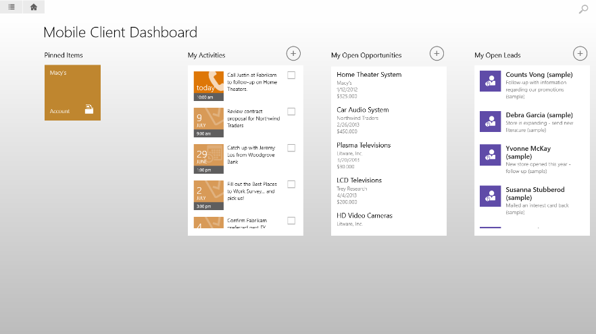
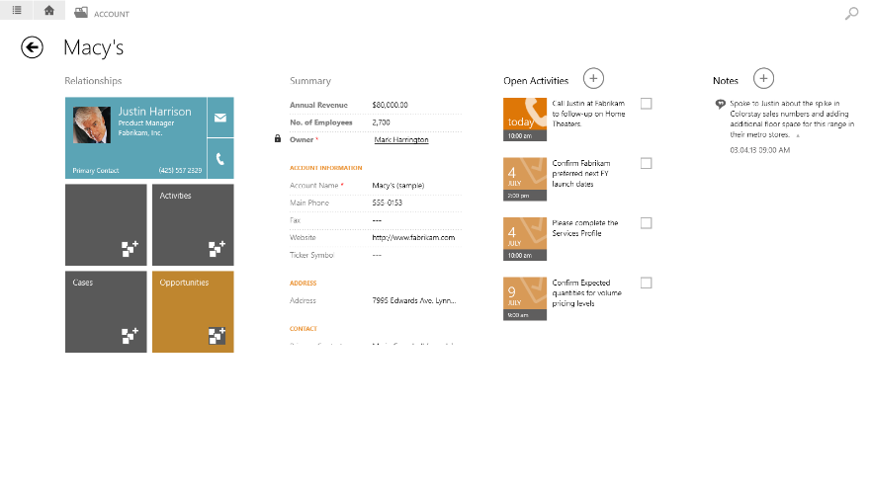
Microsoft Dynamics CRM
Increase customer satisfaction with real-time data
Maximize the potential of site visits with real-time reporting and analytics.
Provide field sales reps up-to-date account and sales data.
Help product managers make smart decisions and execute on them quickly.
Access rich contextual information including digital assets, availability, and pricing.

Slide 20
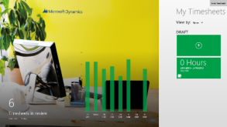
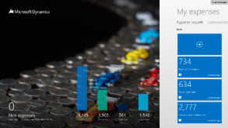
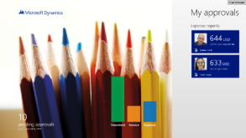
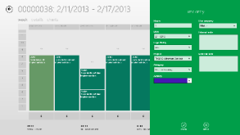
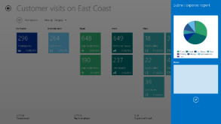
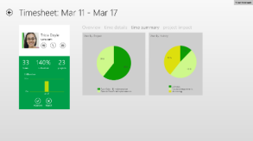
Time for Microsoft Dynamics AX
Expense for Microsoft Dynamics AX
Approvals for Microsoft Dynamics AX
Employee self-service: Record time sheets for staff while on-the-go.
Allocate time to development activities.
Improve working capital through decreased billing cycle times.
Employee self-service: Record and reconcile expenses while travelling.
Allocate expenses to projects and activities.
Helps retailers better integrate expense policies.
Manager self-service: Stay on top of approvals while on-the-go.
Reduce time spent on administrative processes like budget requests.

Slide 21
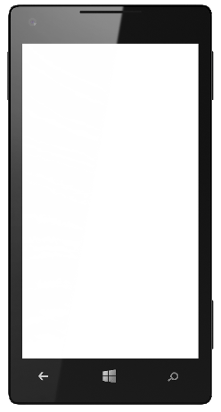
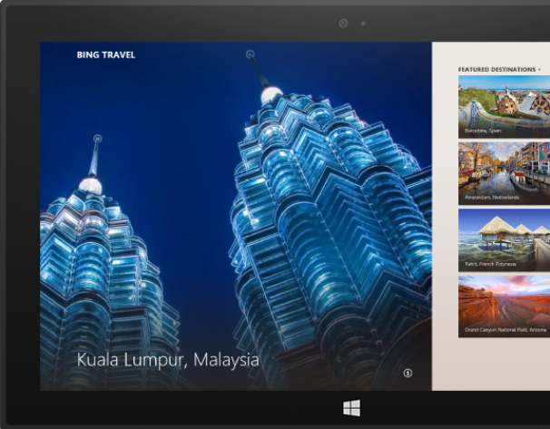
Use Windows apps across all devices
User Benefits:
Buy on any device and use on any device
More apps and faster app updates
Experience improvements in real time
Developer Benefits:
Windows API set and shared app model
Converged controls and unified toolset
One toolset to learn, one model to support

Slide 22
Enterprise-grade security and manageability

Slide 23
Manufacturing security challenges
Devices go "missing" Manufacturers struggle to prevent devices from being taken in highly unmanaged work environments. Devices open access to sensitive data
Proprietary design and instruction files are highly sensitive and needs to be protected. Unauthorized usage of apps Multi-user devices create vulnerabilities with increased risk of unauthorized usage or unsecure applications.

Slide 24
Stay protected with Windows security capabilities
Malware resistance
Protect corporate data
Modern access control
Built-in anti-malware solution
Secured system start-up
Core system hardening
Sandboxed Windows Store apps
Real time anti-phishing protection
Device Encryption all editions
Remote Business Data Removal
Corporate encryption enforcement
IP protection with Office IRM
Corporate compliance with Lync
Multifactor authentication
Virtual smartcard support
Biometrics
TPM key attestation
Certificate reputation
Dynamic access control
Trustworthy hardware

Slide 25
Managing Windows devices
Governance
Full control
Exchange ActiveSync
Mobile Device Management via OMA-DM
Enterprise Management
Windows provides choices
Choose a device based on the scenario or capabilities required
Enable employees to bring their own device

Slide 26
Offering a unified platform for modern business
Windows Azure Active Directory Premium
Windows Azure Rights Management
Windows Intune
Many apps, one identity repository
Manage identities and access to cloud apps
Monitor and protect access to enterprise apps
Unify your environment
Protect your data
Protect your data
No on-premise infrastructure required

Slide 27
Introducing the Enterprise Mobility Suite
Cloud/Hybrid Identity
Management
Enabled via Azure Active Directory Premium
Group management & security / audit reports
Self Service Password Reset & MultiFactor Authentication
Connection between AD / Azure AD
Enabled via Windows Intune
Mobile Device Management
Mobile device settings management
Mobile app management
Selective wipe
Enabled via Azure Rights Management Service
Information Protection
Information protection
Connection to on-premises assets
Microsoft Differentiation for EMS: One Vendor, One Contract, One SKU

Slide 28
Windows Embedded Industry
Offering a superset of Windows Pro with additional industry functionality.
Lockdown gestures, write access, and USB devices by serial number.
Enable more scenarios to support organizational needs.
Customize the lockdown to meet a variety of needs.
Windows Embedded Industry
(Pro, Enterprise)
Advanced Lockdown
Windows
(Pro, Enterprise)

Slide 29
Office in manufacturing & resources

Slide 30
Enterprise grade cloud
Essential productivity services
Enterprise-grade cloud
Essential productivity services
Office Vision:
Flexibility and choice
Familiar and easy
Productivity Cloud
Flexibility and choice
Familiar and easy

Slide 31
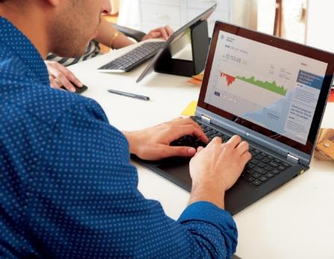
Office vision: Do your best work
Interactive
Expression
Enterprise
Social
Personalized
Insight
Responsible Empowerment
Office experiences on any device
Touch, ink, and voice
Live documents & data
Multi-media & HD presentations
Enterprise social
Cloud sharing
Real-time collaboration
Video, voice, and web conferencing
Small & Big Data access
Ad-hoc reporting and analysis
Natural language query
Visualization & geo-mapping
Device & Data Protection
DLP & Rights Management
Policy & compliance standards
eDiscovery

Slide 32
Windows devices in practice

Slide 33
Customer Evidence: Windows devices in manufacturing
Bridgestone Asia Pacific
Eskom
PSA Peugeot Citroën
BT Telecom
NASCAR
Miele
“Our decision to opt for Microsoft Windows 8 and Microsoft Office 2013 was based on these platforms capacity for touch integration. At Eskom we apply a ‘one device per individual’ approach – so we knew that the tablet PCs supplied to our executive staff needed to be intuitive and user friendly.“
Sean Maritz
Head of Enterprise Strategy & Innovation
Eskom
“In addition to ease of use, Windows 8 on tablets gives our service advisors a truly homogenous work environment. Everything is so simple and intuitive, and increases effectiveness and productivity.”
Christophe Binard
Front Office Manager
Service & Telematics
PSA Peugeot Citroën

Slide 34
Summary

Slide 35
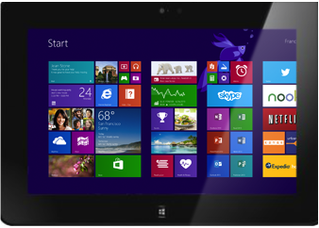
Windows mobile devices for manufacturing & resources
The power of the Microsoft suite… in the palm of your hand
Engaging customers
Informing smart decisions
Increasing efficiencies

Slide 37
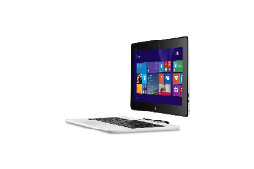
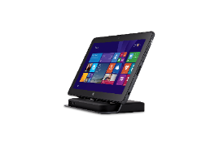
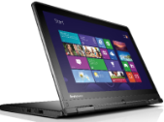
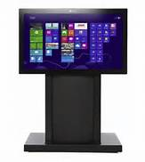
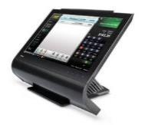
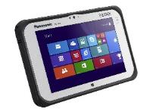
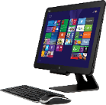
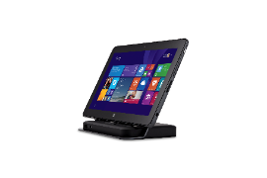
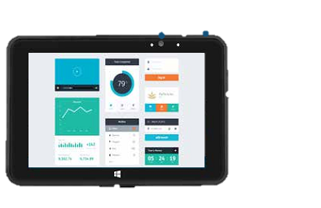
Range of Windows devices
Phones
2 in 1’s
Lumia 1020
Lumia 520
ASUS Transformer
Dell Venue 11 Pro
(LTE Option)
Lenovo ThinkPad Yoga
Surface Pro 3
Fujitsu LIFEBOOK T904
Small Tablets
Notebooks and All in Ones
Perceptive Pixel (PPI)
Dell Venue 8 Pro (LTE Option)
Lenovo ThinkPad 8
Toshiba Wave
Dell XPS 18
Panasonic ToughPad 4K
Dell XPS 27
Large Tablets
Embedded
Surface Pro 3
Dell Venue 11 Pro (LTE Option)
HP ElitePad 1000 (LTE Option)
Panasonic ToughPad FZ-G1
Winmate Durable
M101B
Partech Tablet 8
Bluebird PB30 & BM180
PolyTouch 22000
Availability and prices may vary by geography

Slide 38
Windows devices for manufacturing & resources
Scenario | Devices | Desirable Feature | Processor Preference
Field service & operations |  | Long battery life, security, manageability, durability | RT/Atom
Design Review |  | Performance, long battery life, security, manageability, durability | Atom/Core
Electronic work instruction |  | Performance, long battery life, security, manageability, durability | Atom/Core
Sales & marketing |  | Performance, long battery life, security, manageability, durability | Atom/Core
Panasonic ToughPad FZ-G1
Panasonic ToughPad FZ-M1
Panasonic ToughPad FZ-E1
Lumia 1520 & 930
Winmate M101B
Surface Pro 3
Panasonic ToughPad 4K
Surface Pro 3
Fujitsu Arrows Tab Q704/H
Panasonic ToughPad FZ-M1
Panasonic ToughPad FZ-G1
Panasonic ToughPad FZ-E1
Winmate M101B
Dell Venue 8 Pro
(LTE Option)
Surface Pro 3
Lenovo ThinkPad 8
HP ElitePad 1000
(LTE Option)
Dell Venue 11 Pro
(LTE Option)
ASUS VivoTab Note 8

Slide 39
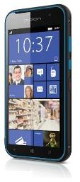
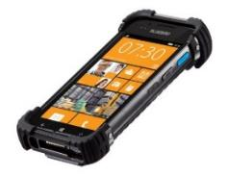
Range of embedded devices
Bluebird BM180
Dual-Core Cortex-A15 Processor
8 MP with LED flash
Barcode Scanner
5” HD display
1.2 m/4ft drop-ready
Bluebird BP30
Dual Core Coretex-A15
5” screen
2D barcode scanner and HF RFID reader
Long battery life
1.8m drop-ready
Empathy EM07
7” Screen with 8 hrs. Battery life
BT 4.0/ NFC/RFID/MSR/IC Reader
Bay Trail Support
IP-65 with PCI-PTS
Empathy EM10
E3800 Intel Atom processor
10.1” LCD display
Long battery life (up to 16 hours)
5 MP camera with LED flash
PARTech Tablet 8
Small, lightweight & reliable
Long battery life (up to 10 hours)
Supported and Backed by PAR
Software Partner Ecosystem Support
Winmate M101B
4G LTE
Intel ® Celeron N2920 Quad Core 1.86GHz processor
10.1” IPS LED display
IP65 water and dust proof

Slide 40
Choose the model that fits your business
 | Lumia 1520 | Lumia 1320 | Lumia 1020 | Lumia 930/ICON | Lumia 925 | Lumia 635 | Lumia 625 | Lumia 520
Business features across the range | Microsoft Office and Outlook, Word, PowerPoint, Excel, OneNote, HERE navigation apps with offline support, Internet Explorer, OneDrive, Lync, SharePoint, IBM Notes Traveler, security, device management, private apps, in-house & cloud support
Data network | 4G/LTE | 4G/LTE | 4G/LTE | 4G/LTE | 4G/LTE | 4G/LTE | 4G/LTE | 3G
Processor | 2.2 GHz Quad-Core | 1.7 GHz Dual-Core | 1.5 GHz Dual-Core | 2.2 GHz Quad-Core | 1.5 GHz Dual-Core | 1.2 GHz Quad-Core | 1.0 GHz Dual-Core | 1.0 GHz Dual-Core
Wireless charging | Built in | No | Accessory cover | Built in | Accessory cover | No | No | No
Changeable shells | Yes | No | No | Yes | No | Yes | Yes | Yes
NFC | Yes | No | Yes | Yes | Yes | No | No | No
Primary camera | 20 MP Zeiss dual led flash | 5 MP led flash | 41 MP Zeiss xenon flash | 20 MP Zeiss dual led flash | 8.7 MP Zeiss dual led flash | 5 MP | 5 MP led flash | 5 MP
Front camera | HD 1.2 MP wide angle | VGA | HD 1.2 MP wide angle | HD 1.2 MP wide angle | HD 1.2 MP wide angle | No | VGA | No
Display | 6” Clearblack Oled | 6” LCD | 4.5“ Clearblack Amoled | 5” Clearblack Oled | 4.5" Clearblack Amoled | 4.5" Clearblack LCD | 4.7“ LCD | 4“ Clearblack LCD
Supersensitive touch | Yes | Yes | Yes | Yes | Yes | Yes | Yes | Yes

Slide 41
Windows: Assigned Access
Enables a single Windows Store app experience on the device
User only experiences the specified app
Unable to access system files and other apps
Windows Embedded Industry: Broader set of device lockdown capabilities (ATMs, etc.)

Slide 42
Advanced Lockdown with WE Industry
Multi App Lockdown
Multi Role Lockdown
Boot to Application

