Slide 1
TEMPLATE NOTES
This pitch deck template is provided for Microsoft Azure partners and is formatted to match other partner docs. Partners can customize this as they see fit.
The OpenText EIM Suite on Azure:
Helping You Thrive in a Digital World

Slide 2
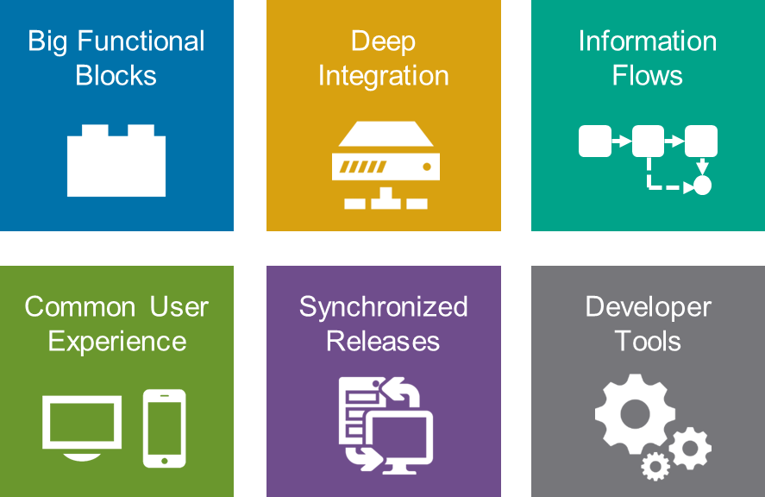
The OpenText EIM Suite on Azure:
OpenText is a $1.6 billion public company with over 100,000 customers in every industry sector in 114 countries. OpenText’s suite of solutions is designed to extend the capabilities of Office 365, SharePoint, SQL Server, Exchange and other Microsoft platform products, both on-premises, in a private or public cloud and/or in a hybrid cloud environments.
OpenText ECM Suite
With Microsoft Azure Virtual Machine Services, Microsoft offers a comprehensive Infrastructure as a Service (IaaS) platform. OpenText’s core ECM platform (Content Server 10.5 SP1, Archive Server and Directory Services 10.5) is supported on Azure Virtual Machines (IaaS).
OpenText Media Management
OpenText Media Management (OTMM) is an enterprise level digital asset management application that captures, manages, searches for, views, distributes, and dynamically uses digital assets, including images, video, audio, text, layouts, and graphics.
OpenText Extended ECM for SAP Solutions OpenText Extended ECM for SAP Solutions combines structured data from SAP systems with ECMLink – a combination of a Content Server module and an SAP package, integrating ECM functionality into SAP business processes, surfaced in SharePoint and Office 365.
OpenText Application Governance & Archiving for SharePoint
OpenText Application Governance & Archiving for Microsoft SharePoint provides a seamless integration of Microsoft SharePoint with OpenText’s ECM Suite, adding archiving, compliance capabilities, search integration and more to SharePoint and SharePoint Online (Office 365).

Slide 3
OpenText roadmap for Microsoft Azure
Phase 1 - Completed
Phase 2 – In Progress
Under consideration (TBD)
Q1 CY2015
Q3 CY2015
tbd
Content Suite Platform
Content Server 10.5 SP1
Archive Server 10.5 SP1
OTDS 10.5
SharePoint Solutions
Application Governance & Archiving for SharePoint 10.7 SP1
SharePoint Services for Extended ECM 10.7 SP1 / SAP Content Management for SharePoint
Email Solutions
Email Archiving for Exchange 10.5 SP1
Email Management for Exchange 10.5 SP1
Extended ECM for SAP Solutions 10.5 SP1 / SAP Extended ECM
Media Management 10.5 / SAP Digital Asset Management
Customer Communication Mgmt.
Legodo PowerDocs
Capture Center
Archive Center
BPM
Notes:
Solution Overview and Internal FAQ: https://knowledge.opentext.com/knowledge/cs.dll/Open/18095577

Slide 4
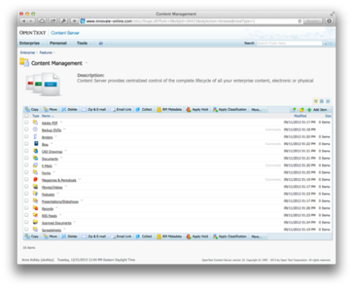
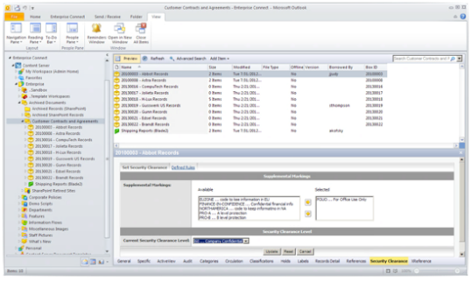
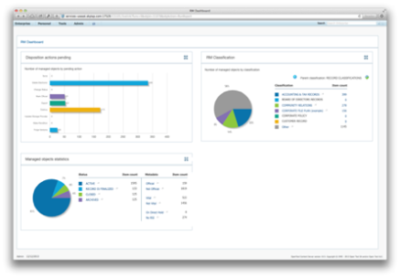
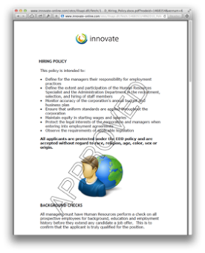
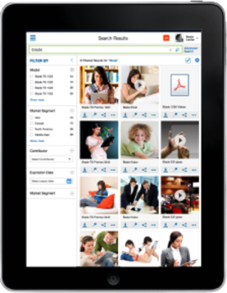
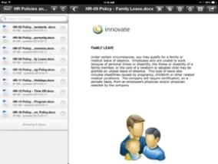
Content Suite is a comprehensive ECM platform with applications and add-ons to manage the flow of information
from capture through archiving and disposition
Notes:
ECM provides a common and consistent information governance infrastructure that enables secure, and dependable adherence to laws, rules, and regulations - without compromising user adoption and productivity
OpenText Content Suite, the foundation for OpenText Enterprise Information Management (EIM) offerings, is a comprehensive enterprise content management (ECM) system designed to manage the flow of information from capture through archiving and disposition. Uniting capture, document and records management, workflow, search and archiving, OpenText Content Suite Platform offers a secure, highly scalable ECM foundation to organize and share electronic and physical content across the enterprise.
Information in its lifecycle has several steps or stages that can be identified as it flows through these steps; capture, classify, manage, discover and archive. Every step has different levels of information change possibilities as well as access rules.

Slide 5
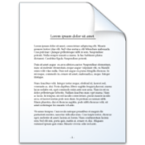
Content Suite Platform Components
Desktop Application Integrations
Multilingual UI & Metadata
Versioning, Permissions, Audit
Collaboration
Workflow
Text Editor
Document Viewer
Reports
Search
REST API
File Sync & Share
Classifications (Manual, Assisted, Automatic)
Hold Management
Event-Based Retention
Physical Records
Preservation
Labels
Security Clearance
Disposition
Document Management
Records Management
Archiving
Imaging
Encryption
Compression
Virtualization
Tiered storage
Single Instance Storage
Viewing
Scanning
Indexing
Rendering
Annotations
Notes:
The core offering of the Content Suite is the Content Suite Platform. It contains these capabilities.
Tempo Box - Qualifying customers upgrading to Content Suite Platform 10.5 will be entitled to free Standard Named Users of Tempo Box across their enterprise for no cost, allowing their Content Suite Platform users to use Tempo Box for secure file sharing and synchronization purposes. In the Fall of 2014, this program will be updated to allow Content Suite Platform customers the ability to roll out an unlimited number of Tempo Box standard user licenses to all users in the Enterprise. For more info see the Tempo Box Free FAQ https://knowledge.opentext.com/knowledge/llisapi.dll/Overview/51740367.

Slide 6
Content Suite Platform
Manage the flow of information from capture through archiving and disposition
any application
any device
Capture
Classify
Manage
Discover
Archive
Dispose
“With so much content, of different types across more than 40 countries, OpenText helps us meet the demands of the various regulatory and legislative bodies.”
Mike Haywood, Record Management & Archiving Manager, Givaudan
Notes:
Information in its lifecycle has several steps or stages that can be identified as it flows through these steps; capture, classify, manage, discover, archive and of course we need to get to the point where we dispose. Every step has different levels of information change possibilities as well as access rules.
ECM provides a common and consistent information governance infrastructure that enables secure, and dependable adherence to laws, rules, and regulations - without compromising user adoption and productivity
Governing all Enterprise Information from any application and any device.
With the ultimate goal of …understanding information…keeping critical information for compliance …defensibly deleting information
ECM underpins SAP, Oracle offerings as well as SharePoint and Office integrations, so when we’re talking about ecosystems we should also think about ECM.
Content Suite provides enterprises with a "single source of truth" for any information accessed anywhere through any app or device.

Slide 7
Benefits with OpenText on Azure
Easy, fast and quick deployment
Use Azure credits
Compliance and security standards
High system availability
Runs all virtual
Be flexible where to run
Azure Storage
Integrate in your network

Slide 8
Example Pricing Content Suite Platform 1000 user*
Server (Production) | Number | vCores | RAM [GB] | Price [€]
Content Server [A3] | 2 | 4 | 7 | 598,39
Archive Server [A3] | 1 | 4 | 7 | 199,47
MS-SQL [A4] | 1 | 4 | 14 | 842,17
Server (Test) | Number | vCores | RAM [GB] | Price [€]
Content Server [A2] | 2 | 1 | 3.5 | 199,47
Archive Server [A2] | 1 | 1 | 3.5 | 99,74
MS-SQL [A2] | 1 | 2 | 3.5 | 321,36
Storage (Production) | Volume | Configuration | Price [€]
Page Blobs and Disks | 2.000 GB | Locally Redundant | 74,47
Block Blobs | 5.000 GB | Zone Redundant | 110,23
Storage Transactions | 150 Mio |  | 4,04
Backup | 2.000 GB |  | 297,14
Storage (Test) | Volume | Configuration | Price [€]
Page Blobs and Disks | 1.000 GB | Locally Redundant | 37,24
Block Blobs | 1.000 GB | Zone Redundant | 22,35
Storage Transactions | 50 Mio |  | 1,35
From 1.800 to max € 2.800 per month

Slide 9
CONTACT INFO
For more information on the Microsoft – OpenText partnership, go to:
http://www.opentext.com/what-we-do/products/opentext-suite-for-microsoft
http://www.microsoft.com/opentext
For most Microsoft EPG and SMS&P accounts, OpenText has counterpart account executives. For help in connecting with counterpart OpenText AE’s, contact any of the following:
Mike Stankowitsch, Director, Strategic Alliances, OpenText
Jeff Jinnett, Ecosystem Program Manager for the Americas, OpenText
Bernd Hennicke, Director, Microsoft Solutions Group, OpenText, b
To view an on-demand CMSWiRE webinar co-presented by Microsoft and OpenText experts entitled “Start Your Hybrid Cloud Journey: Get on the Right Path With Microsoft and OpenText Cloud Strategies

