Slide 1



The Sitecore® Experience Platform™ on Microsoft Azure
Your customers know what they want. Do you?

Slide 2

Customer first
Great marketing starts with
the customer.
Customers don’t separate marketing from the product…
  It is the product.
They don’t separate marketing from their in-store or online experience…
  It is the experience.
And in the era of engagement…
  Marketing is the company.
Notes:
Key goal of the slide:
To be a successful marketer in today’s digital landscape, putting the customer first is essential.
Great marketing starts with the customer
Talking Points:
Today’s tech savvy customers no longer separate marketing from the product. It is the product.
Today’s customer does not separate their in store or online experience. They expect experiences and interactions with products to be consistent regardless of which channel they engage your product in.
Your marketing dictates the customers perception of your:
Product
Company
Brand Identity

Slide 3
Introducing Sitecore®
Know every customer
Turn data into insight
Shape every experience
Obtain complete visibility into every customer interaction.
Connect data from disconnected systems.
Build a rich picture of what your visitors want and need.
Seamlessly manage all your marketing efforts in one place.
Analyze customer data in real time.
Measure performance of content, experiences, and campaigns.
Deliver impactful content along your customer’s decision journey.
Respond immediately to customers’ actions.
Ensure brand consistency across every touchpoint.
Notes:
Key goal of slide:
Introduce the Sitecore Experience Platform, and how it helps the CMO address the common challenges outlined in the previous slide.
Sitecore gives your marketers the tools they need to deliver personalized, effective marketing
Talking Points:
Sitecore gives marketers the tools to:
Know every customer
Collect customer data from all interaction across all touchpoints and obtain a visibility into customer interactions
Turn Data into Insight
The ability to take mass amounts of data captured from customers and analyze it in a central location
Measure and evaluate how well your current campaigns are working
Shape Every Experience
Take your data and use it to shape meaningful and relevant customer experiences
Create a consistent story across your touchpoints

Slide 4
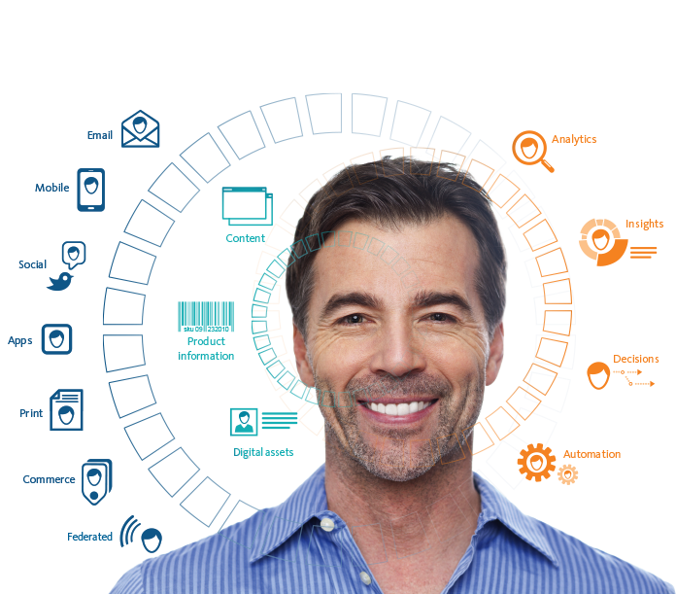
What does this mean for you?
Single, connected platform, delivering a single, connected experience.
Know every customer
Shape every experience
Across all channels
In real time
Notes:
Key goal of slide
What does this mean for you? Sitecore enables your marketing team to know your customers across all channels in real-time from a single platform
The Sitecore solution empowers marketers to put the customer at the center of their marketing efforts
Talking Points:
Single, connected platform, delivering a single, connected experience.
Consumers ( think: real people like you and me) are using multiple channels and devices. Our customers need to have a joined up “conversation” across all these channels with these consumers.
This means the using complete platform, not just Web CMS
Know every customer
You need a rich dataset to do this, so we have to help our customers understand the value of the Experience Database; of collecting all the experiencial data from all these channels, and connecting the dots, to see the real people – their prospects and customers – that they want to sell to.
Shape every experience
You need to do more than just publish content – you need to be able to optimize that content. That means being able to easily personalize it, test it and measure it. Sitecore 8 makes it easier to do this than ever before.
Across all channels
Web, landing pages, email, mobile web, mobile apps, web stores, retail stores, social channels – the list goes on
In real time
Not tomorrow, or in an hour, but in the moment.
The Sitecore Experience platform does all this.

Slide 5

Get your ideas up and running faster
Free your IT team…
Sitecore on Azure gives marketers the ability to deploy to the cloud quickly and autonomously.
Notes:
Key goal of slide:
Sitecore is a great tool for your marketing team and deploying it on Microsoft Azure helps marketers launch new campaigns quickly, and scale as needed.
Deploy Sitecore in the cloud to be up and running almost instantly, nearly eliminating the need for IT
Talking Points:
Deploy Sitecore on Azure to be up and running quickly and efficiently
Other companies are competing for your customers loyalty
Don’t let lengthy IT implementations cost you customers
Deploy on Azure and begin a personalized conversation with your customers today.
Your competition isn’t waiting. Neither should you.

Slide 6

Why Azure?
Infinite scalability
Always on
Easily scales up and down as demand changes.*
Never miss a beat; always be there for your customers.
The only enterprise-grade cloud
Accident protection
Reliable and redundant copies of your data and automatic failover protection.
Microsoft Azure ensures that Sitecore® Experience Database™ is secure.
Speed to market
Pay-as-you-go
Rapidly deploy Sitecore on Azure without worrying IT.
Only pay for the power and capacity you’re using.*
Familiarity of Windows
Interoperability
Integrates seamlessly with your existing back-end systems and marketing investments.
Built on .NET, Sitecore uses the technology that your IT department already knows.
*Customers will need to ensure the proper number of content delivery servers from Sitecore to meet scaling requirements.
Notes:
Key goal of slide
Azure is the only enterprise-grade cloud, and is the ideal partner to deploy Sitecore on.
Azure is the worldwide leader in cloud computing services, designed to save you resources and get the most out of your investments
Talking Points:
8 reason why Azure is ideal for Sitecore:
Familiarity of Windows
Sitecore is built on .NET
Speed to Market
By deploying on Azure Sitecore can be up and running very quickly
The only enterprise-grade cloud
Azure has the security parameters to handle enterprise companies and their data
Infinite Scalabiltiy
Azure lets you pay for more or cut down on storage space, letting you use your resources efficiently
Always on
Stay on top of your customer interactions in real-time with Azure’s 99.95% uptime
Accident Protection
Copies of your data are created in the cloud for failover protection
Pay-as-you-go
Azure let’s you pay only for the amount of cloud computing you actually need
Interoperability
Azure and Sitecore integrate easily with one another in addition to your other software investments

Slide 7

Turn ordinary into extraordinary
How are you ensuring every message is aligned with your brand?
What are you doing for multichannel marketing?
Do you customize the experience based on each visitor?
How do you measure the impact and effectiveness of your marketing campaigns?
Do you plan to combine online and offline business?
Notes:
Key Goal of the slide
Help your audience start thinking if Sitecore on Azure can help them. (optional Slide)
Talking Points:
Sitecore on Azure helps to:
Align your brand messaging
Customize the experience for each visitor across channels
Effectively measure and evaluate the success of campaigns
Combine your online and offline business

Slide 8

Explaining to your leadership team
Eliminate randomness in the story you tell your customers.
Gain instant and usable insights from every interaction with your customers.
Centralize and make marketing tools available to empower your team.
Optimize every marketing dollar spent.
Free up IT resources.
Notes:
Key Goal of the slide
Help your audience think about how Sitecore on Azure may help address and resolve challenges your company is facing overall (beyond just marketing). (optional slide)
Talking Points:
Sitecore on Azure lets marketers:
Eliminate randomness from the customer experience and gain insight from their interactions with your brand
Centralize all marketing campaigns to ensure budgets are optimized
Free up IT resources by quickly deploying Sitecore on Azure

