Slide 2
What is Stratocast?
Cloud-Based Video Monitoring System
powered by
Support for Hybrid Cloud / On-Premises Systems
Targeting Installations, Deploying < 16 Cameras/per site
Support for multi-site Federation.
(Appeals to Enterprise, Corporate and SMBs)
Low-Cost, Subscription-Based Service
Engineered to the Highest Security and Privacy Standards
Uses a wide variety of encryption techniques (TLS/SSL, AES, etc.) to ensure the data is protected from the moment it leaves the camera or your app.
Leverages industry leading identity providers to ensure you have full control over your account.
Full control on who may or may not view the video.
Undergoes regular Security Penetration Testing and Vulnerability Assessments by third party white hat hacking agencies.
Notes:
Hosted video -- off-site recording
By definition, any system that offers 'hosted video' provides off-site recording of surveillance video. The term hosting refers to the service provider's hosting of the video at their own facilities. Video is generated at a customer's site, transferred across the customer's wide area network (commonly DSL or cable modem) and stored at datacenters managed by the hosted video provider.
Definitions of 'plug n play' vary causing great confusion. We define 'plug n play' as a system (camera, encoder or recorder) that automatically connects to a central management server without having to (1) setup IP addresses, (2) setup DNS information, (3) forward ports or (4) change firewall configurations.
Lowers the cost and time on-site to setup system. Because it eliminates on-site networking changes, this can save hours of time and separate trips by installers and IT technicians.
More reliable system over the long term: 'Plug n play' systems are generally not impacted by changes in broadband providers, networking configurations or replacement of routers. By contrast, non plug n play systems can be taken off line by any of the above changes.
All of these benefits are especially important in facilities with low camera counts (16 or under). In these facilities, the costs of networking and troubleshooting can be a significant burden.
Off-Site storage eliminates the need for any storage appliances at the customer's site. No storage appliances on site eliminates most on-site service calls (that result from hard drive failures). Furthermore, it ensures that the video cannot be tampered with or stolen by any adversary (e.g., a burglar stealing the DVR). On the other hand, because 90%+ of user's have limited upstream bandwidth, off-site storage generally requires significantly lower frame rate and resolution compared to on-site storage. Specifically, where 4CIF (640 x 480) recording at 10-15 fps is becoming common and easy to do with on-site recorders, off-site recording is more likely to use CIF (320 x 240) and 5 fps recording.

Slide 3
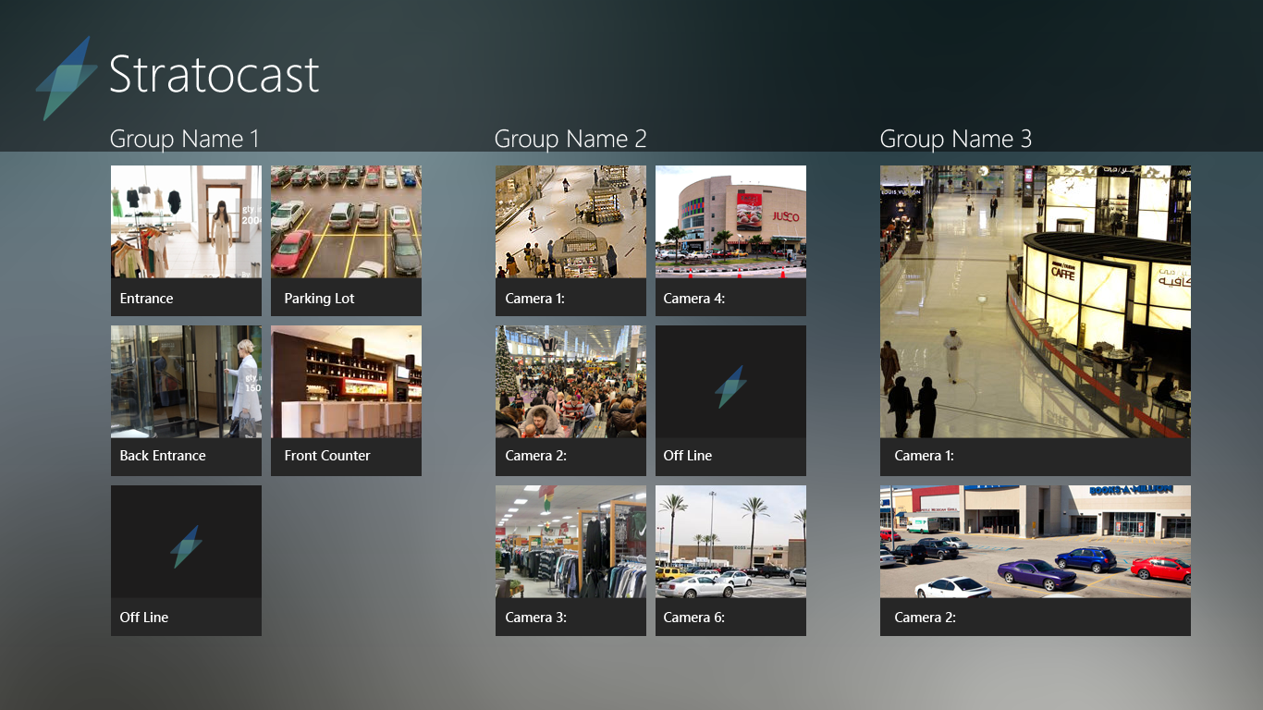
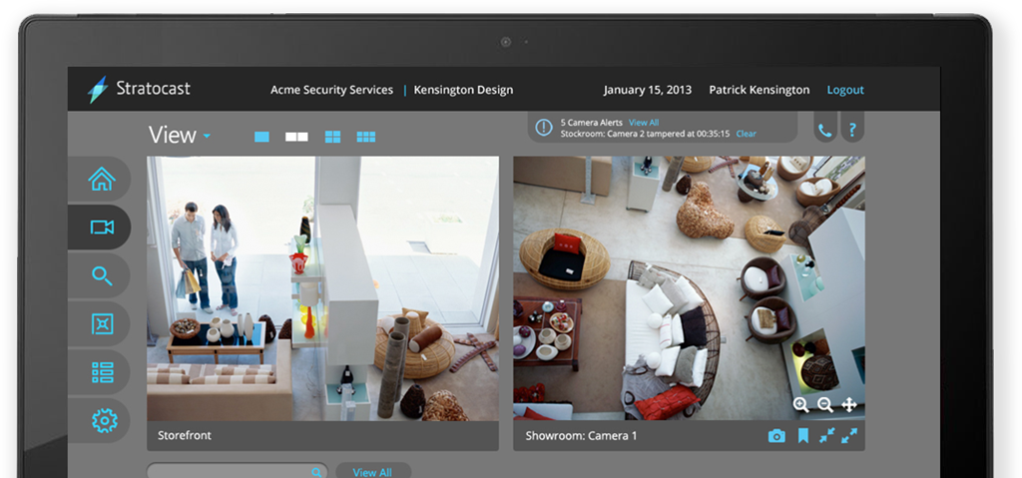
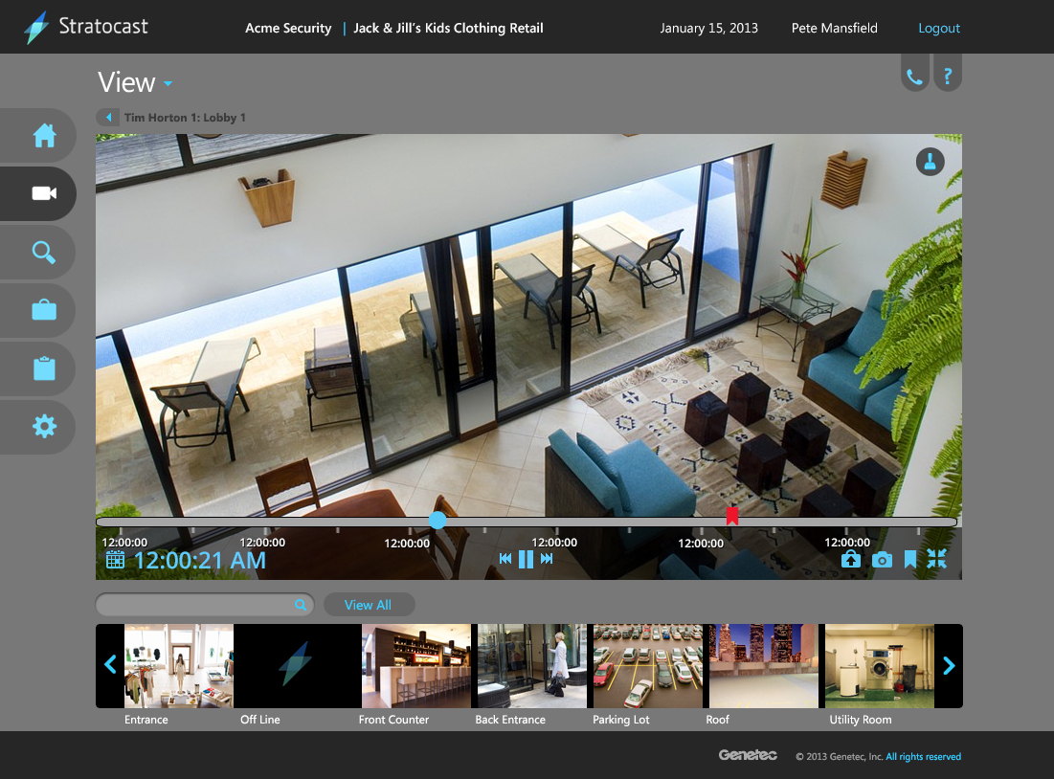
Simple, Intuitive UI

Slide 4
Simple, Cloud Deployments
Minimal On-Premise Equipment to Maintain & Manage
Simplified System Installation and Commissioning
Reduced Investment in Hardware and Professional IT/Security Staff
Automated & Frequent Release Cycles

Slide 5
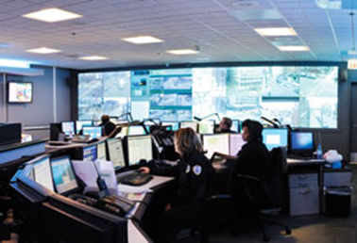
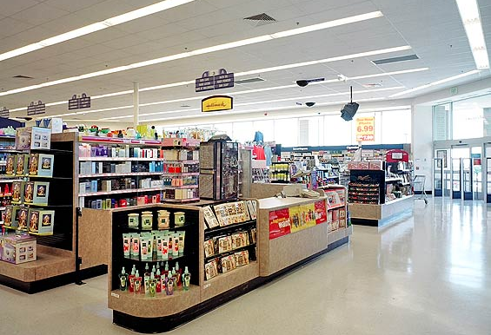
Stratocast in the Enterprise
A Few Examples….
Satellite School & Office Buildings
City-Wide Surveillance
Multi-Site Retailers

Slide 6
Stratocast System Diagram
Support for Mobility -
Smart Phones and Tablets
Android, IOS, Windows Phone 8, Windows 8
Security Center Federation
Hybrid Cloud/On-premise Systems
Web Application
IE, Firefox, Chrome & Safari
On Windows & Mac
Alarm Monitoring
Remote Video Surveillance
Client Site 1
Video Surveillance
Client Site “n”
Video Surveillance &
Access Control
Client Site 2
Access Control

