Slide 1
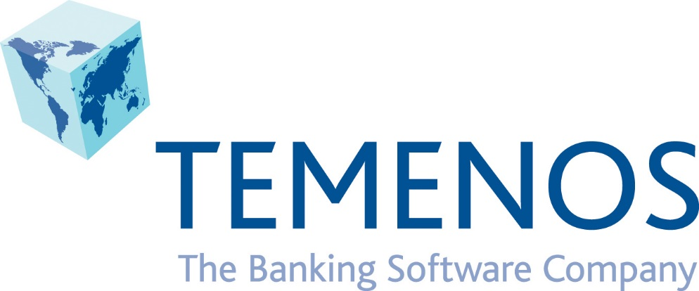

Slide 2

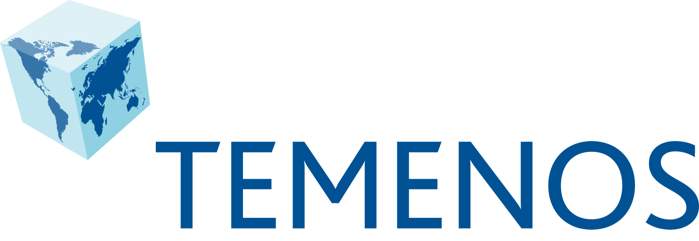
Temenos – a global market leader
World’s
leading banking software company
No.1
    2000+ installations in 150+ countries
    469m USD
    revenues
    in 2014
    4,000+
    employees in
    72 international
    offices
Innovation
led
World class delivery
    Highest level of R&D in the industry to drive innovation
    135 go lives in 2014
    Strength and depth: 1,000+ consultants, 100 concurrent projects
    Regular software upgrade strategy
    Passion for standards and openness
    Community of 2,000+
    certified partner consultants

Slide 3
Powerhouse in financial software
38
500 million
of top 50 banks use Temenos
customers rely on Temenos for
daily banking needs
US$5 trillion
US$115m
in assets processed through Temenos software
In annual R&D

Slide 4
Cloud adoption across the banking landscape
Established Banks
New Start Banks
Credit Unions
Microfinance Institutions
Innovative established banks looking for smart ways to increase return on equity and renew their focus on the customer proposition
New entrant banks or existing banks entering new markets that wish to move fast without the burden of complicated IT systems
Credit unions looking for the same standard of technology as banks, but without the complexity, enabling them to focus on their members and service
Microfinance Institutions looking for cost-effective solutions that help them speed up the real economic and social benefit they deliver in emerging markets.

Slide 5
Cloud-banking reality
It’s a matter of when, not if
Option:
Implication:
Install and maintain software
in-house
Greater control vs
Higher upfront & ongoing support costs
On-premise banking solution
Implement and integrate a highly customised solution
Custom functionality vs longer implementation
timescale & limited flexibility
Manage version upgrades & security updates in house
Direct access to applications vs higher risk of system downtime
Access banking software as a cloud-based service
Lower upfront costs vs software installed and maintained
by 3rd party
Cloud-based implementation based on pre-configured solution
Agility and higher speed to market vs elements of standardisation
Cloud-banking solution
Automatic Upgrades & Security Controls included in service
In-house IT resources can focus on strategic projects

Slide 6


Why Azure?
Infinite scalability
Always on
Easily scales up and down as demand changes.*
Never miss a beat; always be there for your customers.
The only enterprise-grade cloud
Accident protection
Reliable and redundant copies of your data and automatic failover protection.
Microsoft Azure ensures that Temenos® T24 data are secure.
Speed to market
Pay-as-you-go
Rapidly deploy Temenos on Azure without worrying IT.
Only pay for the power and capacity you’re using.*
Familiarity of Windows
Interoperability
Integrates seamlessly with your existing back-end systems and marketing investments.
Temenos uses the technology that your IT department already knows.
Notes:
Key goal of slide
Azure is the only enterprise-grade cloud, and is the ideal partner to deploy Sitecore on.
Azure is the worldwide leader in cloud computing services, designed to save you resources and get the most out of your investments
Talking Points:
8 reason why Azure is ideal for Sitecore:
Familiarity of Windows
Sitecore is built on .NET
Speed to Market
By deploying on Azure Sitecore can be up and running very quickly
The only enterprise-grade cloud
Azure has the security parameters to handle enterprise companies and their data
Infinite Scalabiltiy
Azure lets you pay for more or cut down on storage space, letting you use your resources efficiently
Always on
Stay on top of your customer interactions in real-time with Azure’s 99.95% uptime
Accident Protection
Copies of your data are created in the cloud for failover protection
Pay-as-you-go
Azure let’s you pay only for the amount of cloud computing you actually need
Interoperability
Azure and Sitecore integrate easily with one another in addition to your other software investments

Slide 7

Contact us
Thomas Kurishingal
tkurishingal@temenos.com
www.temenos.com
Ulrich Eitler
Ulrich.Eitler@microsoft.com
partners@temenos.com

