Slide 1
Top Windows 8 Health Apps Updated November 2014

Slide 2
Section 1 – apps for health professionals
AirStrip ONE
AHRQ ePSS
CDC
Care Navigator
Care Optimizer
EMR Next
GreenWay PrimeMobile
MedCase
Medcitas (Spanish)
MicroMedex Drug Information
NextDocs Clinical Trials Exchange
PatientLive
Patient Engagement
QA Inspector for Health
SAP EMR
UpToDate
VitalHub

Slide 3
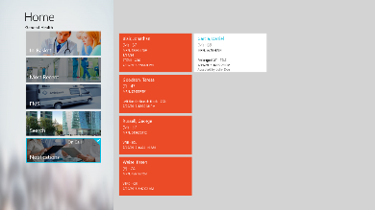
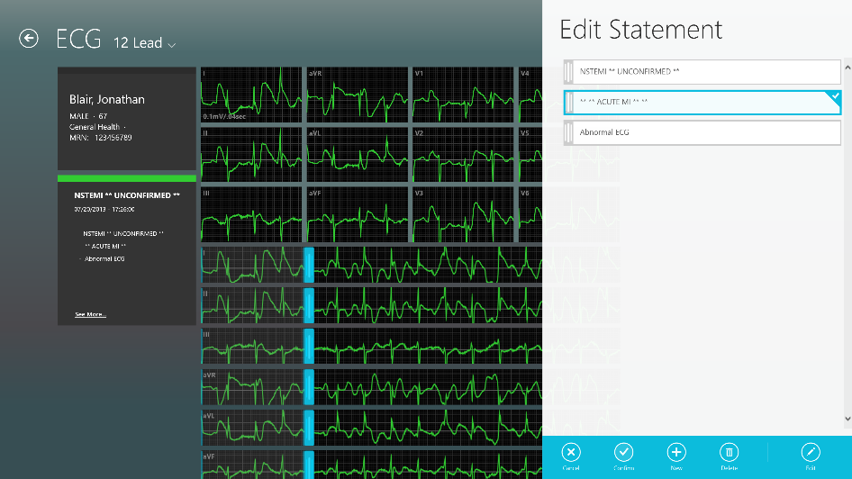
Airstrip ONE
Airstrip ONE
App type: Medical Records
Target Audience: Health Care (Cardiology)
MSFT Owner / Contact:
Gareth Hall
Delivery: Store
Date Available: Now
Regions available:
Currently available on iPad? Yes
Is Win Phone app available? Yes
To customer value prop:
AirStrip ONE is the complete enterprise solution that provides the architecture and interactive user experience that fully delivers on the promise of clinical mobility.
Windows 8 features used (e.g. share charm):
Build for touch
Cloud connected
Pinch/stretch zoom
Live tile updates
Pin to start screen
Click here for Script
Click here to find in Windows Store
Click here to find in Windows Phone Store

Slide 4
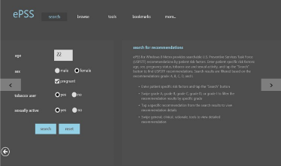
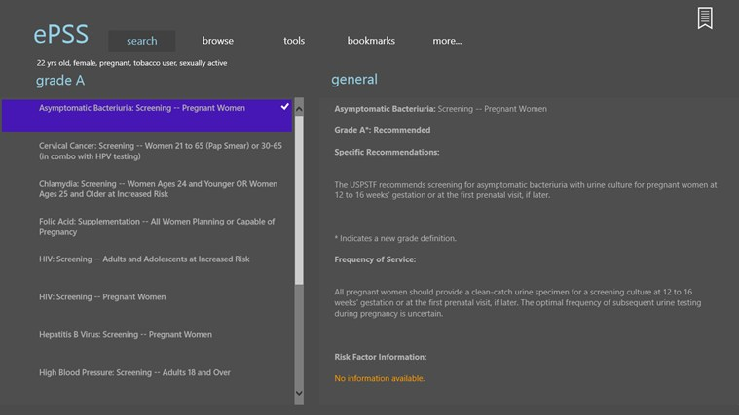
AHRQ - ePSS
App type:
Physician reference
Target Audience:
Health Professionals
MSFT Owner / Contact:
Delivery:
Store / sideload
Date Available:
Regions available:
Currently available on iPad?
Y/N
Is Win Phone app available?
Y/N
To customer value prop:
Help primary care clinicians identify the screening, counseling, and preventive medication services appropriate for their patients.
Designed and developed by the U.S. Department of Health & Human Services (HHS), Agency for Healthcare Research and Quality (AHRQ), the Nation's lead Federal agency for research on health care quality, costs, outcomes and patient safety. The ePSS information is based on the current recommendations of the U.S. Preventive Services Task Force (USPSTF), searchable by specific patient characteristics, such as age, sex, and selected behavioral risk factors.
To partner value prop:
Click here to find in Store
Notes:
http://apps.microsoft.com/windows/en-us/app/ahrq-epss/9347f509-025f-479a-84c8-ff4e6671e238#

Slide 5
Center for Disease Control - CDC
App type:
Physician reference
Target Audience:
Health Professionals
MSFT Owner / Contact: Ben Flock
Delivery:
Store
Date Available:
10/26
Regions available:
Currently available on iPad?
Y
Is Win Phone app available?
N
To customer value prop:
Current health information and news at your fingertips.
It features important health articles, popular journals, timely updates and access to social media to coincide with important health concerns and events throughout the year.
It gives an increasingly mobile public 24/7 access to important and timely health information that people can use to protect their lives and loved ones.
To partner value prop:
Click here to find in Store
Notes:
http://apps.microsoft.com/windows/en-us/app/cdc/e8d25f43-482e-41f6-aba2-edb947c28461#

Slide 6
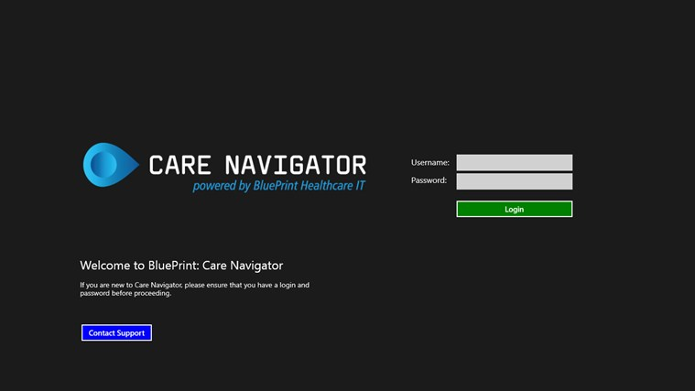
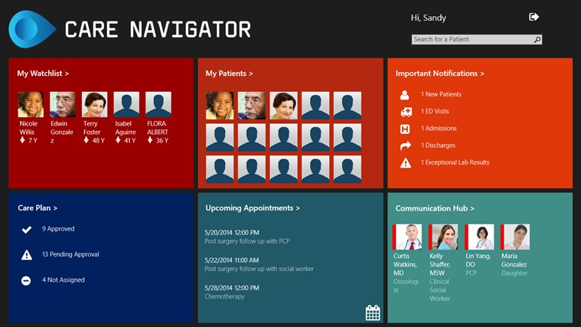
Care Navigator - Blueprint
App type:
Physician reference
Target Audience:
Health Professionals
MSFT Owner / Contact:
Delivery:
Store
Date Available:
2014
Regions available:
Currently available on iPad?
Y
Is Win Phone app available?
N
To customer value prop:
Care Optimizer is developed by Capgemini and can be applied in different situations.
Firstly, it helps to determine the individual needs of clients to offer flexible and person centred care. This ensures a better quality of life, a healthier population of elderly and lower health care costs. It shows which capabilities are required per region in order to offer this care. Thus, managers gain timely insight in deficits in areas of expertise so they can take measures.
Secondly, the Care Optimizer can be used in assessing the daily operations of a care institution. Through benchmarking the best practices for the given situation can be determined. This helps in managing the expenses and cutting down costs.
Finally, Care Optimizer can be used for justification to the central government of the quality of care delivered and the budget used for the delivery of care.
To partner value prop:
Click here to find in Phone Store
Click here to find in Store
Notes:
http://apps.microsoft.com/windows/en-us/app/cdc/e8d25f43-482e-41f6-aba2-edb947c28461#

Slide 7
Care Optimizer – CapGemini Nederland
App type:
Physician reference
Target Audience:
Health Professionals
MSFT Owner / Contact:
Delivery:
Store
Date Available:
2013
Regions available:
Currently available on iPad?
N
Is Win Phone app available?
N
To customer value prop:
Current health information and news at your fingertips.
It features important health articles, popular journals, timely updates and access to social media to coincide with important health concerns and events throughout the year.
It gives an increasingly mobile public 24/7 access to important and timely health information that people can use to protect their lives and loved ones.
To partner value prop:
Click here to find in Store
Notes:
http://apps.microsoft.com/windows/en-us/app/cdc/e8d25f43-482e-41f6-aba2-edb947c28461#

Slide 8
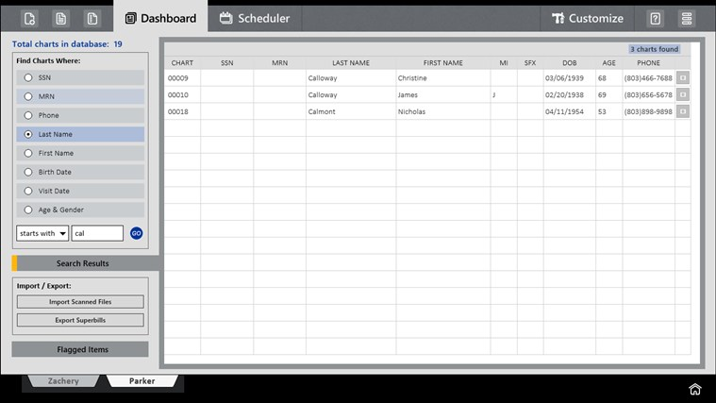
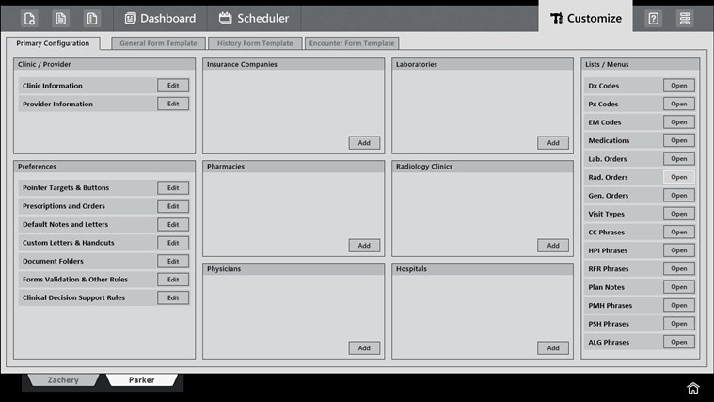
EMR Next – UnisonCare
App type:
Physician reference
Target Audience:
Health Professionals
MSFT Owner / Contact:
Delivery:
Store
Date Available:
2013
Regions available:
Currently available on iPad?
N
Is Win Phone app available?
N
To customer value prop:
A truly functional, adaptable and affordable electronic medical records system for physicians and healthcare providers.
To partner value prop:
Click here to find in Store
Notes:
http://apps.microsoft.com/windows/en-us/app/cdc/e8d25f43-482e-41f6-aba2-edb947c28461#

Slide 9
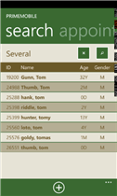
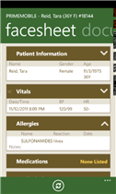
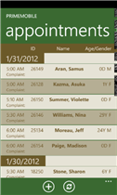
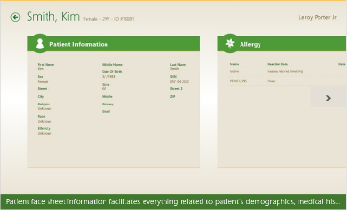
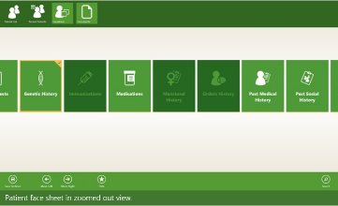
Greenway Medical - PrimeMobile
App type:
EMR
Target Audience:
Medical professionals
MSFT Owner / Contact:
Delivery:
Store
Date Available:
10/26
Regions available:
Currently available on iPad?
Y
Is Win Phone app available?
Y
To customer value prop:
Remote, two-way integration of complete ambulatory information and remote charge submission housed in electronic health records.
Provides patient history and Problem lists, progress notes and appointment schedules encompassing a healthcare providers’ entire patient population.
As well as providing clinical tools such as viewing lab results, PrimeMOBILE also integrates patient billing and charge capture which assures proper claims and the financial health of a practice. Accessed by a simple login, providers can view patient notes and search individual patient records.
To partner value prop:
Click here for to-partner video
Click here for demo script
Click here for phone app
Click here to find in Store
Notes:
http://apps.microsoft.com/windows/en-us/app/primemobile-1-6/423fc999-9a26-4869-a43a-199030aeb319#

Slide 10
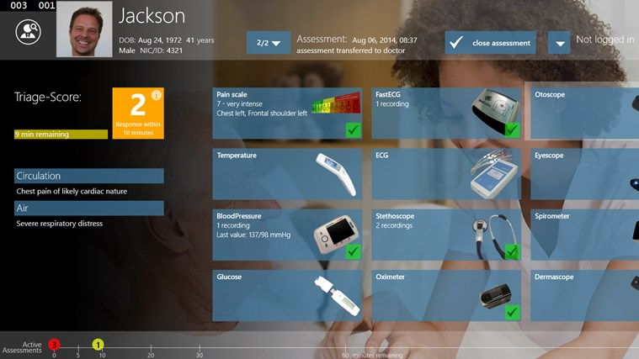
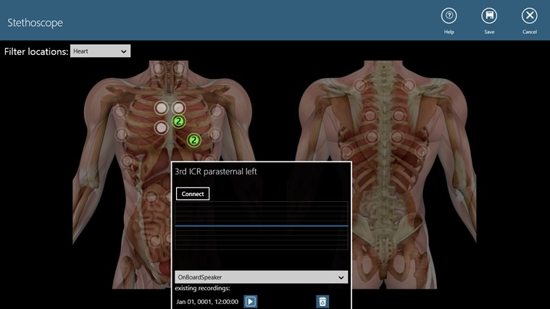
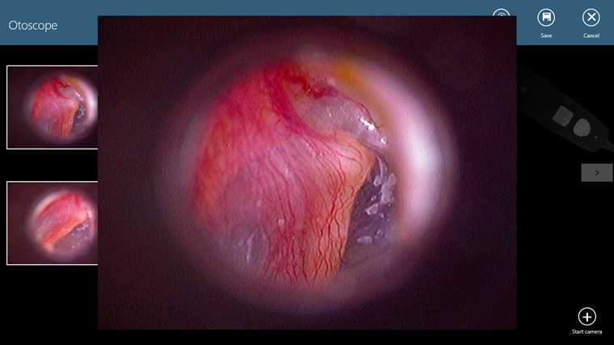
MedCase - MedCubes
App type:
Health/Fitness
Target Audience:
Medical professionals
MSFT Owner / Contact:
Delivery:
Store
Date Available:
2014
Regions available:
Currently available on iPad?
Y
Is Win Phone app available?
N
To customer value prop:
MedCase is an App that connects people without access to Healthcare with their doctors. It is a bundle of hard- and software and works in combination with selected medical devices.
Features:
Connect medical devices
Integrated Triage score
Transfer data to doctors
Various cameras like otoscope, dermascope, eye
Recording of stethoscope audio data
To partner value prop:
Click here to find in Store
Notes:
http://apps.microsoft.com/windows/en-us/app/primemobile-1-6/423fc999-9a26-4869-a43a-199030aeb319#

Slide 11
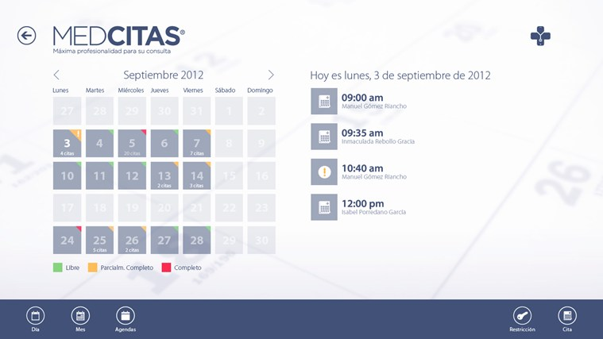
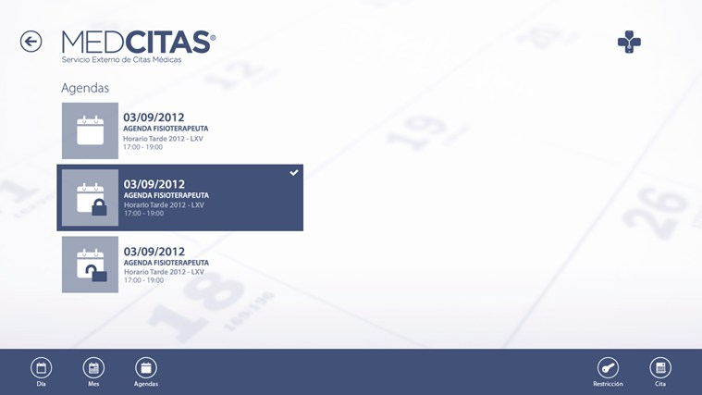
Netboss eHealth - Medcitas
App type:
Patient Management
Target Audience:
Professionals
MSFT Owner / Contact:
Delivery:
Store
Date Available:
201
Regions available:
Spanish Langauge
Currently available on iPad?
Y/N
Is Win Phone app available?
Y/N
To customer value prop:
Comprehensive appointment and patient flow management.
MedCitas posibilita la gestión integral de la cita previa y un aumento de su visibilidad y afluencia de pacientes a través del Directorio de Profesionales MedCitas.
Click here to find in Phone Store
Click here to find in Store
Notes:
http://apps.microsoft.com/windows/en-us/app/medcitas-medico/f5602fba-d2ea-4532-9f77-a8ed1ac8d360#

Slide 12
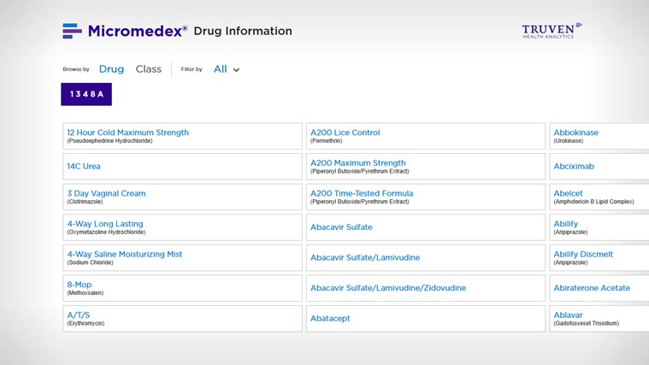
Truven Health Analytics - MicroMedex Drug
App type:
Clinical Reference
Target Audience:
Clinicians
MSFT Owner / Contact:
Delivery:
Store
Date Available:
May 2013
Regions available:
All
Currently available on iPad?
Y
Is Win Phone app available?
N
To customer value prop:
Evidenced based drug information.
Drug Information contains the industry’s most comprehensive drug information and is backed by Micromedex’s thorough, unbiased editorial process.
Now from anywhere, clinical care teams can instantly get information to support confident treatment decisions.
Click here to find in Store
Notes:
http://apps.microsoft.com/windows/en-ca/app/micromedex-drug-information/36adef4a-fb14-4c68-986c-2404e2b3015b#

Slide 13
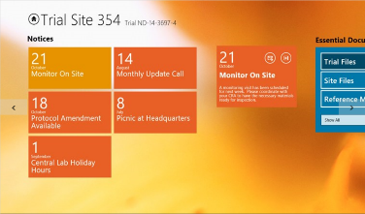
NextDocs - Trials Exchange
App type:
Health Professionals
Target Audience:
Clinical Trial staff
MSFT Owner / Contact:
Delivery:
Store
Date Available:
Dec 2012
Regions available:
Currently available on iPad?
N
Is Win Phone app available?
N
To customer value prop:
Optimized tablet experience for trial site staff to review trial materials while on the go.
A companion app to the NextDocs Trial Exchange web application, this software is designed to deliver notices, essential documents and reference materials to trial site staff in an easy to use, lightweight framework.
Users can move easily between trials, view documents and search and share notices.
Click here to find in Store
Notes:
http://apps.microsoft.com/windows/en-us/app/trial-exchange/6d50c691-0de7-4dd2-9a38-2186abadb3a2#

Slide 14
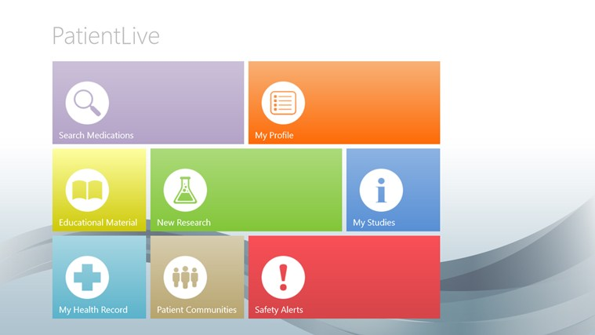
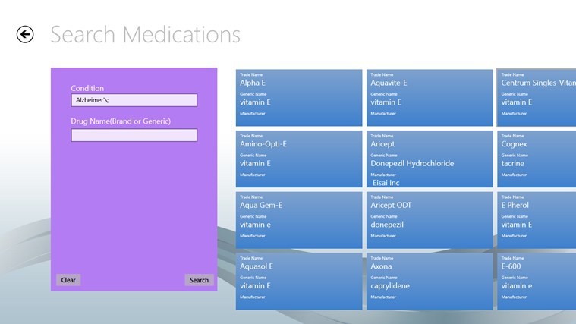
PatientLive
App type:
Health Professionals, Patients
Target Audience:
Clinical Trial staff
MSFT Owner / Contact:
Delivery:
Store
Date Available:
10/26/12
Regions available:
Currently available on iPad?
Y
Is Win Phone app available?
N
To customer value prop:
The PatientLive™ app provides consumers and patients with a comprehensive overview of approved medications and new medical therapies for their conditions (or their loved ones).
The application also provides registrants with personalized updates when new medical therapies are available as well as a link to Microsoft HealthVault™
Click here to find in Store
Notes:
http://apps.microsoft.com/windows/en-us/app/trial-exchange/6d50c691-0de7-4dd2-9a38-2186abadb3a2#

Slide 15
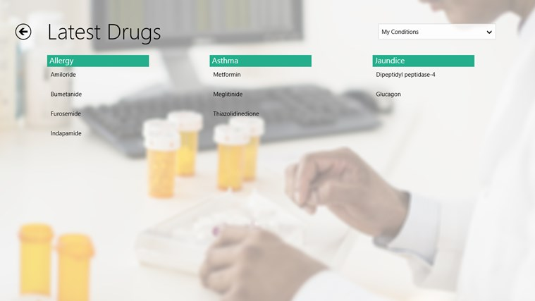
Patient Engagement - iLinkSystems
App type:
Health Professionals, Patients
Target Audience:
Clinical Trial staff
MSFT Owner / Contact:
Delivery:
Store
Date Available:
2013
Regions available:
Currently available on iPad?
N
Is Win Phone app available?
N
To customer value prop:
An interactive medium for Patients and Health & Life Sciences organizations to improve health outcomes, consolidate health information of the patient, and cut healthcare costs.
It is an Interoperable Solution Accelerator that allows Health and Life Sciences organizations to directly engage members in health-related decision-making, promote clinical trials, while enabling seamless information exchange among different health services.
Click here to find in Store
Notes:
http://apps.microsoft.com/windows/en-us/app/trial-exchange/6d50c691-0de7-4dd2-9a38-2186abadb3a2#

Slide 16
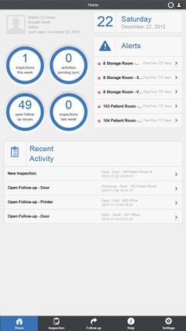
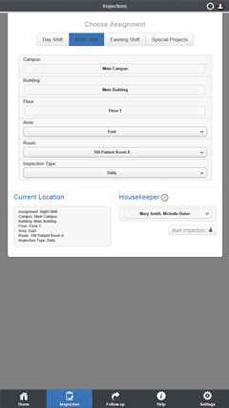
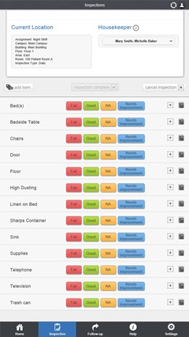
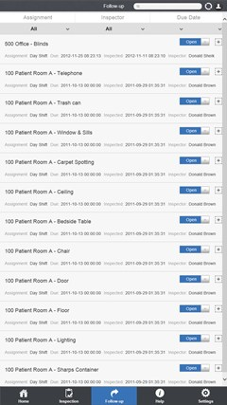
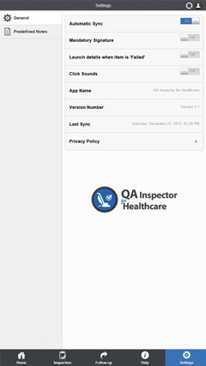
QA Inspector for Health
App type:
Health Professionals, Admins
Target Audience:
Healthcare Admins
MSFT Owner / Contact:
Delivery:
Store
Date Available:
Dec 2011
Regions available:
Currently available on iPad?
N
Is Win Phone app available?
Y
To customer value prop:
QA Inspector for Healthcare streamlines cleanliness in the inspection process from start to reporting. Automate all housekeeping inspections and surveys, add ratings, photos, notes and due dates to all items, drill down to individual checklists by location you are in, demand inspectors sign off after completing inspection, assign a responsible to all failed items, resolve all follow-up issues in real time or add additional notes and photos. All inspection data collected is uploaded to a custom backend portal. The portal allows users to customize their locations, checklists and users. Run performance, audit and score reports on housekeepers, items, inspections, locations and more!
Click here to find in Store
Notes:
http://apps.microsoft.com/windows/en-us/app/trial-exchange/6d50c691-0de7-4dd2-9a38-2186abadb3a2#

Slide 17
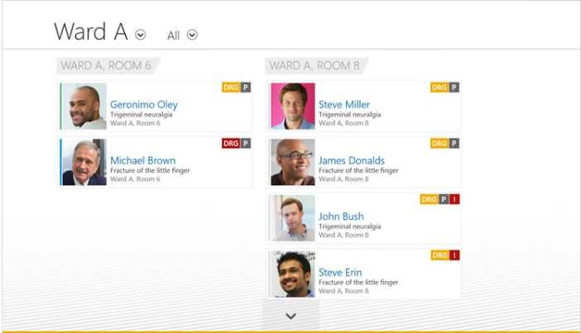
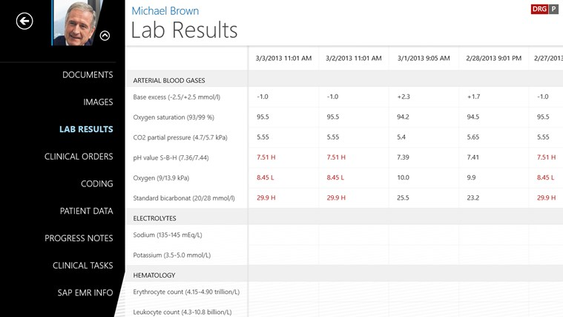
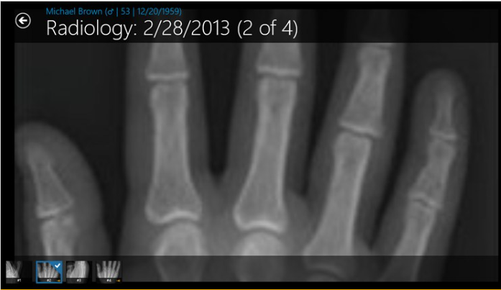
SAP AG - SAP EMR Unwired
App type:
EMR
Target Audience:
Clinicians
MSFT Owner / Contact: Bettina Zielke
Delivery:
Store
Date Available:
Available now
Regions available:
WW
Currently available on iPad?
Y
Is Win Phone app available?
N
To customer value prop:
Physicians and nurses have easy, secure access to patient data right at the point of care.
The app connects to clinical back-end systems, including hospital information and imaging systems (PACS), and displays the patient's data on the Windows tablet in a clear and easy-to-read format
Click here to find in Store
Notes:
http://apps.microsoft.com/windows/cy-gb/app/sap-emr-unwired/c03c1d0c-5de5-4c25-ae6c-eca8af8f4bc5#

Slide 18
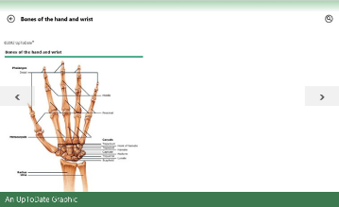
UpToDate - UpToDate
App type:
Decision Support
Target Audience:
Medical Professionals
MSFT Owner / Contact:
Delivery:
Store
Date Available:
10/31
Regions available:
Currently available on iPad?
Y
Is Win Phone app available?
Y
To customer value prop:
Find clinical answers at the point of care or anywhere you need them.
Access current, synthesized clinical information from UpToDate® — including evidence-based recommendations — quickly and easily on your Windows 8 phone or tablet.
Demo Username: CONV5
Demo Password: CONV6
DO NOT SHARE OUTSIDE OF MSFT
Click here to find in Phone Store
Click here to find in Store
Notes:
http://apps.microsoft.com/windows/es-co/app/uptodate/8d4b67a6-2939-4ac8-b78d-8c8825483511#

Slide 19
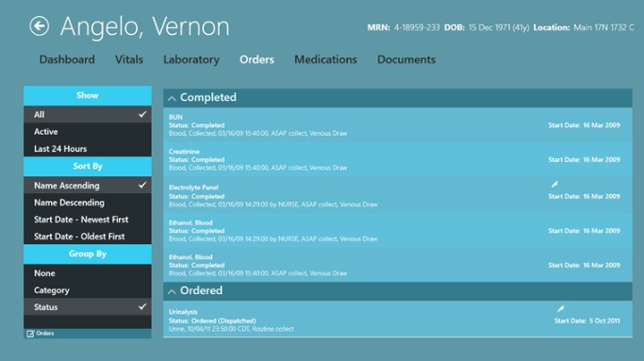
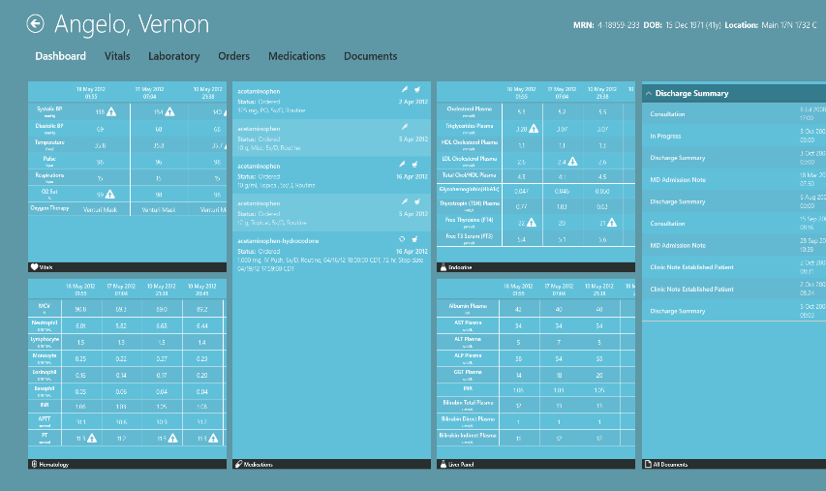
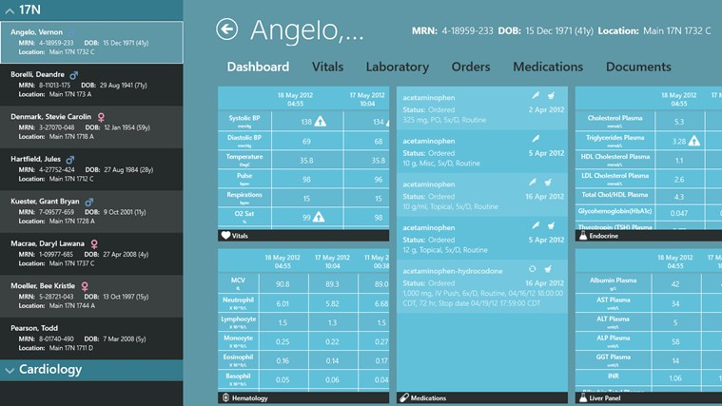
VitalHub - VitalHub Chart
App type: EMR
Target Audience:
Clinicians
MSFT Owner / Contact: Hemang Patel
Delivery:
Store
Date Available:
June 2013
Regions available:
All
Currently available on iPad?
Y
Is Win Phone app available?
N
To customer value prop:
Single, unified, intuitive interface into multiple clinical systems.
VitalHub was designed by and for clinicians to deliver concise, relevant patient information at-a-glance.
VitalHub’s mobile solution provides clinicians with an integrated view of the patient by rapidly accessing and aggregating data from multiple disparate systems, saving clinicians’ time .
Click here to find in Store
Notes:
http://apps.microsoft.com/windows/en-us/app/vitalhub-chart/1c950020-c994-4490-980c-c3709b3dd36c/m/row#

Slide 20
Section 2 – health apps for consumers
Accupressure
Aetna Passage (WalkTheWorld)
Azumio Health and Fitness Suite
Ball Strike
Carolinas Healthcare System
Children’s Hospital of Colorado
Dubai Health Authority
Endomondo
Fitbit
Health Choices (NHS)
iKorlap (Hungary)
J&J Digital Health Scorecard
LifeWise
Mayo Pregnancy App
Medicover (Polish)
Medical Image Vault
NextGen Medicine Cabinet
Premera Windows App
PatientLive
TalkingTiles
Unilever HeartAge
WellSpan Health

Slide 21
AM Mobile - Acupressure: Treat yourself
App type:
Consumer health
Target Audience:
Consumer
MSFT Owner / Contact:
Valentina Ion
Delivery:
Store
Date Available:
10/26
Regions available:
WW
Currently available on iPad?
Y/N
Is Win Phone app available?
N
To customer value prop:
Easy to use app with illustrated instructions for doing acupressure point massage.
Acupressure is an ancient healing art that uses the fingers to press key points on the surface of the skin to stimulate the body's natural self-curative abilities. When these points are pressed, they release muscular tension and promote the circulation of blood and the body's life force to aid healing.
Click here to find in Phone Store
Click here to find in Store
Notes:
http://apps.microsoft.com/windows/en-us/app/acupressure-treat-yourself/6a98de40-1c94-4663-907a-ece6790ea5cb#

Slide 22
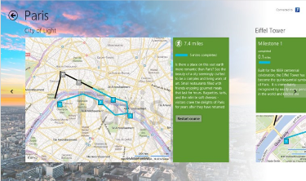
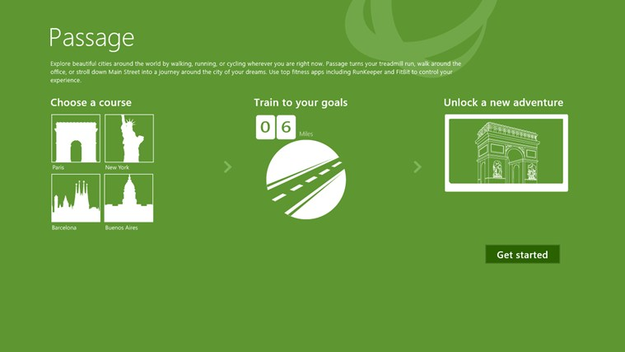
Aetna - Passage (WalkTheWorld)
App type:
Consumer fitness
Target Audience:
Consumer
MSFT Owner / Contact:
Delivery:
Store / sideload
Date Available:
Regions available:
Currently available on iPad?
Y/N
Is Win Phone app available?
Y/N
To customer value prop:
Transforms the running, walking, and cycling that you track using FitBit or RunKeeper into a game-like experience.
Your goal is to complete courses by getting active. A mile that you record in RunKeeper or FitBit is a mile that you progress through the course. As you progress through the course, you unlock a beautiful virtual memory book that let's you explore the sites you would have passed on your journey.
Click here to find in Store
Notes:
http://apps.microsoft.com/windows/en-us/app/passage/ebf9baed-a745-4430-b49d-60b3027d66de#

Slide 23
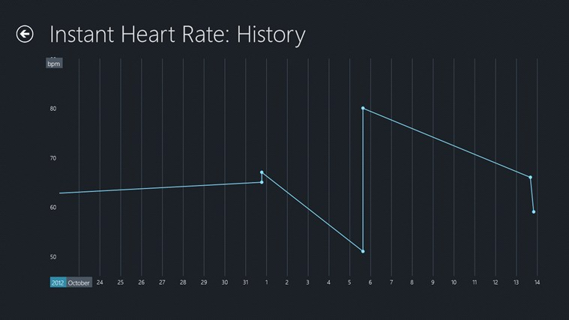
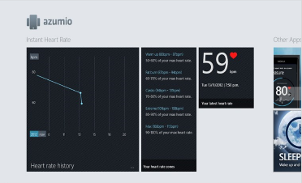
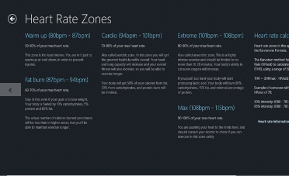
Azumio - Azumio Health and Fitness Suite
App type:
Consumer Fitness
Target Audience:
Consumer
MSFT Owner / Contact: Ben Flock
Delivery:
Store
Date Available:
Regions available:
Currently available on iPad?
Y/N
Is Win Phone app available?
Y/N
To customer value prop:
Access all your health information at one place, at one time. The Azumio Health and Fitness Dashboard gives you access to heart rate information and your latest heart rate readings.
Click here to find in Phone Store
Click here to find in Store
Notes:
http://apps.microsoft.com/windows/en-nz/app/azumio-health-and-fitness/3eeeb62d-0b05-42c4-86d9-d94875f3c9ca#

Slide 24
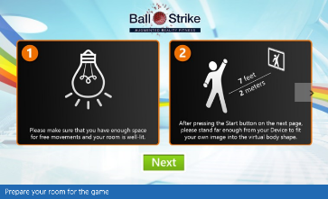
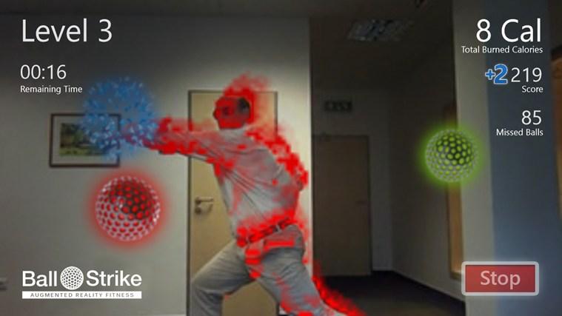
GPS Tuner - Ball Strike
App type:
Consumer fitness
Target Audience:
Consumer
MSFT Owner / Contact:
Valentina Ion
Delivery:
Store
Date Available:
10/26
Regions available:
WW
Currently available on iPad?
N
Is Win Phone app available?
N
To customer value prop:
Augmented reality fitness game.
Simply stand in front of your computer's camera and start burning calories!
You are motivated and challenged by this fitness application, where you use your body to twist, turn, kick, hit and jump to make the balls explode.
Click here to find in Store
Notes:
http://apps.microsoft.com/windows/ar-bh/app/ballstrike/6d3c47b8-a273-43ed-8e2b-a7c502181c6c#

Slide 25
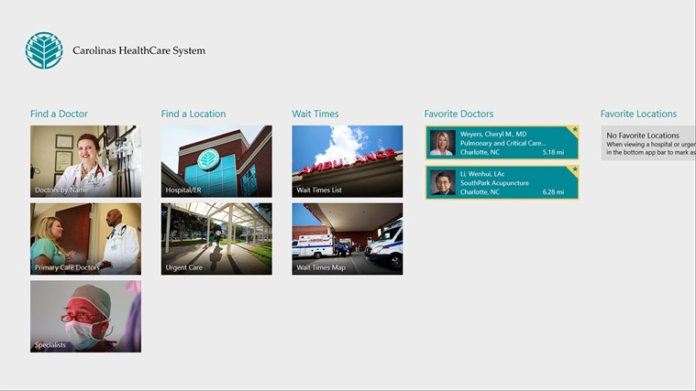
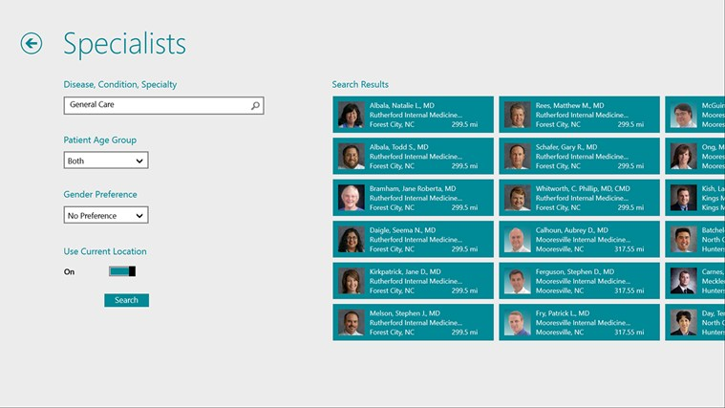
Carolinas Healthcare System
App type:
Lookup
Target Audience:
Patients
MSFT Owner / Contact: Cindy O’Neill
Delivery:
Store
Date Available:
May 2013
Regions available:
Currently available on iPad?
Y/N
Is Win Phone app available?
Y/N
To customer value prop:
This free application allows users to find local Carolinas HealthCare System (CHS) Hospitals, Emergency Rooms and Urgent Care locations with up-to-date wait times and driving directions.
Users also may search for a provider by name or specialty.
Click here to find in Phone Store
Click here to find in Store
Notes:
http://apps.microsoft.com/windows/en-us/app/carolinas-healthcare-system/73f0e660-d2c3-4f10-beab-98089cabd2cf#

Slide 26
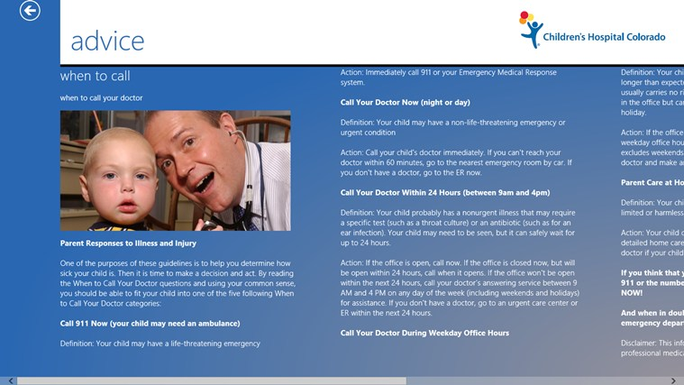
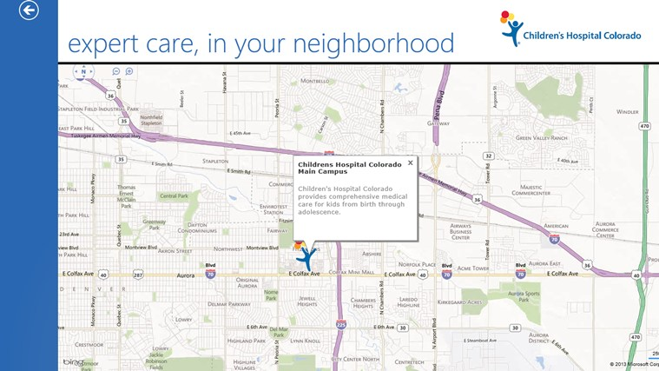
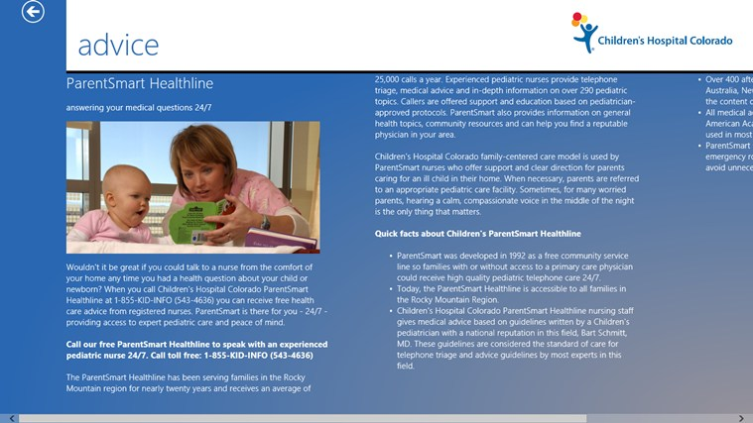
Children’s Hospital Colorado
App type:
Lookup
Target Audience:
Patient
MSFT Owner / Contact: Sam Robinson
Delivery:
Store
Date Available:
May 2013
Regions available:
Currently available on iPad?
Y
Is Win Phone app available?
N
To customer value prop:
Discover Children's Hospital Colorado and get advice from our experts. What's the difference between a cold and the flu? Should I call 911, my child's pediatrician, or wait it out? Where is the nearest Children's Hospital Colorado facility? What services are offered in each location?
Click here to find in Store
Notes:
http://apps.microsoft.com/windows/en-us/app/childrens-hospital-colorado/fe1272c2-9ba4-4fc0-93c6-469b529bf75e#

Slide 27
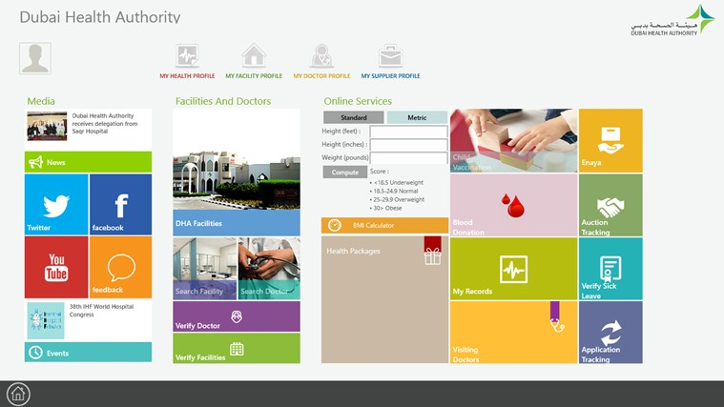
Dubai Health Authority
App type:
Consumer fitness
Target Audience:
Consumer
MSFT Owner / Contact:
Delivery:
Store
Date Available:
2013
Regions available:
All
Currently available on iPad?
Y
Is Win Phone app available?
N
To customer value prop:
DHA smartphone app provides an easy access to numerous healthcare services on customer’s preferred device.
Access Profile, Appointments, Prescriptions, Lab Results, In-Patient Visits, Medical Advices, My Records etc.
Child Vaccination feature will allow parents to register their children to view complete vaccination plan
Health Packages: The customers will be to view and request health packages through this feature like Diabetes, Smoking & Women Health
Search Facilities, Professionals: Features to search professionals & facilities, verify license details
ENAYA Insurance network search, Application Tracking, Verify Sick Leave, Auction Status, Supplier Profile, Professional Profile, Facility Profile, Blood Donation, BMI Calculator, etc
DHA & its Facilities: List of DHA Facilities, Maps, Driving directions, Visiting doctors, news, events, feedback, emergency numbers
Click here to find in Store
Notes:
http://apps.microsoft.com/windows/en-us/app/6bccabc9-9515-4522-9b50-c66237088b0f#

Slide 28
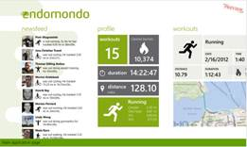
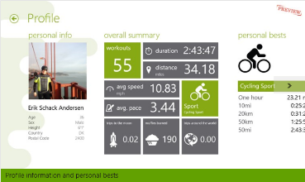
Endomondo US - Endomondo
App type:
Consumer fitness
Target Audience:
Consumer
MSFT Owner / Contact:
Ben Flock
Delivery:
Store / sideload
Date Available:
10/26
Regions available:
All
Currently available on iPad?
Y
Is Win Phone app available?
N
To customer value prop:
Keep track of your personal fitness activities and share them with your friends. Make sports more fun by challenging your friends.
This application is a companion to the Endomondo mobile application. Track your activities with the mobile phone and use this application to review your results and browse your friends results
Click here to find in Phone Store
Click here to find in Store
Notes:
http://apps.microsoft.com/windows/en-us/app/6bccabc9-9515-4522-9b50-c66237088b0f#

Slide 29
Fitbit - Fitbit
App type:
Fitness
Target Audience:
Consumer
MSFT Owner / Contact:
Delivery:
Store
Date Available:
Dec 2012
Regions available:
All
Currently available on iPad?
Y
Is Win Phone app available?
N
To customer value prop:
This app enables you to view graphs of your activity levels, sleep and weight and gives you a clear picture of your health and fitness trends.
Click here to find in Phone Store
Click here to find in Store
Notes:
http://apps.microsoft.com/windows/en-nz/app/fitbit/e0879b33-8acb-4610-801f-8a3e06d8616b#

Slide 30
3chillies - Health Choices
App type:
Consumer Health
Target Audience:
Consumer
MSFT Owner / Contact:
Carlos Gomes
Delivery:
Store
Date Available:
10/26
Regions available:
UK Only (will be in internal demo WW corp app store soon )
Currently available on iPad?
Y
Is Win Phone app available?
Y
To customer value prop:
Information about NHS services in England and health information at your fingertips.
This App has been developed in collaboration with NHS Choices who supply all NHS service details and condition / treatment information. Integration with Microsoft® HealthVault® adds the ability to save condition and NHS service information against a secure personal account.
Click here to find in Store
Notes:
http://apps.microsoft.com/windows/cy-gb/app/health-choices/5dd3f3c9-1b82-4158-a53e-d853597f4c9b#

Slide 31
Hospitaly Kft - iKorlap (Hungary)
App type:
Reference
Target Audience:
Patient
MSFT Owner / Contact:
Delivery:
Store
Date Available:
2012
Regions available:
Hungary
Currently available on iPad?
Y/N
Is Win Phone app available?
Y/N
To customer value prop:
View your medical information online.
A háziorvosnak lehetősége van áttekinteni páciense kórtörténetét, a közfinanszírozásban hozzárendelt ellátási eseményeket, valamint a beváltott recepteket
Előzetes rövid regisztráció után a háziorvosnak azonnal rendelkezésére áll
A pontos és megbízható kórkép révén csökkennek a feleslegesen ismételt vizsgálatok, javul a gyógyítás hatásfoka
Click here to find in Store
Notes:
http://apps.microsoft.com/windows/hu-hu/app/ikorlap/02E21B86-68B0-47E3-9AA9-AD1E52265430#

Slide 32
Luna Assistive Technology – IUVO Communicator
App type:
Assisted Speech
Target Audience:
Patient
MSFT Owner / Contact:
Delivery:
Store
Date Available:
2012
Regions available:
Currently available on iPad?
Y/N
Is Win Phone app available?
Y/N
To customer value prop:
A modular communicator for people with speech disabilities.
The best thing about IUVO is that you are creating your own interactive in-app tiles! Using your own custom tiles, You can create complex sentences and prepare user for any situation.
Click here to find in Store
Notes:
http://apps.microsoft.com/windows/en-us/app/iuvo-communicator/B49B8541-E9F0-4883-A196-BDBD5C23DD80#

Slide 33
Johnson & Johnson - Digital Health Scorecard
App type:
Consumer health
Target Audience:
Consumer
MSFT Owner / Contact:
Ben Flock
Delivery:
Store
Date Available:
10/26
Regions available:
Currently available on iPad?
Y/N
Is Win Phone app available?
Y/N
To customer value prop:
Helps you understand your likelihood of developing common chronic diseases such as diabetes, heart or respiratory diseases or cancer.
With just a few minutes of your time, this application takes you through seven key questions about your current health measures and habits. Based on your answers, a personal health risk factor score is calculated. Your healthcare provider can then help you identify ways to improve your health score and reduce your risk through lifestyle changes, treatments and community-based support resources.
Click here to find in Store
Notes:
http://apps.microsoft.com/windows/en-us/app/digital-health-scorecard/34dfeac4-b282-40cc-ac1b-bee5c388bce8#

Slide 34
LifeWise
App type:
Consumer Health
Target Audience:
Consumer
MSFT Owner / Contact:
Delivery:
Store
Date Available:
2014
Regions available:
Currently available on iPad?
Y
Is Win Phone app available?
Y
To customer value prop:
Consumers can find a doctor near them using their mobile device.
Features
Find a Doctor - In network or out-of-town, know where to go for quality healthcare with doctor reviews & ratings
Mobile Proof of Coverage - Keep your member info handy on your phone
Member Discounts - Save through the Extras! Program
Customer Service - Get answers to health plan questions
Find info about our trusted partner's app to manage your funding accounts - HSA/FSA/HRA
24-hour NurseLine - Ask a nurse about the best remedies for bee stings and broken bones
Click here to find in Store
Click here to find in Phone Store
Notes:
http://apps.microsoft.com/windows/en-us/app/digital-health-scorecard/34dfeac4-b282-40cc-ac1b-bee5c388bce8#

Slide 35
Mayo Clinic – Mayo Clinic on Pregnancy
App type:
Consumer Health
Target Audience:
Consumer
MSFT Owner / Contact: Ben Flock
Delivery:
Store
Date Available:
Dec 2012
Regions available:
Currently available on iPad?
N
Is Win Phone app available?
N
To customer value prop:
Guide to pregnancy, childbirth and your baby's first three months.
Simply enter your due date (or baby's birth date) to start receiving weekly medical guidance. Mayo Clinic on Pregnancy gives you valuable knowledge and tips to guide you through your pregnancy beginning the day you learn you’re expecting all the way to birth and through the postpartum experience, helping you become more confident and prepared for your baby's arrival and earliest months.
Click here to find in Store
Notes:
http://apps.microsoft.com/windows/en-us/app/mayo-clinic-on-pregnancy/d3dd3aae-9e50-4871-8a91-74cd4f0aca2b#

Slide 36
Prof Telecom - Medarhiv (Russia)
App type:
PHR
Target Audience:
Patient
MSFT Owner / Contact:
Delivery:
Store
Date Available:
2012
Regions available:
Russia
Currently available on iPad?
Y/N
Is Win Phone app available?
Y/N
To customer value prop:
Integrated view of your medical records and medicine reminders.
Получать напоминания о наступлении событий медицинского календаря Мед@рхива
Вносить записи о приеме лекарств и физиологических показателях в электронную медицинскую карту
Отправлять в медицинскую карту актуальные фото (медицинские документы, фото травм и т.п.)
Наблюдать диаграмму своего здоровья
Click here to find in Store
Notes:
http://apps.microsoft.com/windows/ru-ru/app/medarhiv/FAD0D42B-C009-4016-9A8C-21E2EBE6882A#

Slide 37
Mobile Solutions - Medical Image Vault
App type:
Image sharing
Target Audience:
Patient
MSFT Owner / Contact:
Delivery:
Store / sideload
Date Available:
Regions available:
Currently available on iPad?
Y/N
Is Win Phone app available?
Y/N
To customer value prop:
Access to the medical images in your HealthVault account.
It can upload, query, receive and display yours or your family's medical images while being at the doctor's office or anywhere else.
You can now report critical injuries and skin conditions instantaneously to your physician and, most important, you can always have with you and share your medical images in case of an emergency.
Click here to find in Store
Notes:
http://apps.microsoft.com/windows/en-us/app/2aae0706-c77d-4c29-9850-157c29ab27d9#

Slide 38
Medicover (Polish)
App type:
Patient health
Target Audience:
Patient
MSFT Owner / Contact:
Delivery:
Store
Date Available:
2013
Regions available:
Polish Language
Currently available on iPad?
Y/N
Is Win Phone app available?
Y/N
To customer value prop:
Access for Medicover to facilities, bookings and health calculator.
Aplikacja ułatwia korzystanie w usług Medicover. Zawiera wyszukiwarkę dostępnych wizyt, oferuje promocyjne ceny na wizyty lekarskie z ostatniej chwili. Jest również zbiorem najważniejszych informacji o zdrowiu: zawiera m.in. artykuły o profilaktyce. W aplikacji można wypełnić ankietę zdrowia, która pomoże ocenić ogólną kondycję. Dodatkowo, znajdują się tam: kalkulator BMI, kalendarz szczepień ochronnych oraz kalendarz badań profilaktycznych. Aplikacja przybliża również ofertę Medicover, przeznaczoną dla Klientów indywidualnych oraz dla firm.
Click here to find in Store
Notes:
http://apps.microsoft.com/windows/pl-pl/app/medicover/f09bf1f3-612f-4e9a-93fd-14f0500bc274#

Slide 39
NextGen - Medicine Cabinet
App type:
Consumer health
Target Audience:
Consumer
MSFT Owner / Contact:
Delivery:
Store
Date Available:
10/26
Regions available:
Currently available on iPad?
Y/N
Is Win Phone app available?
Y/N
To customer value prop:
Help patients manage your list of medications, when to take them, dosing and schedule information. It also help keeps track of when medications are taken or missed.
Click here to find in Store
Notes:
http://apps.microsoft.com/windows/en-us/app/medicinecabinet/223107a6-b444-4991-8b9f-2da924136010#

Slide 40
Premera Windows App
App type:
Consumer health
Target Audience:
Consumer
MSFT Owner / Contact:
Delivery:
Store
Date Available:
2014
Regions available:
Currently available on iPad?
Y/N
Is Win Phone app available?
Y
To customer value prop:
Consumers can find a doctor near them using their mobile device.
Features
Find a Doctor - In network or out-of-town, know where to go for quality healthcare with doctor reviews & ratings
Mobile Proof of Coverage - Keep your member info handy on your phone
Member Discounts - Save through the Extras! Program
Customer Service - Get answers to health plan questions
Find info about our trusted partner's app to manage your funding accounts - HSA/FSA/HRA
24-hour NurseLine - Ask a nurse about the best remedies for bee stings and broken bones
Premera Blue Cross is an Independent Licensee of the Blue Cross Blue Shield Association.
Click here to find in Phone Store
Click here to find in Store
Notes:
http://apps.microsoft.com/windows/en-us/app/medicinecabinet/223107a6-b444-4991-8b9f-2da924136010#

Slide 41
ePharmasolutions - PatientLive
App type:
Consumer Health
Target Audience:
Consumer
MSFT Owner / Contact:
Delivery:
Store
Date Available:
10/26/12
Regions available:
Currently available on iPad?
Y
Is Win Phone app available?
N
To customer value prop:
Provides consumers with a comprehensive overview of approved medications and new medical therapies for their conditions (or their loved ones).
The application also provides registrants with personalized updates when new medical therapies are available as well as a link to Microsoft HealthVault™
Click here to find in Store
Notes:
http://apps.microsoft.com/windows/en-us/app/patientlive/9cdea51f-f62d-4dd3-bb24-fe683bd547d8#

Slide 42
Mozzaz Corp – Talking Tiles
App type:
Assistive Technology App for:
Communication, Learning, Daily Living, Social Skills
Target Audience:
Individuals with a special-need or disability that need help with daily living
MSFT Owner / Contact:
Gareth Hall
Delivery:
Windows Store
Date Available:
Currently available
Regions available:
Worldwide
Currently available on iPad?
Yes
Is Win Phone app available?
June 2013
To customer value prop:
An assistive care app that can be used for communication (‘AAC’), learning, and daily living for individuals with a special need, disability, or a behavioral health disorder.
It can be personalized to suit the needs of both children and adults, making it an effective care and learning tool to enhance an individual’s quality of life.
Windows features:
Windows Azure based cloud services
Secure
Private
Trusted
Windows 8
Windows Phone 8
To partner value prop:
Tablet deployment services in a healthcare or special-needs environment
Windows 8 assistive technology implementation services
TalkingTILES content development
Large Touch Screens to SmartPhones
Customize Layouts Easily
Click here to find in Store
Notes:
http://apps.microsoft.com/windows/cy-gb/app/talkingtiles/0fc3b20b-6f81-4a6b-8f0c-bad182e9c228#

Slide 43
Unilever - HeartAge
App type:
Consumer health
Target Audience:
Health
MSFT Owner / Contact: Ben Flock
Delivery:
Store
Date Available:
Dec 2012
Regions available:
All
Currently available on iPad?
N
Is Win Phone app available?
N
To customer value prop:
This clever calculator gives you an overall idea of the health of your heart based on a variety of factors that can make you appear to have the heart health of a younger or older person. This is called your ‘Heart Age’.
It aims to help you understand whether you need to make changes to your lifestyle to improve your heart health or simply keep up your good work. Find out your Heart Age today and discuss with your doctor.
Click here to find in Store
Notes:
http://apps.microsoft.com/windows/en-us/app/heart-age/37939927-be10-4ff0-90eb-3428ba89ede9#

Slide 44
WellSpan Health
App type:
Consumer health
Target Audience:
Health
MSFT Owner / Contact:
Delivery:
Store
Date Available:
2013
Regions available:
All
Currently available on iPad?
Y
Is Win Phone app available?
Y
To customer value prop:
WellSpan Health provides quick access to the WellSpan integrated network of physicians, hospitals, urgent care and specialty centers serving south central Pennsylvania and northern Maryland. Use our app to access the My WellSpan patient portal and view the newborn nursery.
Click here to find in Phone Store
Click here to find in Store
Notes:
http://apps.microsoft.com/windows/en-us/app/heart-age/37939927-be10-4ff0-90eb-3428ba89ede9#

