Slide 1


Mobility & devices
for retail

Slide 2




Retail industry challenges
Rise of the mobile shopper
Shoppers expect personalized experiences
Retailers push customer loyalty
Low customer delight equals low sales results

Slide 3






Windows in retail
Devices and experiences users love
Enterprise-grade solutions retail requires

Slide 4
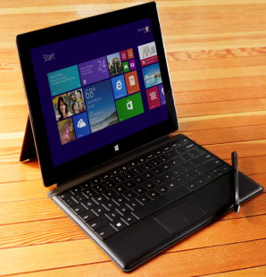
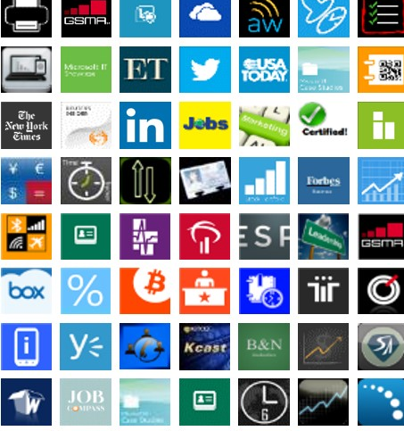

Windows: The right choice for retail
Best business
tablets and phones
Windows apps
for business
Enterprise-grade
security and
manageability

Slide 5

Windows: Best business tablets
Productivity and LOB support
Intel Core and Intel Atom-based tablets with the power of a PC streamline access to desktop LOB applications.
Multi-touch and traditional input options
Touch experiences streamline tasks and free hands; keyboard and mouse enable typing tasks.
Connectivity
Access the corporate network, the Internet, and other devices through broadband, Wi-Fi, and NFC.
Battery life
ARM and Intel Atom-based tablets can last a full day without recharging.

Slide 6

Windows: Great devices for retail
Thin and light
Portable, elegant ARM and Intel Atom-based tablets enhance sales experiences.
Fully digitized Stylus
Pen input options enable signature capture from customers and mobile computing with gloved hands.
Rugged form factors
Sturdy devices stand up to tough use in storerooms or on delivery routes with water, heat, and drop resistance.
Peripheral extensibility
Connect to card readers, barcode scanners and mobile printers through a variety of ports and connections.

Slide 7

Windows: Best business phones
The right device at the right price
Choose the right device for your organization with a suite
of Windows-ready devices from Lumia.
Anywhere productivity
Read and edit Office materials from anywhere
with seamless integration to O365 and other products.
One converged apps platform
With a unified app model and shared API set across Windows devices, easily access an app from across devices.
Unified, open device management
IT can push updates, configure accounts, and assist users
from anywhere and MDM support preserves consumer data.
Enterprise-grade security
Full-device encryption and trusted boot and Malware
protection allows secure access to data from anywhere.

Slide 8

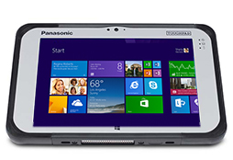
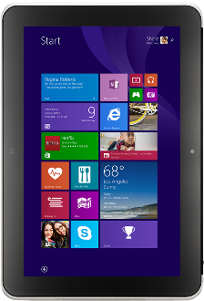
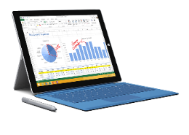
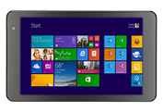
Windows tablets for every retail scenario
Surface Pro 3
Dell Venue 8 Pro
(LTE Option)
Panasonic ToughPad FZ-M1
HP ElitePad 1000
(LTE Option)
Intel Core processor (Pro)
Any position kick stand
Type cover with
magnetic fold
Soft-grade pen
Intel Core processor
Ruggedized for 4’ drop
Ready for extreme conditions
Daylight-readable screen
Intel Atom processor
All-day battery life
Nonslip grip
Pen input support
Intel Atom processor
All-day battery life
Jackets for expansibility
Extra battery

Slide 9
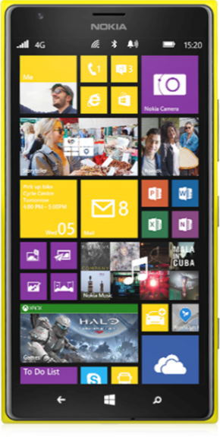
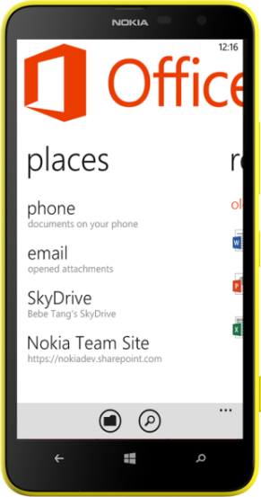
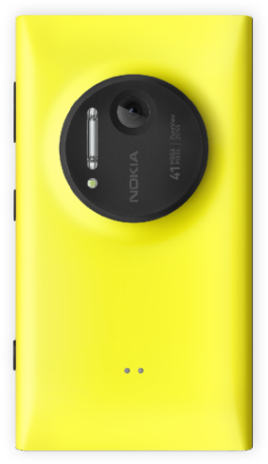
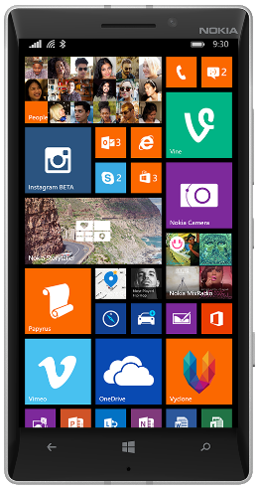
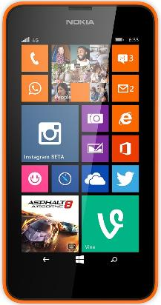
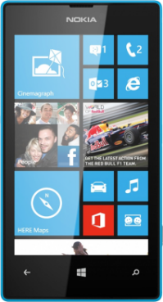
Windows Phones for every retail scenario
Lumia 1520
Lumia 1020
Lumia 1320
Lumia 930
Lumia 635
Lumia 520

Slide 10

Retail Scenarios

Slide 11



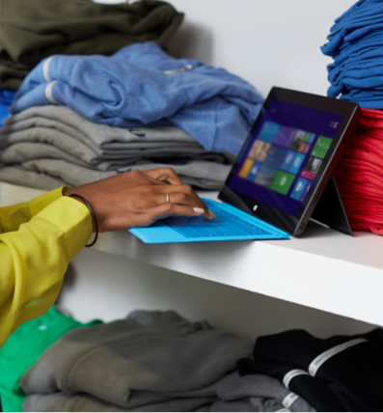
Retail scenarios
Assisted selling
Help sales associates improve customer service, boost productivity, and increase sales
Modern POS
Provide customers a convenient, fast purchase experience from anywhere in the store
Retail execution
Help field reps and merchandisers efficiently manage retail execution end to end
Store operations
Help associates and managers maximize operational efficiency

Slide 12

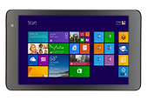
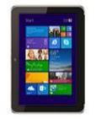


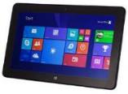
Assisted selling
Help sales associates improve customer service, boost productivity, and increase sales
Provide instant access to product information through associates’ devices or self-service kiosks.
Give associates insight into customers’ purchase history and loyalty program data.
Alert associates of cross-sell/upsell opportunities.
Complete the sale with mobile POS anywhere in the store.
Facilitate efficient communication and collaboration between associates and managers.
Dell Venue 8 Pro HP ElitePad 1000 Lenovo ThinkPad 8 Panasonic ToughPad 4K Dell Venue 11 Pro
(LTE Option) (LTE Option) (LTE Option)

Slide 13

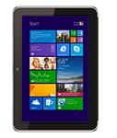
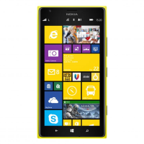

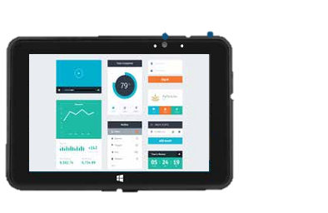

Modern
point-of-sale (mPOS)
Provide customers a convenient, fast purchase experience from anywhere in the store
Increase conversion rates and reduce abandoned carts with checkout service from anywhere in the store.
Reduce checkout wait times with “line-busting” mobile cashiers who can scan barcodes and swipe credit cards on the tablet.
Provide secure payment options to ensure your customers’ privacy.
Capture key loyalty data easily.
HP ElitePad 1000 Dell Venue 8 Pro Lumia 1520 Bluebird BM180 PARTech Tablet 8
(LTE Option) (LTE Option) & 930

Slide 14
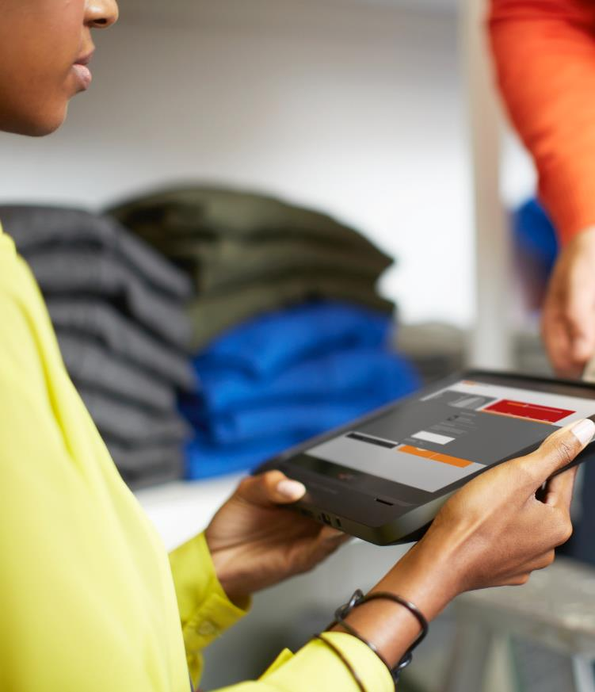
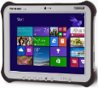

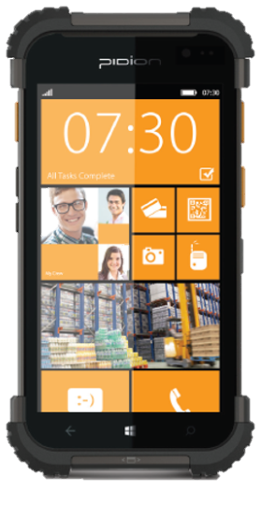
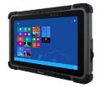
Retail execution
Help field reps and merchandisers efficiently manage retail execution end to end
Deliver real-time account and sales data that reps need to maintain brand appearance and keep shelves stocked.
Help field reps quickly recognize and correct branding and pricing issues.
Grant seamless access to sales history, inventory levels, and warehouse availability.
Enable “on the go” communication and collaboration with marketing, production, or warehouse.
Provide durable devices for virtually anywhere, any time access in rugged conditions.
Panasonic ToughPad Panasonic ToughPad Bluebird BP30 Lumia 1520 Winmate
FZ-M1 FZ-E1 BP30 & 930 M101B

Slide 15






Store operations
Help associates and managers maximize operational efficiency
Associates and managers track, transfer, and replenish inventory from anywhere in the store.
Increase store managers’ floor time and monitor
store KPI’s in real time.
Manage time & attendance, labor costs without leaving the floor.
Increase collaboration among employees, across stores, and between corporate headquarters.
Includes Task management, Workforce management, HR management, Loyalty.
Surface Pro 3 Dell Venue 11 Pro Bluebird BM180 ASUS Transformer Lumia 1520
(LTE Option) & 930

Slide 16
Apps for your business

Slide 17


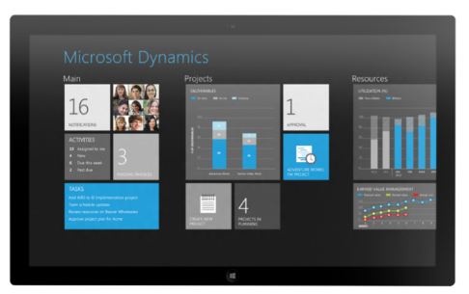
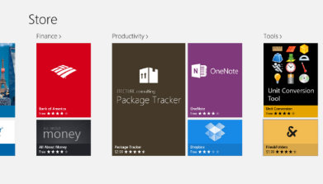

New Windows apps for business
Apps for your customers
Internal line of
business apps
Leading 3rd-party
line of business apps

Slide 18

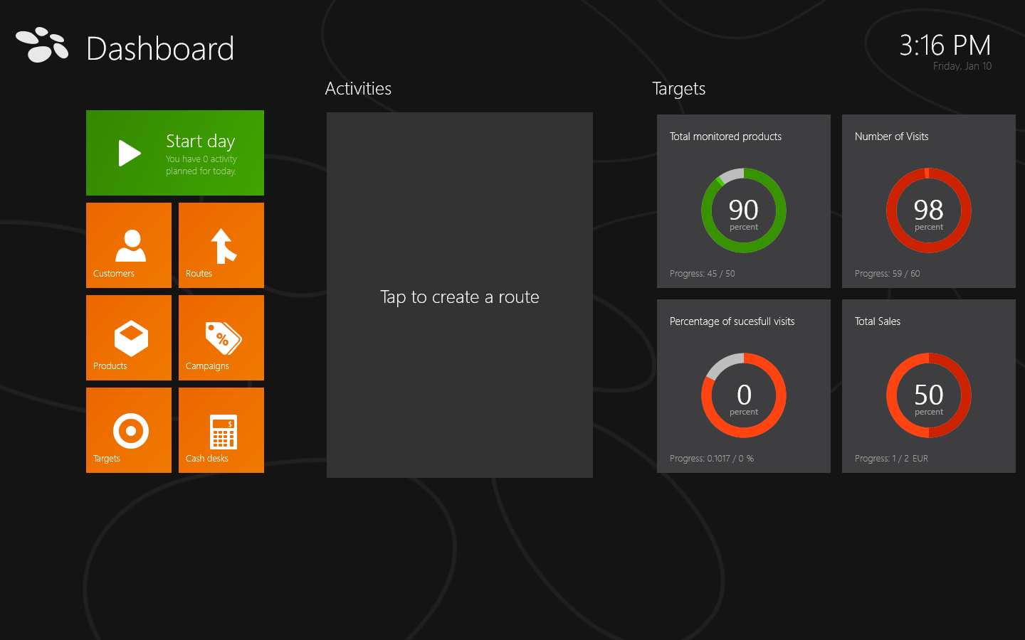
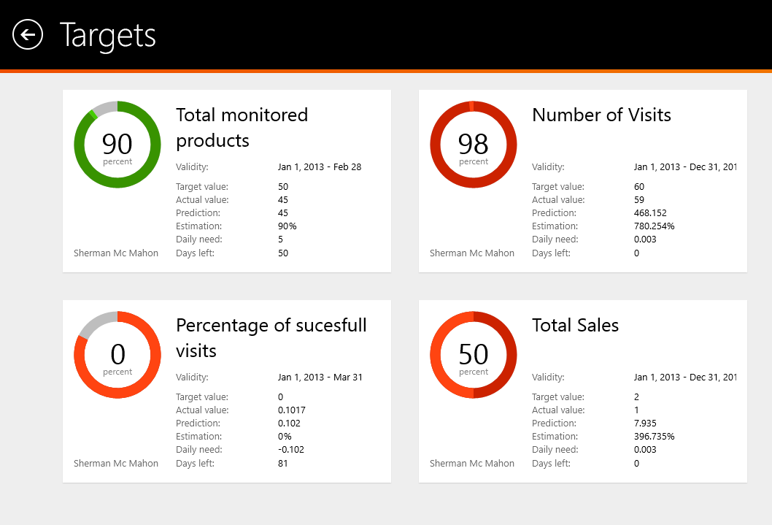
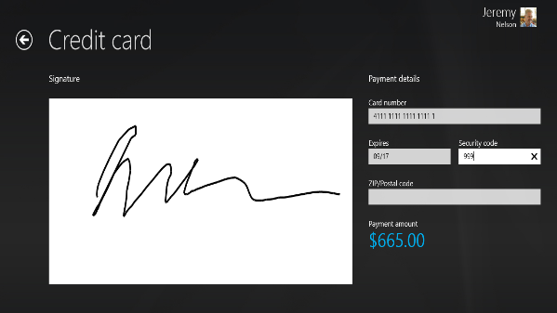
Go-to-market solution providers for retail
Assisted Sales
MS Dynamics AX for Retail
Avanade Oltiva Automotive Dealer/Manager
NCR: Sales Advisor
Retail Execution
Visicom SFA
MS Dynamics CRM
TXT Mobile
ESRI ArcGIS
Accenture CAS
mPOS
MS Dynamics AX for Retail
Micros: Simphony
Store Operations
JDA/Red Prairie Retail Store Operations & Workforce Management
MS Dynamics AX for Retail
O365 Retail Portal

Slide 19
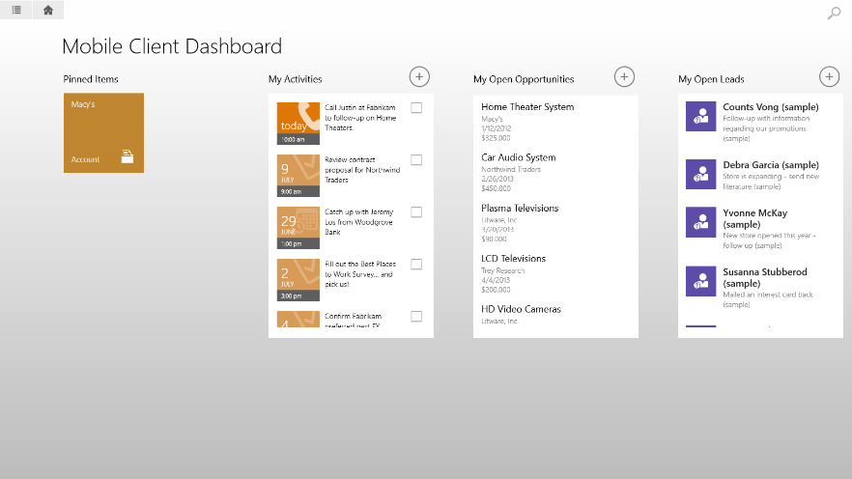
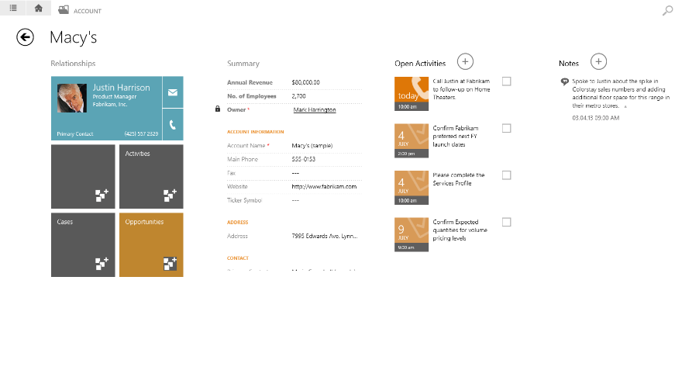
Microsoft
Dynamics CRM
Increase customer satisfaction with
real-time data
Maximize the potential of site visits with real-time reporting and analytics.
Provide field sales reps up-to-date account and sales data.
Help product managers make smart decisions and execute on them quickly.
Access rich contextual information including digital assets, availability, and pricing.

Slide 20

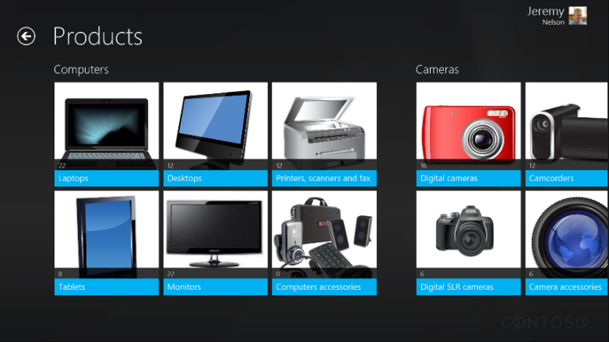
Microsoft Dynamics
Clienteling
Take your business to the next level
Provide a truly personalized shopping experience to customers.
Access customer profiles including transaction history and preferences.
View the full catalog, including product availability and product comparison.
Process sales and returns through tablet as Modern Point of Sale (mPOS).

Slide 21

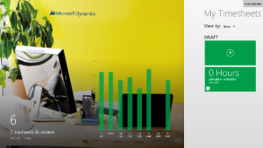
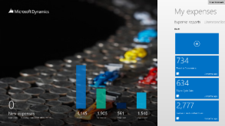
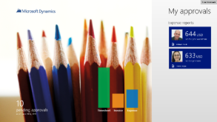
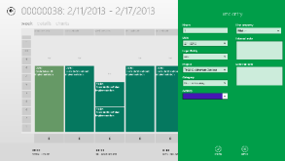
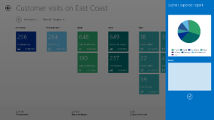
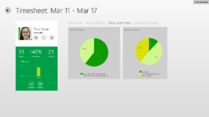
Time for
Microsoft Dynamics AX
Expense for
Microsoft Dynamics AX
Approvals for
Microsoft Dynamics AX
Employee self-service: Record time sheets for staff while on-the-go.
Allocate time to development activities.
Improve working capital through decreased billing cycle times.
Employee self-service: Record and reconcile expenses while travelling.
Allocate expenses to projects and activities.
Helps retailers better integrate expense policies.
Manager self-service: Stay on top
of approvals while on-the-go.
Reduce time spent on administrative processes like budget requests.

Slide 22
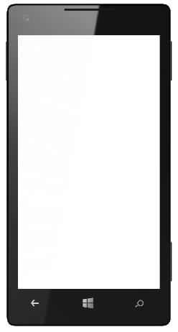
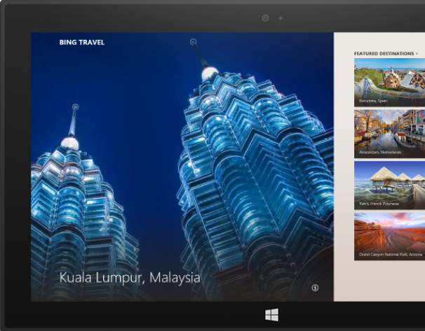

Use Windows apps across all devices
  User Benefits:
  Buy on any device and use on any device
  More apps and faster app updates
  Experience improvements in real time
  Developer Benefits:
  Windows API set and shared app model
  Converged controls and unified toolset
  One toolset to learn, one model to support

Slide 23

Enterprise-grade security and manageability

Slide 24

Retail security
challenges
Devices go "missing"
Retailers struggle to prevent tablets form being taken in highly unmanaged work environments.
Devices open access to sensitive data
Sales and supply chain data is highly sensitive and needs to be protected.
Unauthorized usage of apps
Multi-user devices create vulnerabilities with increased risk of unauthorized usage or unsecure applications.

Slide 25
Stay protected with Windows security capabilities
Malware resistance
Protect corporate data
Modern access control
  Built-in anti-malware solution
  Secured system start-up
  Core system hardening
  Sandboxed Windows Store apps
  Real time anti-phishing protection
  Device Encryption all editions
  Remote Business Data Removal
  Corporate encryption enforcement
  IP protection with Office IRM
  Corporate compliance with Lync
  Multifactor authentication
  Virtual smartcard support
  Biometrics
  TPM key attestation
  Certificate reputation
  Dynamic access control
Trustworthy hardware

Slide 26

Managing Windows devices
Governance
Full control
Exchange
ActiveSync
Mobile Device Management
via OMA-DM
Enterprise
Management
Windows provides choices
Choose a device based on the scenario or capabilities required
Enable employees to bring their own device

Slide 27
Offering a unified platform for modern business
Windows Azure Active
Directory Premium
Windows Azure
Rights Management
Windows Intune
Many apps, one identity
repository
Manage identities and
access to cloud apps
Monitor and protect
access to enterprise apps
Unify your environment
Protect your data
Protect your data
No on-premise infrastructure
required

Slide 28
Introducing the Enterprise Mobility Suite
Cloud/Hybrid Identity
Management
Enabled via Azure Active Directory Premium
Group management & security / audit reports
Self Service Password Reset & MultiFactor Authentication
Connection between AD / Azure AD
Enabled via Windows Intune
Mobile Device Management
Mobile device settings management
Mobile app management
Selective wipe
Enabled via Azure Rights Management Service
Information Protection
Information protection
Connection to on-premises assets
Microsoft Differentiation for EMS: One Vendor, One Contract, One SKU

Slide 29

Windows Embedded Industry
Offering a superset of Windows Pro with additional industry functionality.
Lockdown gestures, write access, and USB devices by serial number.
Enable more scenarios to support organizational needs.
Customize the lockdown to meet a variety of needs.
Windows Embedded Industry
(Pro, Enterprise)
Advanced Lockdown
Windows
(Pro, Enterprise)

Slide 30

Office in retail

Slide 31


Enterprise
grade
cloud
Essential productivity services
Enterprise-grade cloud
Essential productivity services
Office Vision:
Flexibility
and choice
Familiar
and easy
Productivity Cloud
Flexibility
and choice
Familiar
and easy

Slide 32


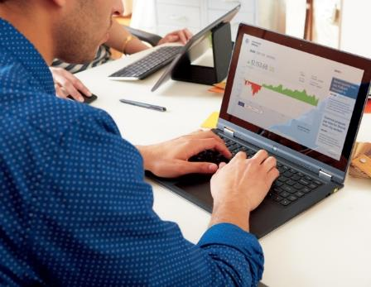

Office vision: Do your best work
Interactive
Expression
Enterprise
Social
Personalized
Insight
Responsible Empowerment
Office experiences on any device
Touch, ink, and voice
Live documents & data
Multi-media & HD presentations
Enterprise social
Cloud sharing
Real-time collaboration
Video, voice, and web conferencing
Small & Big Data access
Ad-hoc reporting and analysis
Natural language query
Visualization & geo-mapping
Device & Data Protection
DLP & Rights Management
Policy & compliance standards
eDiscovery

Slide 33

Windows devices in practice

Slide 34




Customer Evidence: Windows devices in retail
Sheraton Hotels & Resorts
The Habit Restaurants
Rooms To Go
New Belgium Brewing Company

Slide 35

Summary

Slide 36
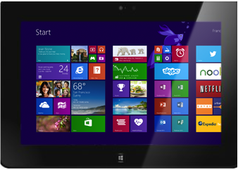
Windows mobile devices for retail
The power of the Microsoft suite…
in the palm of your hand
Engaging customers
Informing smart decisions
Increasing efficiencies

Slide 38
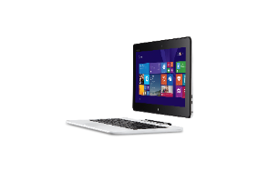
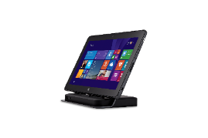


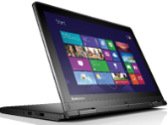

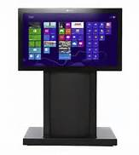

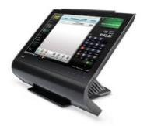
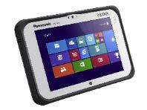

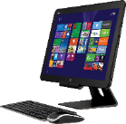
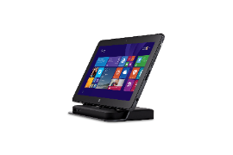






Range of Windows devices
Phones
2 in 1’s
Lumia 1020
Lumia 520
ASUS Transformer
Dell Venue 11 Pro
(LTE Option)
Lenovo ThinkPad Yoga
Surface Pro 3
Fujitsu LIFEBOOK T904
Small Tablets
Notebooks and All in Ones
Perceptive Pixel (PPI)
Dell Venue 8 Pro (LTE Option)
Lenovo ThinkPad 8
Toshiba Wave
Dell XPS 18
Panasonic ToughPad 4K
Dell XPS 27
Large Tablets
Embedded
Surface Pro 3
Dell Venue 11 Pro (LTE Option)
HP ElitePad 1000
(LTE Option)
Panasonic ToughPad FZ-G1
Winmate Durable
M101B
Partech Tablet 8
Bluebird PB30 & BM180
PolyTouch 22000
Availability and prices may vary by geography

Slide 39









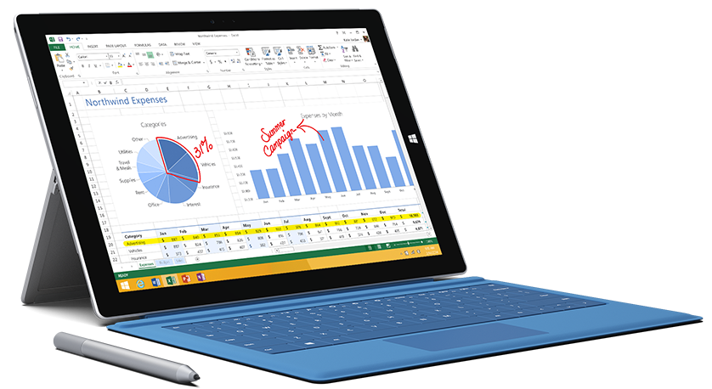




Windows devices for retail
Scenario | Devices | Desirable Feature | Processor Preference
mPOS |  | Lightweight, long battery life, security, manageability, durability | RT/Atom
Assisted Selling |  | Lightweight, long battery life, security, manageability, durability | RT/Atom
Store Operations |  | Long battery life, security, manageability, durability | Atom/Core
Retail Execution |  | Long battery life, security, manageability, durability | Atom/Core
HP ElitePad 1000
(LTE Option)
Dell Venue 8 Pro
(LTE Option)
Lumia 1520
& 930
Bluebird BM180
PARTech Tablet 8
ASUS VivoTab
Note 8
Dell Venue 8 Pro
(LTE Option)
HP ElitePad 1000
(LTE Option)
Lenovo ThinkPad 8
Panasonic ToughPad 4K
Dell Venue 11 Pro
(LTE Option)
ASUS VivoTab
Note 8
Fujitsu Arrows
Tab Q704/H
Surface Pro 3
Surface Pro 3
Dell Venue 11 Pro
(LTE Option)
Bluebird BM180
ASUS Transformer
Lumia 1520
& 930
HP ElitePad 1000
(LTE Option)
Panasonic
ToughPad FZ-M1
Panasonic
ToughPad FZ-E1
Bluebird BP30
Lumia 1520
& 930
Winmate M101B
Dell Venue 8 Pro
(LTE Option)
Lenovo ThinkPad 8
Asus VivoTab
Note 8

Slide 40






Range of embedded devices
Bluebird BM180
Dual-Core Cortex-A15 Processor
8 MP with LED flash
Barcode Scanner
5” HD display
1.2 m/4ft drop-ready
Bluebird BP30
Dual Core Coretex-A15
5” screen
2D barcode scanner and HF RFID reader
Long battery life
1.8m drop-ready
Empathy EM07
7” Screen with 8 hrs. Battery life
BT 4.0/ NFC/RFID/MSR/IC Reader
Bay Trail Support
IP-65 with PCI-PTS
Empathy EM10
E3800 Intel Atom processor
10.1” LCD display
Long battery life (up to 16 hours)
5 MP camera with LED flash
PARTech Tablet 8
Small, lightweight & reliable
Long battery life (up to 10 hours)
Supported and Backed by PAR
Software Partner Ecosystem Support
Winmate M101B
4G LTE
Intel ® Celeron N2920 Quad Core 1.86GHz processor
10.1” IPS LED display
IP65 water and dust proof

Slide 41









Choose the model that fits your business
 | Lumia 1520 | Lumia 1320 | Lumia 1020 | Lumia 930/ICON | Lumia 925 | Lumia 635 | Lumia 625 | Lumia 520
Business features across the range | Microsoft Office and Outlook, Word, PowerPoint, Excel, OneNote, HERE navigation apps with offline support, Internet Explorer, OneDrive, Lync, SharePoint, IBM Notes Traveler, security, device management, private apps, in-house & cloud support
Data network | 4G/LTE | 4G/LTE | 4G/LTE | 4G/LTE | 4G/LTE | 4G/LTE | 4G/LTE | 3G
Processor | 2.2 GHz Quad-Core | 1.7 GHz Dual-Core | 1.5 GHz Dual-Core | 2.2 GHz Quad-Core | 1.5 GHz Dual-Core | 1.2 GHz Quad-Core | 1.0 GHz Dual-Core | 1.0 GHz Dual-Core
Wireless charging | Built in | No | Accessory cover | Built in | Accessory cover | No | No | No
Changeable shells | Yes | No | No | Yes | No | Yes | Yes | Yes
NFC | Yes | No | Yes | Yes | Yes | No | No | No
Primary camera | 20 MP Zeiss dual led flash | 5 MP led flash | 41 MP Zeiss xenon flash | 20 MP Zeiss dual led flash | 8.7 MP Zeiss dual led flash | 5 MP | 5 MP led flash | 5 MP
Front camera | HD 1.2 MP wide angle | VGA | HD 1.2 MP wide angle | HD 1.2 MP wide angle | HD 1.2 MP wide angle | No | VGA | No
Display | 6” Clearblack Oled | 6” LCD | 4.5“ Clearblack Amoled | 5” Clearblack Oled | 4.5" Clearblack Amoled | 4.5" Clearblack LCD | 4.7“ LCD | 4“ Clearblack LCD
Supersensitive touch | Yes | Yes | Yes | Yes | Yes | Yes | Yes | Yes

Slide 42

Windows:
Assigned Access
Enables a single Windows Store app experience on the device
User only experiences
the specified app
Unable to access system files
and other apps
Windows Embedded Industry: Broader set of device lockdown capabilities (ATMs, etc.)

Slide 43



Advanced Lockdown with WE Industry
Multi App Lockdown
Multi Role Lockdown
Boot to Application

