Slide 1

We’re living in a changed world.
Notes:
***Before*** you switch to this slide (perhaps on your title/welcome slide), say:
Before we talk about [YOUR TOPIC HERE], I want to share more with you about our company’s mission and how it drives who we are and everything we do, including how it shapes our corporate purpose.
[Then, switch to this slide]
The world continues to confront compounding health, economic, and humanitarian crises; ongoing racial injustice and inequality; and the devastating impacts of climate change.
And while there is great potential for technology to help address society’s biggest issues, the pace of this change is also raising new challenges and intensifying existing inequities in our communities.
As we drive economic growth, we must also commit to creating a more inclusive, equitable, sustainable, and trusted future for everyone.

Slide 2
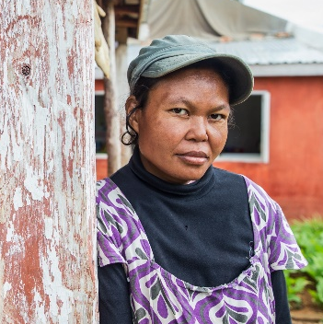
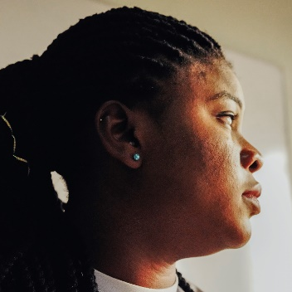
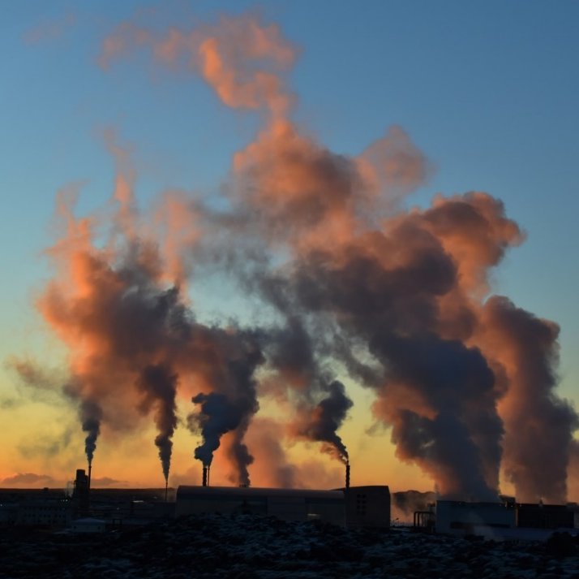
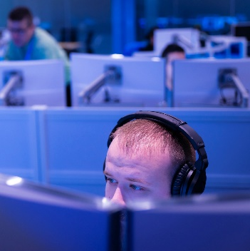
The pace of change is raising challenges and intensifying existing inequities
Inequitable access to economic growth
Persistent fundamental rights issues
An urgent climate crisis
Diminishing trust in technology
Notes:
To help people and organizations everywhere achieve more, we focus on four commitments: support inclusive economic growth, protect fundamental rights, create a sustainable future, and earn trust.
We continue to face ongoing global health, economic, and geopolitical crises that are disproportionately impacting our most vulnerable communities. Access to economic growth is far from equitable.
On top of this, recent events have highlighted the persistent need to address longstanding racial injustice and to defend democracy around the world. We must protect the fundamental rights of all people, ensuring technology protects and empowers everyone and exploits no one.
And, as other challenges grow and persist, so too does the climate crisis. Addressing climate change is the defining issue of our generation. Now is the time for urgent action.
Lastly, trust in technologies and the companies behind them continues to erode. It’s critical that we apply technology and innovations to address these challenges without sacrificing core values like trust, privacy, transparency, and inclusion.

Slide 3
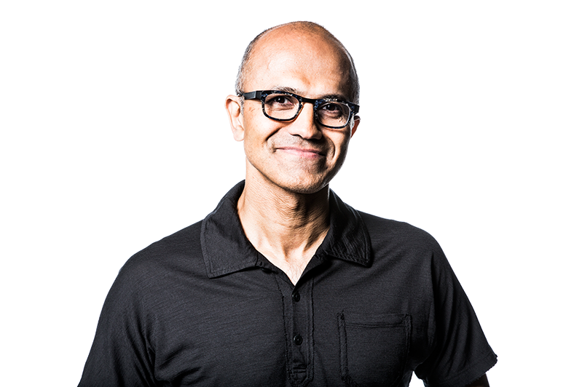
Companies that can do more, should do more
At a time when many are calling attention to the role technology plays in society, our mission remains constant.
It grounds us in the enormous opportunity and responsibility we have to ensure that the technology we create benefits everyone on the planet, including the planet itself.
– Satya Nadella, CEO, Microsoft
Notes:
In the face of the world’s pressing challenges and extraordinary opportunities, we believe that companies that can do more, should do more. And we are.
Our mission to empower every person and every organization on the planet to achieve more has never been more relevant or pressing.
With more than 400,000 partner organizations employing over 22 million people, thousands of suppliers, and customers of every size, in every industry, and in every part of the world, we have an enormous opportunity and responsibility to effect change through our ecosystem.

Slide 4
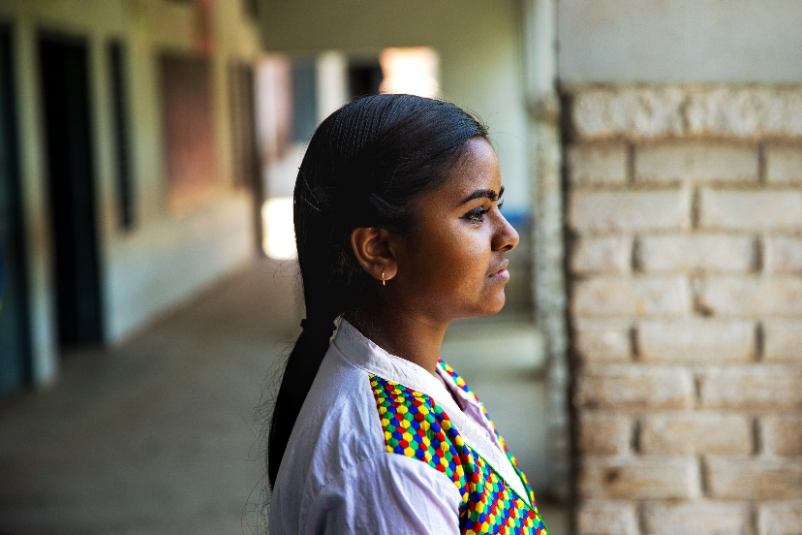
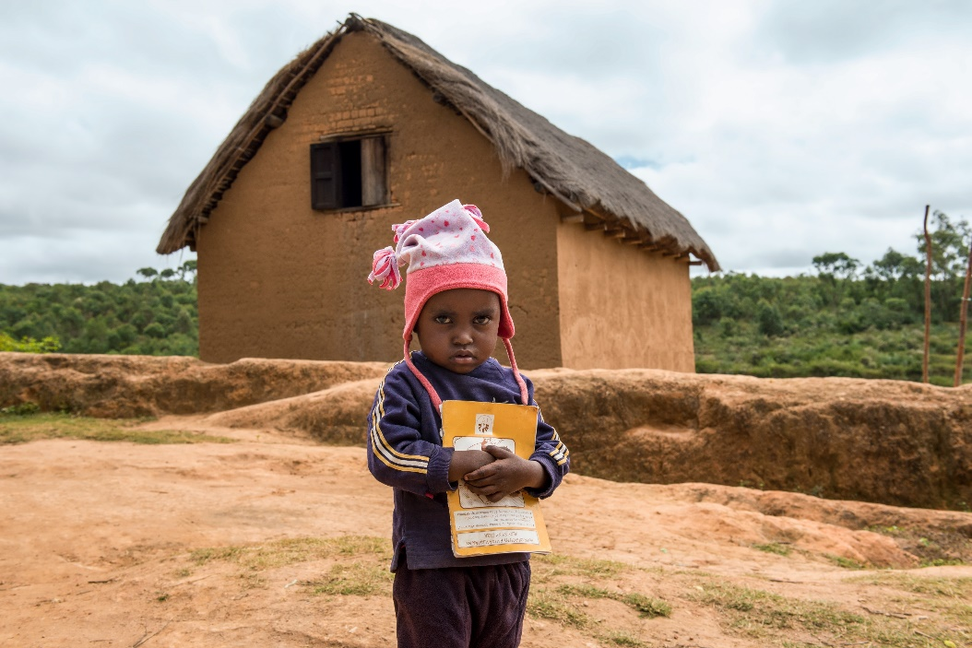
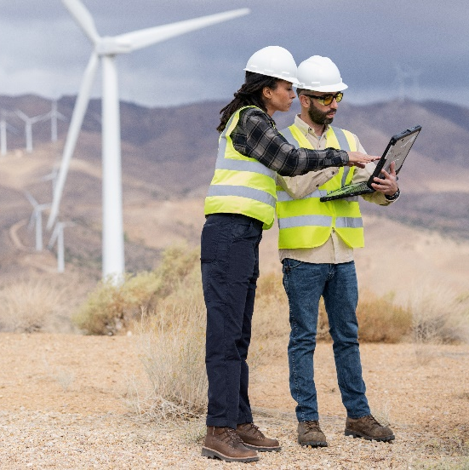
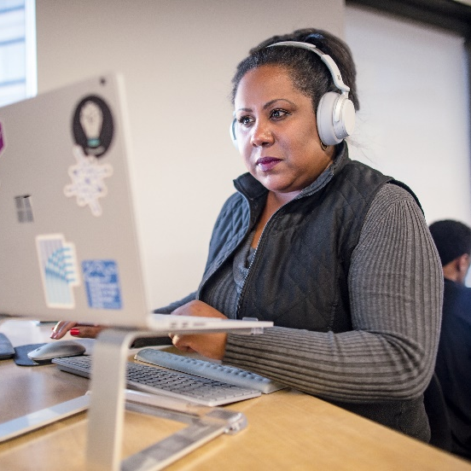
Together, we can reimagine a better future
Support inclusive
economic growth​
Protect
fundamental rights
Create a
sustainable future​
Earn trust
Learn more: Microsoft.com/impact
Notes:
We also know that the challenges facing people and the planet are complex, and no one company, sector, or even country can solve them alone. To reimagine a better future, we must work together.
That’s why we’re committed to working across the sectors to foster partnerships and solutions that will have lasting impact across four interconnected commitments:
Support inclusive economic growth. We believe that economic growth should be inclusive—for every person, organization, community, and country. This starts with increasing access to digital skills and extends to closing the data divide and supporting public health.
Protect fundamental rights. We must unequivocally support the fundamental rights of all people, from defending democracy, to protecting human rights, to addressing systemic racial injustice and inequity around the world. And, as education, healthcare, and other critical services become increasingly dependent on technology, access to broadband and accessible technology are also fundamental to a more equitable future.
Create a sustainable future. We must address climate change for a more sustainable future. Climate change is the defining issue of our generation, and addressing it requires swift, collective action and technical innovation. That’s why we’ve outlined ambitious commitments and detailed plans to achieve them, and we’re helping others set and achieve their own climate goals.
Earn trust. Finally, we recognize that if people don’t trust the technologies or the companies behind them, progress is not possible. That’s why – every day – we strive to earn the trust of our customers, our employees, the communities we serve, and the governments that represent them through a commitment to privacy, cybersecurity, digital safety, responsibly AI, and transparency.
Now is the time for urgent action. We invite you to learn more at Microsoft.com/impact and to join us in reimagining a better future. Because each of us must commit to do more for us all to achieve more.
**OPTIONAL TRANSITION TO VIDEO**: Let’s hear from our President, Brad Smith, about why we’re committed to societal impact and how Microsoft is trying to drive change in the world around us… [ROLL VIDEO ON NEXT SLIDE]
[if you’re not playing the video, continue with the transitions below]
TRANSITION OPTION A:
Now that you know more about our mission and how we’re ensuring people and organizations everywhere can achieve more, let’s talk more about how we can work together to help your organization/company do the same.
TRANSITION OPTION B:
With this overarching commitment in mind, I’d like to share more with you about [YOUR TOPIC] and how it can help us [CONTRIBUTE TO ONE OF THE GOALS ABOVE].
EXAMPLES:
…share more about Accessibility and how it is critical to inclusive economic growth
…share more about Open Data and how it can help support inclusive economic growth
…share more about our work on Defending Democracy and how it helps us protect fundamental rights
…share more about our data centers and the steps we are taking to create a sustainable future
…share more about Azure and how it can help you build trusted technology
…share more about our Digital Crimes Unit and how it helps us advance security and earn trust.

