Slide 1
Welcome to the Executive Briefing Center
Briefing Guidelines
What you need to know about Microsoft’s facility guidance and policies during COVID-19

Slide 2
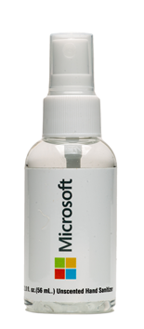
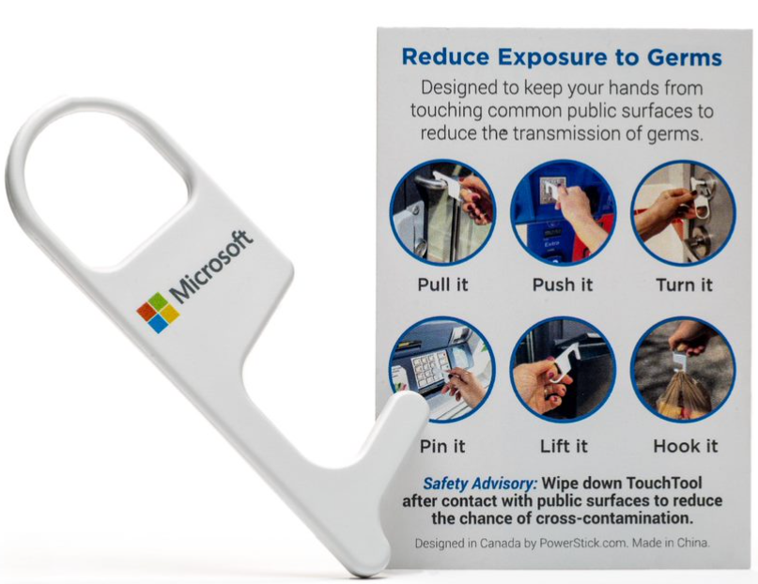
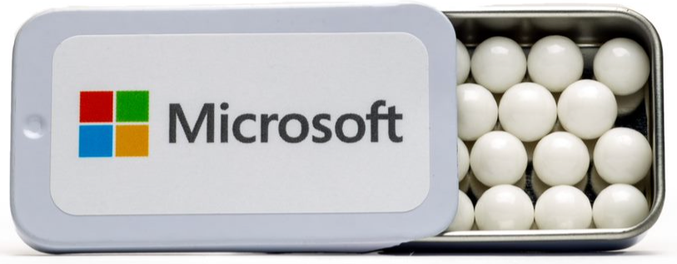
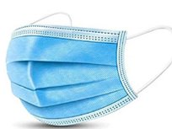
Personal accountability
Personal accountability
All of us have an important role to play in keeping our workplace healthy. To keep our facilities safe, we are asking everyone to take personal accountability for ​their own health. This involves:​
Practicing good hygiene (as outlined in the Health, safety and wellness practices section)​.
Monitoring yourself for COVID-19 symptoms, including daily temperature checks.
Following policies and personal accountabilities.

Slide 3
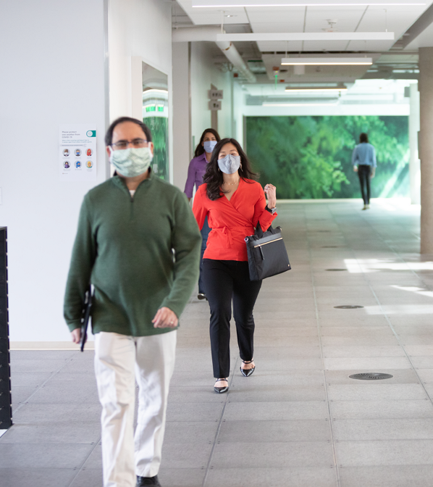
What to do if you feel unwell
What to do if you feel unwell
If you feel unwell, don’t come to a Microsoft facility and please contact your health care provider.
If you start to feel unwell with COVID-19 symptoms while at a Microsoft facility, please take the following actions:
Return home or the place you are staying to avoid exposing others.
If you are a Microsoft employee, confidentially notify HR that you were sick while on site via aka.ms/reportcovid19..
If you are a customer, partner, or external staff, please follow your employer’s reporting procedures. You can also confidentially notify Microsoft that you were sick while on site via aka.ms/reportcovid19..
Consult with your health care provider.
Stay home until you meet the criteria to come back on site.
If you are unable to leave the Microsoft facility independently or need assistance gathering belongings, please call Microsoft Security at +1-425-706-0000 anytime for assistance. While security is assisting you, you may be asked to self-isolate in a conference room.

Slide 4
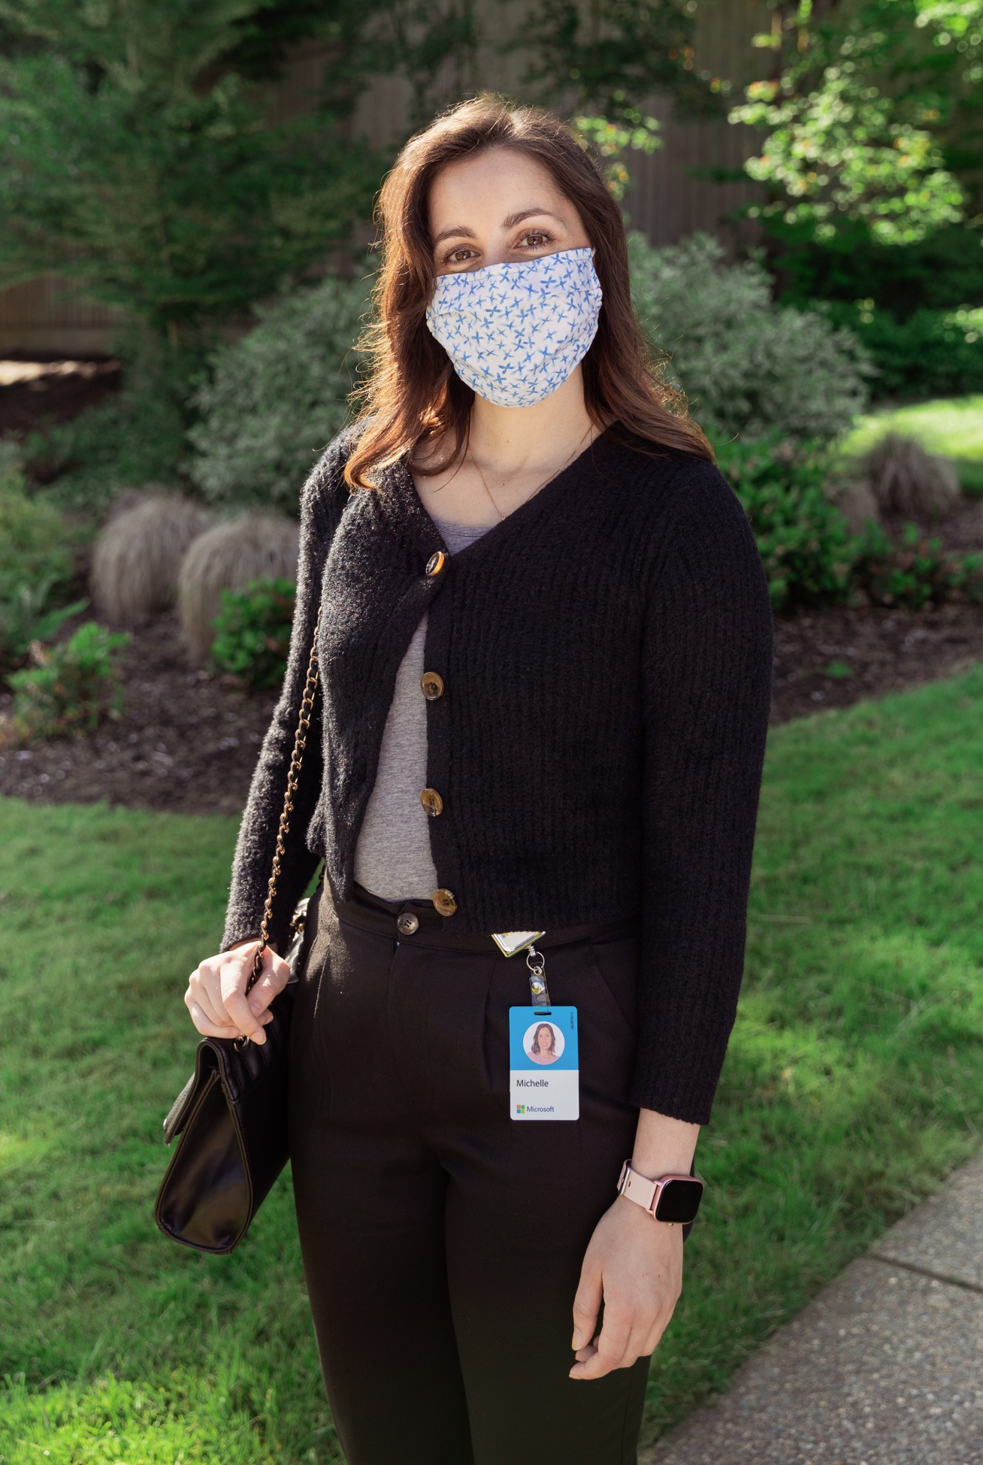
What to do if you feel unwell
What to do if you contract COVID-19
If you are a customer, partner, or external staff, you should follow your employer’s reporting procedures. If you feel you were in close contact with Microsoft staff within 48 hours of diagnosis we request, through your reporting procedures, Microsoft should be notified via aka.ms/reportcovid19.
If you are an employee diagnosed with COVID-19, you notify Microsoft via aka.ms/reportcovid19. This will help us support your next steps and properly protect others from exposure while maintaining your confidentiality. Microsoft will work with local public health authorities to conduct an exposure investigation, privately notify anyone who was in close contact with you, clean facilities, and take any other necessary steps.
Before reentering any Microsoft facility, at least 5 days will need to have passed since your symptoms first appeared or you tested positive if you have had no symptoms.

