Slide 1
1
2
3
4
5
6
7
8
9
10
11
12
13
14
15

Slide 2
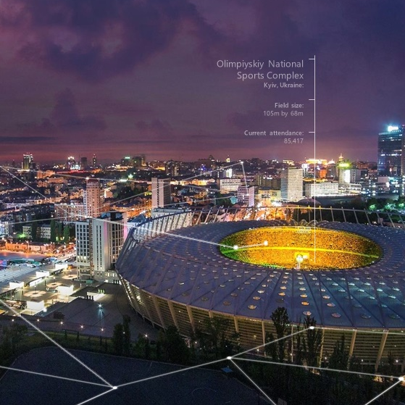
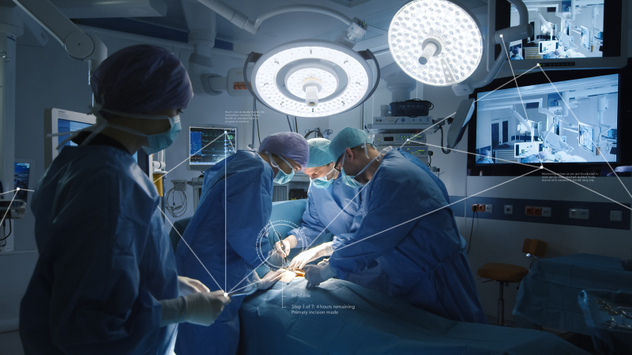
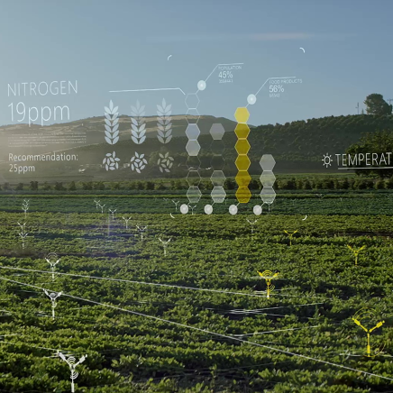
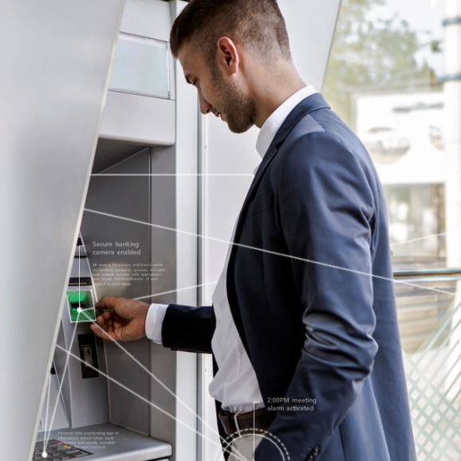
2
4
3
1
5
7
10
Tint
6
Thank you
Opportunity
9
Intelligent Cloud
Intelligent Edge
15
11
14
12
8
13

Slide 3
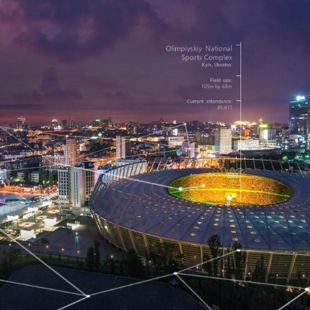
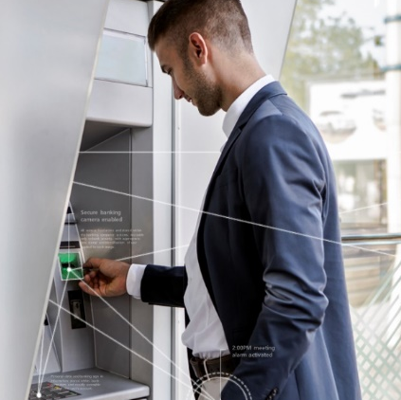
Shadow
Tint
Opportunity

Slide 4
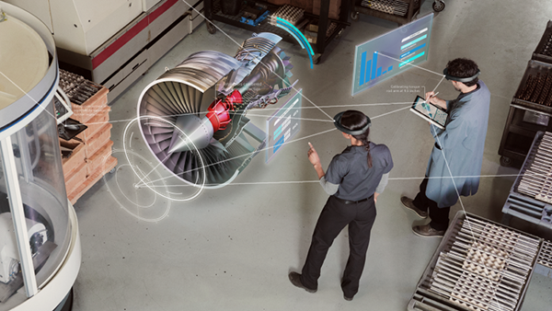
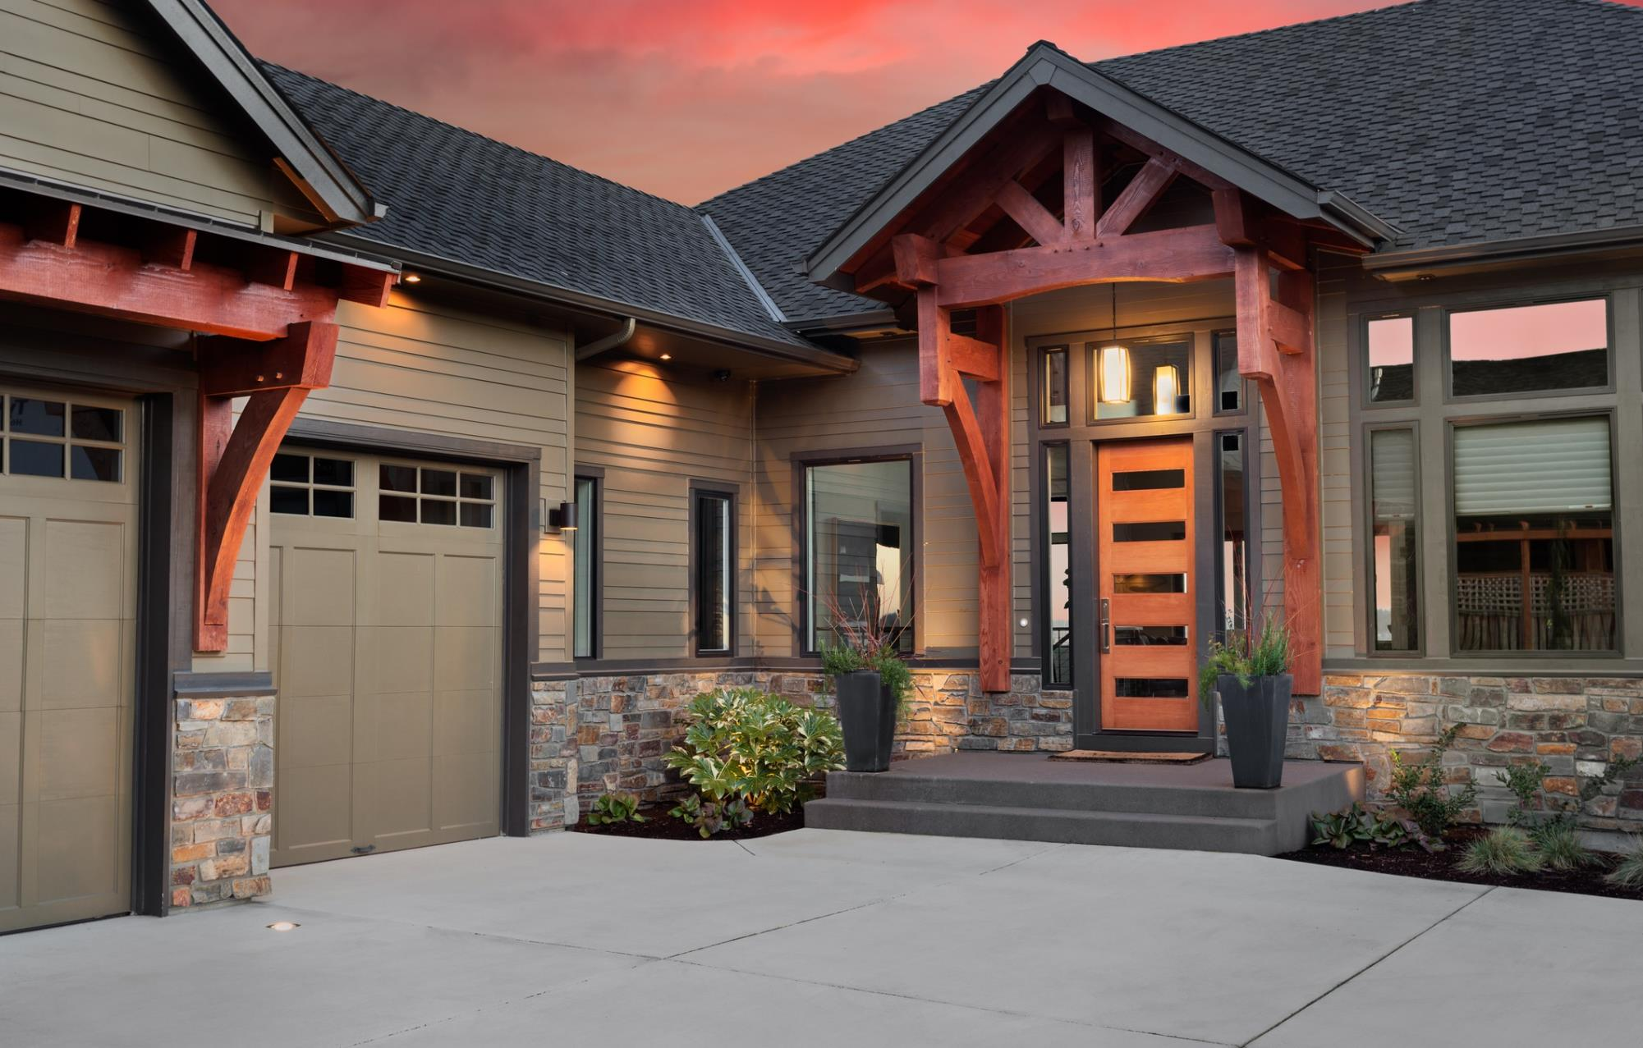
Shadow
Tint
Opportunity
3:00PM meeting synced
6:00PM Anniversary Dinner Chez Gardinier
Last server download 09/04/2018. Security monitor enabled. Data download blocked from personal devices. Keyword enabled for singular security device.
Lights on automatic timer 5:30PM
Door locked at 4:00PM
Home Security System enabled

Slide 5
BP stable
Step 3 of 7: 4 hours remaining Primary incision made
3:00PM meeting synced
6:00PM Anniversary Dinner Chez Gardinier
Monitoring system secure and downloaded to main server. Video playback enabled. To be shared with residence in the left wing only.
Last server download 09/04/2018. Security monitor enabled. Data download blocked from personal devices. Keyword enabled for singular security device.
Heart rate at steady rhythm. No immediate concerns. Patient health at premium level for surgical procedure.

Slide 6
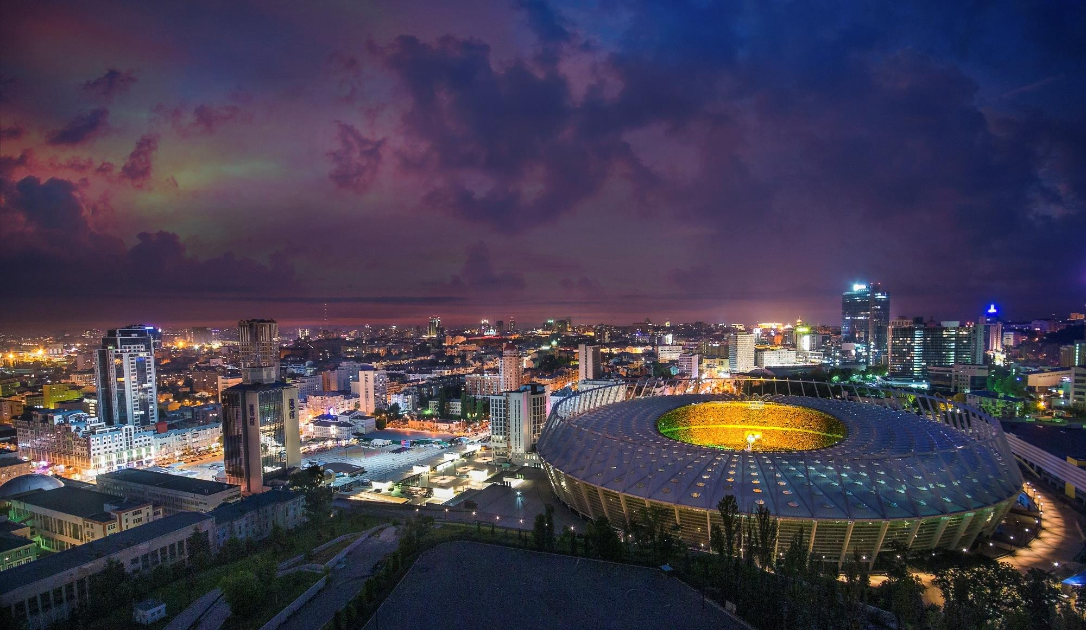
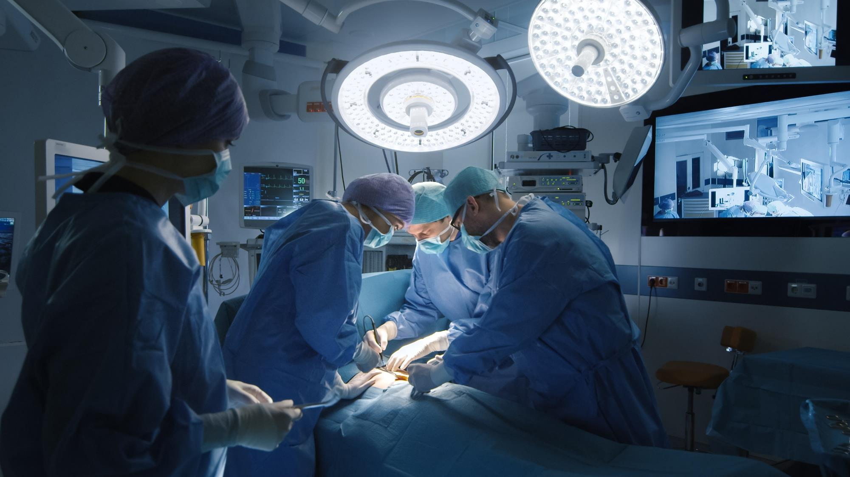
Olimpiyskiy National Sports Complex
Kyiv, Ukraine:
Field size:
105m by 68m
Current attendance:
85,417
BP stable
Step 3 of 7: 4 hours remaining Primary incision made
Monitoring system secure and downloaded to main server. Video playback enabled. To be shared with residence in the left wing only.
Heart rate at steady rhythm. No immediate concerns. Patient health at premium level for surgical procedure.

Slide 7
Olimpiyskiy National Sports Complex
Kyiv, Ukraine:
Field size:
105m by 68m
Current attendance:
85,417
Due for maintenance 01/14/2020
Metal to wear down in this part. Replacement backordered and to be shipped by 01/04. Detrimental to system if not applied immediately.
Running at 98% capacity
Automated system engaged 24-hour motor function
76%

Slide 8
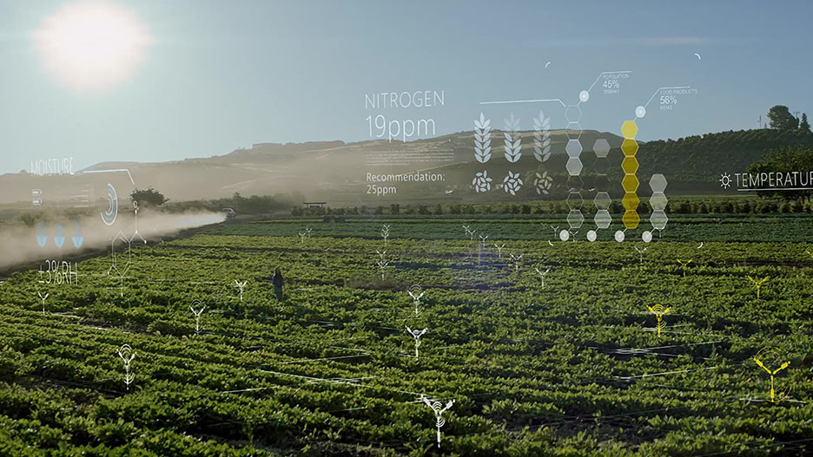
Due for maintenance 01/14/2020
Metal to wear down in this part. Replacement backordered and to be shipped by 01/04. Detrimental to system if not applied immediately.
Running at 98% capacity
Automated system engaged 24-hour motor function
76%

Slide 9
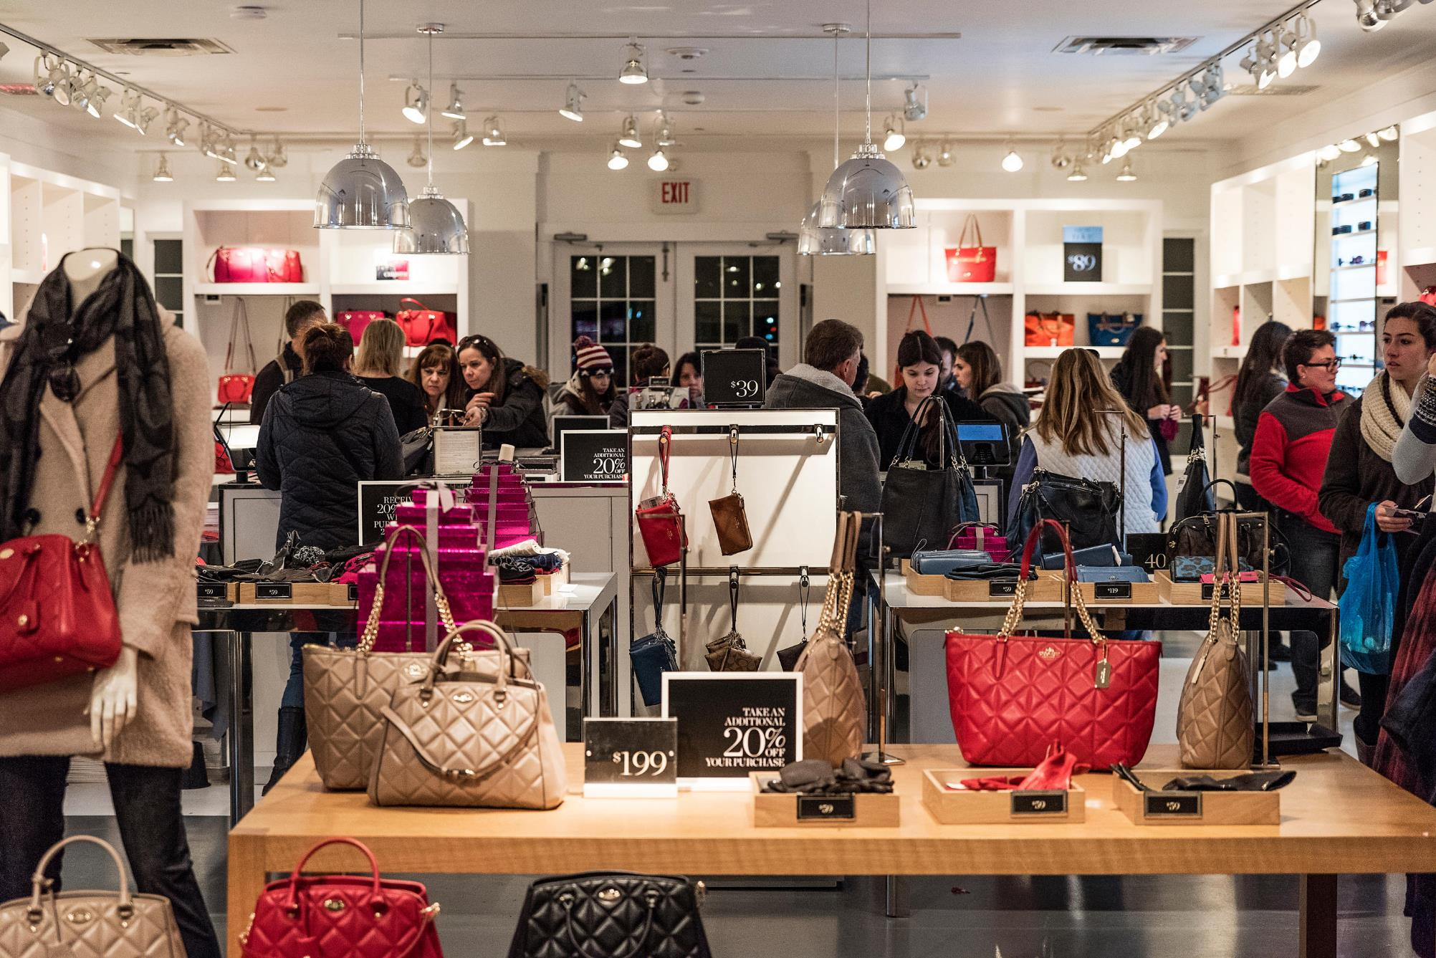
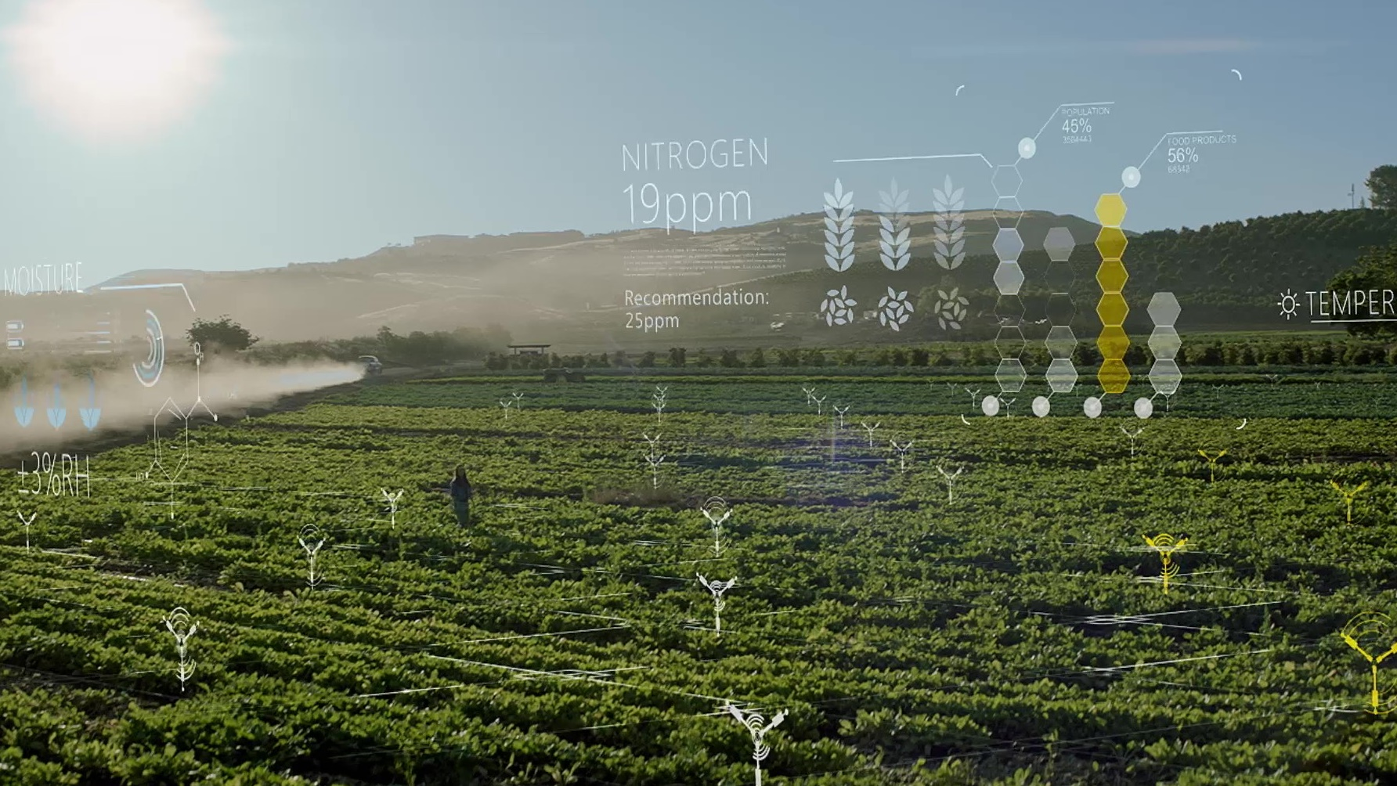
Customer data recorded and applied
Smart device applies all sales available to items collected

Slide 10
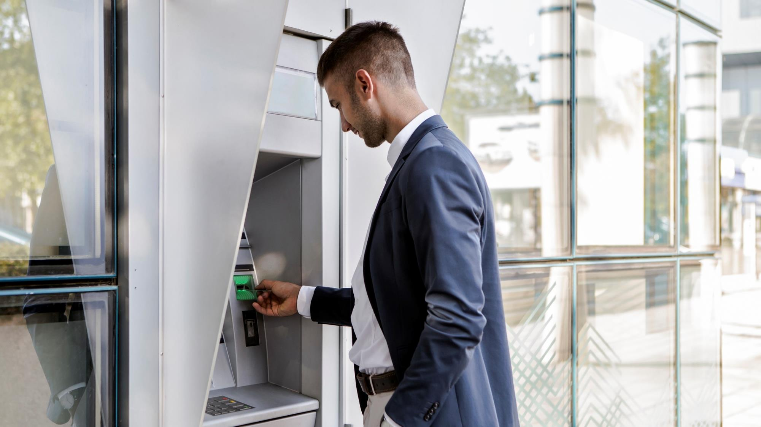
Customer data recorded and applied
Smart device applies all sales available to items collected
Secure banking camera enabled
All camera feed active and stored within the banking computer systems. Accessible only to bank security, with appropriate time stamp and identification of user applied to each image.
2:00PM meeting alarm activated
Personal data and banking sign in information stored within bank computers and readily accessible through the user’s account.

Slide 11
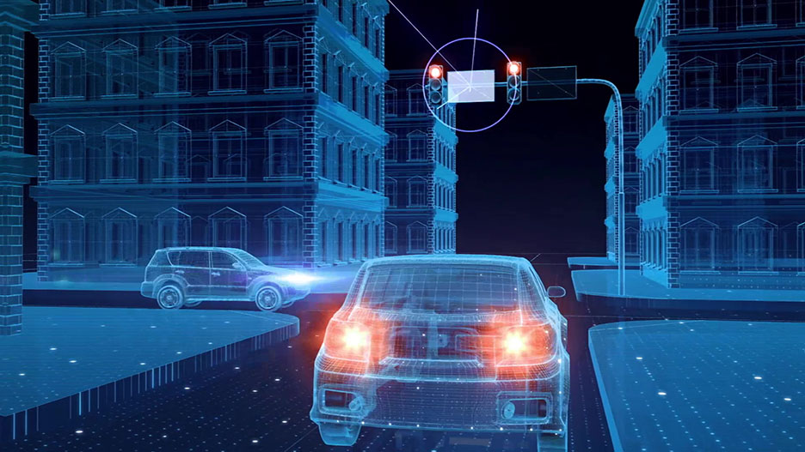
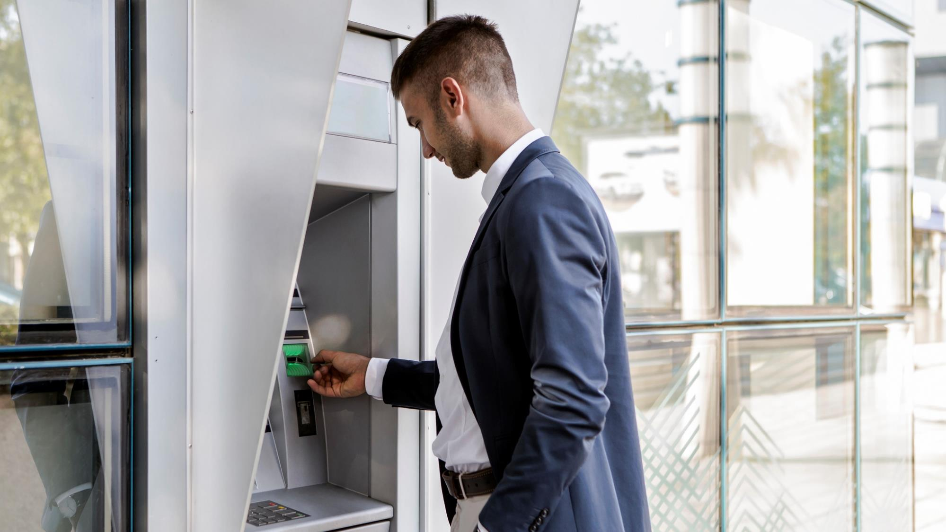
Scanning intersection
Westbound vehicle approaching Northbound signal currently red
Intersection clear
Proceed to Goldfinch Ave and turn left
Destination will be on the right
Vehicle approaching from left at 28 MPH
Secure banking camera enabled
Unsecured wireless network detected
All camera feed active and stored within the banking computer systems. Accessible only to bank security, with appropriate time stamp and identification of user applied to each image.
2:00PM meeting alarm activated
Personal data and banking sign in information stored within bank computers and readily accessible through the user’s account.

Slide 12
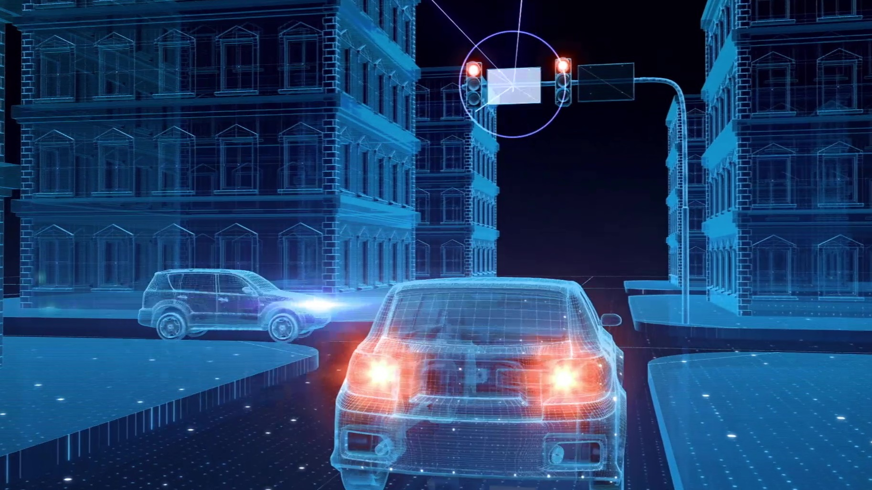
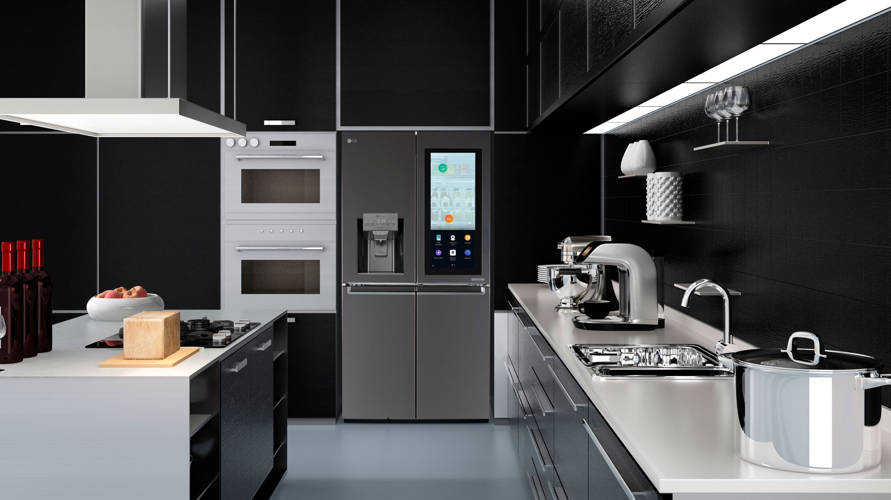
Scanning intersection
Westbound vehicle approaching Northbound signal currently red
Lighting schedules to recess after 5:00PM. Dimmers set on schedule with family hours for workdays, and set to 6:00PM dimming for weekends.
Oven set to automatically alarm if left on without substance inside. Will record heat of dish internally and externally and send information to fridge voice activation to notify the chef
6:30PM
Dinner with the Neilsons Pork roast, asparagus, potatoes
7:00AM timer enabled for automatic start
Intersection clear
Proceed to Goldfinch Ave and turn left
Destination will be on the right
Vehicle approaching from left at 28 MPH
Unsecured wireless network detected

Slide 13
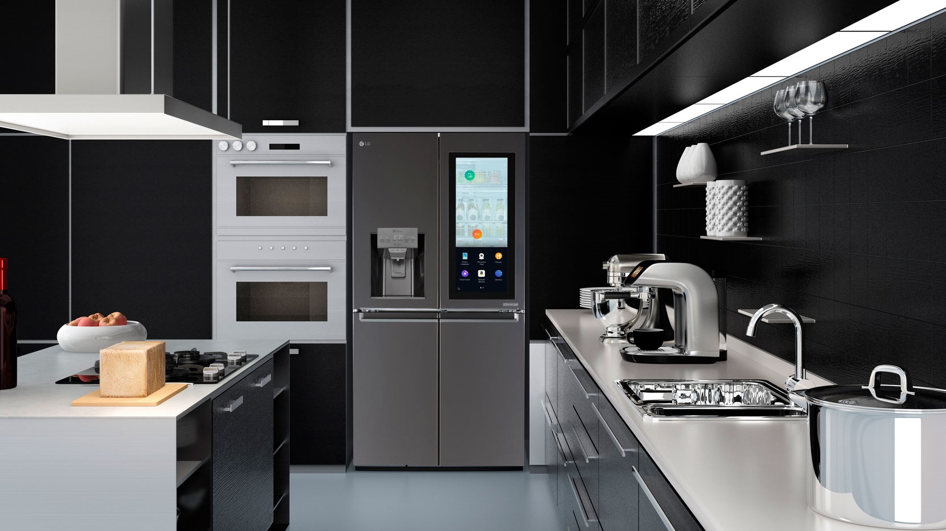
Lighting schedules to recess after 5:00PM. Dimmers set on schedule with family hours for workdays, and set to 6:00PM dimming for weekends.
Oven set to automatically alarm if left on without substance inside. Will record heat of dish internally and externally and send information to fridge voice activation to notify the chef
Intake fins cambered for proper induction
Calibrating torque rod arm at 8.5 inches
Compression system functioning at full capacity
Combustion system functioning at full capacity
Error detected in exhaustion system
Exhaustion system error reported to manager for further inspection
6:30PM
Dinner with the Neilsons Pork roast, asparagus, potatoes
7:00AM timer enabled for automatic start
Tech intensity

Slide 14
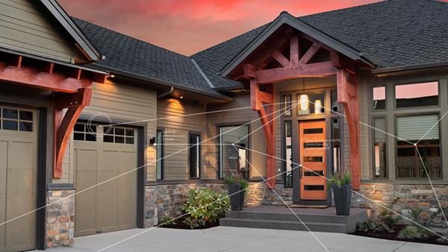
Tint
Intake fins cambered for proper induction
Calibrating torque rod arm at 8.5 inches
Compression system functioning at full capacity
Combustion system functioning at full capacity
Error detected in exhaustion system
Exhaustion system error reported to manager for further inspection
Tech intensity
Tech intensity

Slide 15
Tint
Tech intensity

Slide 16
Tint
Tech intensity
=
(Tech adoption)ˆTech capability

Slide 17
Microsoft mission
Empower every person and every organization on the planet to achieve more

Slide 18
Gaming
Empower employees
Modern life
Engage customers
Modern workplace
Business applications
Intelligent Cloud
Optimize operations
Applications & infrastructure
Intelligent Edge
Transform products
Data & AI

Slide 19
Tint
Tech intensity

Slide 20
Tint

Slide 21
Tint
Tech intensity

Slide 22
TBD
Shantanu Narayen
CEO
Adobe Systems
Bill McDermott
CEO
SAP
PARTNERS ON STAGE

Slide 23
8
9
57
4
5
56
6
Customer experience
53
7
54
55
3
1
49
Mobile/Web
Marketplace
48
47
a
f
51
13
2
50
52
10
40
46
Advertising
Transactions
14
e
b
12
41
15
45
11
IoT
Social
39
16
c
d
32
20
42
44
25
29
31
17
19
38
18
26
43
21
22
30
36
27
24
33
35
37
23
28
34

Slide 24
Customer experience
Internal and external silos
Mobile/Web
Transactions
IoT
Social
Advertising
Marketplace
a
b
c
d
e
f
9
48
32
29
17
57
1
47
20
13
56
25
31
14
53
3
46
42
19
38
6
26
36
54
40
30
10
55
8
44
43
21
15
2
22
33
12
49
51
4
41
24
35
27
37
16
7
45
18
52
5
39
23
34
50
28
11

Slide 25
TBD
Announcing
Open Data Initiative Principles
PARTNER ANNOUNCEMENT
Reimagining customer experiences

Slide 26
Announcing
Open Data Initiative Principles
Customer ownership and control
AI-driven business outcomes
Open and extensible
Reimagining customer experiences

Slide 27
Open Data Initiative, join us
Open Data Initiative Principles
Own, enrich, renew your data
Adobe
Customer Experience Platform
Microsoft
Dynamics 365
SAP
SAP C/4HANA and SAP S/4HANA
…
a
e
c
One data model
d
b
f
Microsoft Azure
Data and AI

Slide 28
Open Data Initiative Principles
Open Data Initiative, join us
Open Data Initiative
Own, enrich, renew your data
Adobe
Customer Experience Platform
Microsoft
Dynamics 365
SAP
SAP C/4HANA and SAP S/4HANA
…
a
e
c
One data model
d
b
f
Microsoft Azure
Data and AI
aka.ms/OpenDataInitiative

Slide 29
Open Data Initiative, join us
Open Data Initiative
aka.ms/OpenDataInitiative

Slide 30
Operations
Tint
Trust & security
Tech intensity
Technology
Partnerships

Slide 31
Operations
Tint
Trust & security
Tech intensity
Technology
Partnerships

Slide 32
Tint
Tech intensity

Slide 33
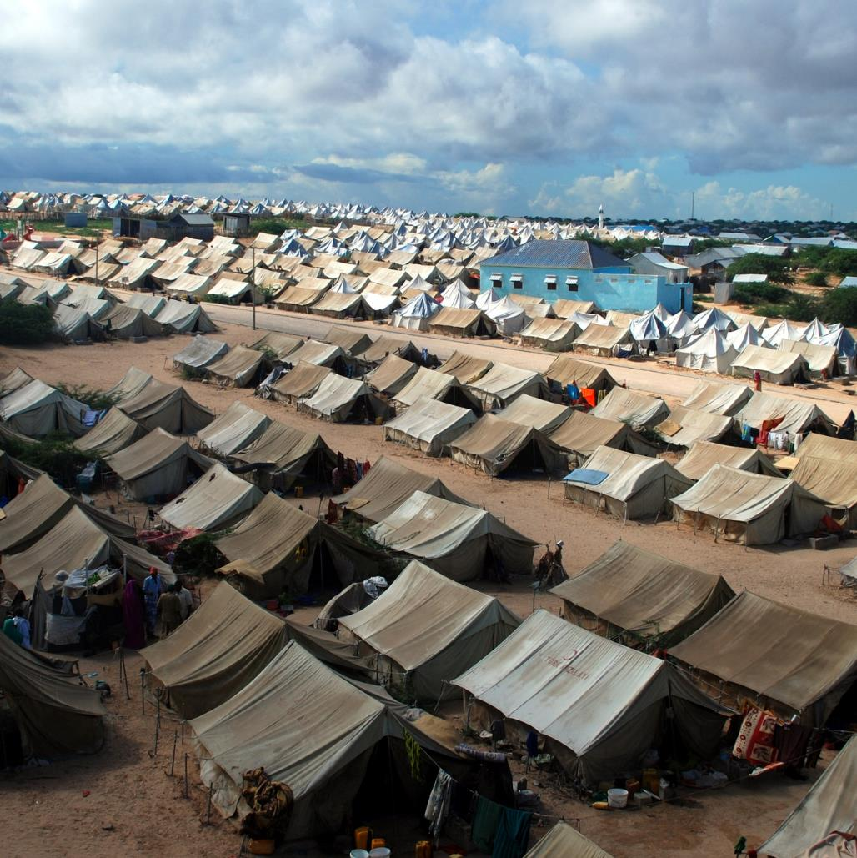
Announcing
AI for Humanitarian Action

