Slide 1
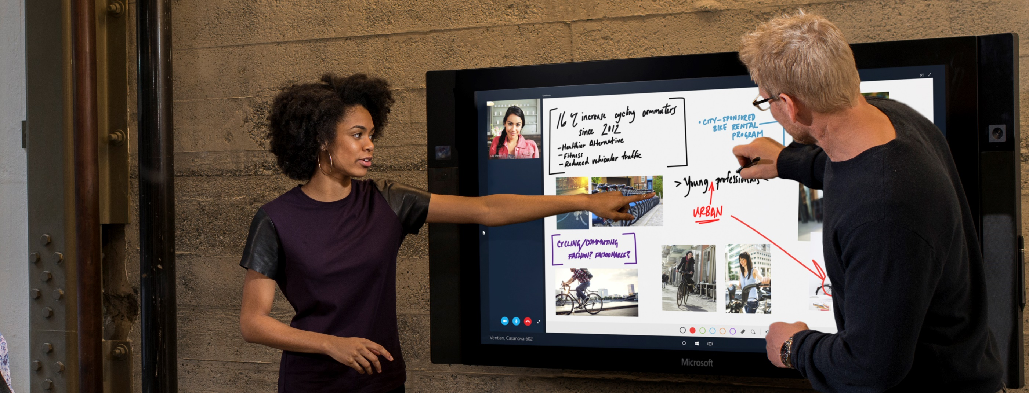
Microsoft Technology
Centers
Experience the Microsoft Cloud
Surf City Briefing Suite
February 8, 2018
BOEING

