Slide 1
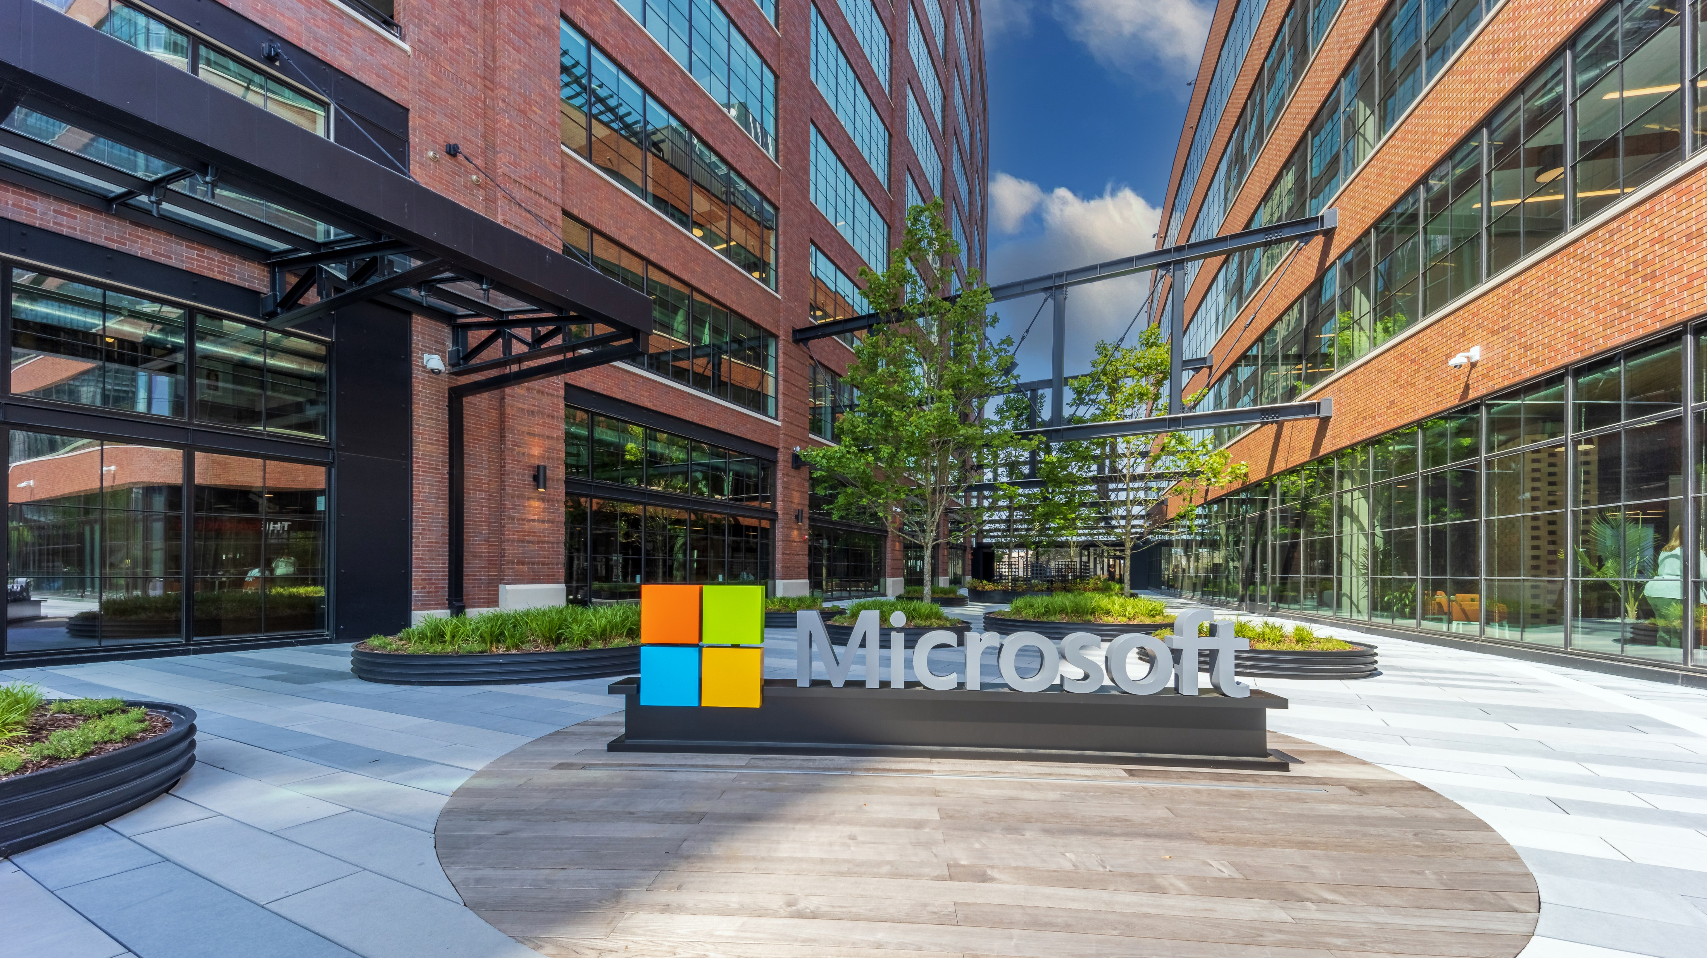
Welcome to
The Hub Atlanta

Slide 2
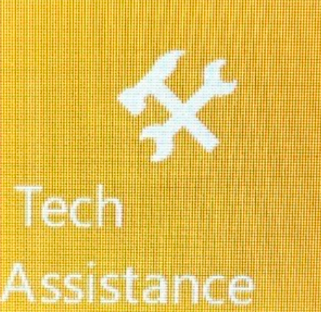
Connecting to WiFi…
Windows and Android Devices
Next: Facility Map
Select and Connect to the MSFTGUEST network.
After you press Connect, a browser will open with login methods. Please select “Event Attendee Code”.
Enter the Event Attendee Code located on the back of your name card. located in your briefing room - msftexec#### - and press “Log In”.
For technical assistance, please use the Tech Assistance button located on the wall panel near the meeting room entrance.
iOS Devices
Within Settings, under WiFi, select the MSFTGUEST network.
At the MSFTGuest Login screen, select “Event Attendee Code”.
When prompted by “Open in Safari”, press Open.
Enter the Event Attendee Code located on the back of your name card located in your briefing room - msftexec#### - and press “Log In”.

Slide 3







Microsoft Innovation Hub | Atlanta
200 17th Street NW, Atlanta, GA 30363
N
INNOVATION FACTORY
BALCONY
ASPEN
BIRCH
CYPRESS
EXPERIENCE ZONE
DOGWOOD
ENVISIONING THEATER
GINKGO
FOXGLOVE
ELM
IRONWOOD
HICKORY
SERVERY
DINING
BALCONY
 | STAIRCASE |  | CONCIERGE |  | ESPRESSO |  | MEDITATION ROOM |  | STANDARD ROOM
 | EXIT |  | DINING AREA |  | RESTROOMS |  | AED & FIRST AID |  | ENVISIONING THEATER
 | PHONE ROOM |  | ELEVATOR |  | LACTATION ROOM |  | SHOWER ROOM |  | FLEX SPACE

