Slide 1
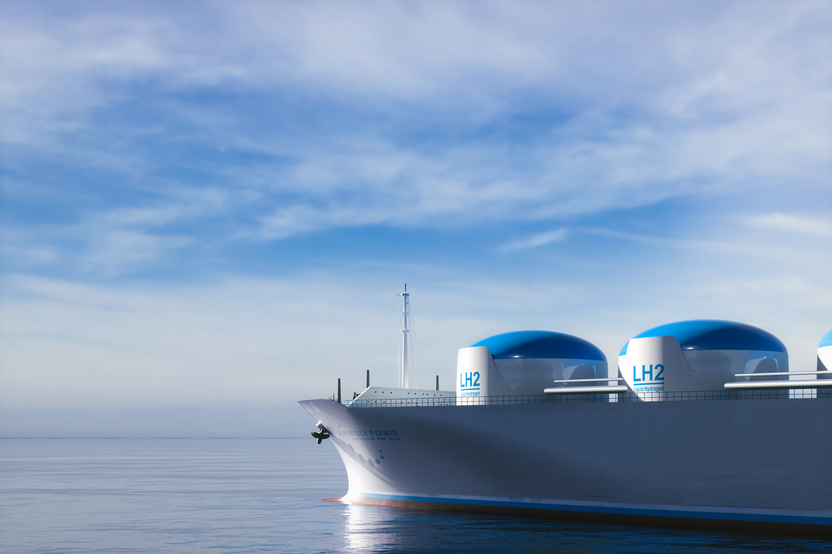
The importance of low carbon hydrogen in global decarbonization efforts
February 2023

Slide 2
Why hydrogen?
By 2030, U.S. annual demand for hydrogen is expected to reach
14 MMT
H₂
H₂
H₂
Hydrogen is viewed as a key energy carrier in the world’s decarbonization efforts
H₂ differentiates itself from other types of energy carriers as it does not produce CO2, particulates or sulfur emissions upon combustion. Rather, hydrogen’s emissions upon combusted is limited to water
The challenge faced today is that pure hydrogen is not commercially available at a sufficient scale
Experts around the world have been tasked with developing alternate ways of producing hydrogen
1
Rise in U.S. legislation promoting hydrogen as an alternative energy source
Infrastructure Investment and Jobs Act (IIJA) Introduced in November 2021
$8 billion
to establish hydrogen hubs
H₂
Inflation Reduction Act (IRA) introduced in August 2022
Incentivizes the production of clean hydrogen via tax credits ranging from
$0.60-$3.00 per kilogram of hydrogen produced (depending on associated emissions)
1. “Road Map to a US Hydrogen Economy,” Fuel Cell and Hydrogen Energy Association, https://carboncaptureready.betterenergy.org/analysis/, accessed 10 January 2023.
Page 2 | Draft

Slide 3
Build in Model-Based Regulatory Strategy
IRA & IIJA | SEC | CSRD | ISCC
The Inflation Reduction Act was introduced in August of 2022. The legislation incentivizes clean hydrogen production through tax credits ranging from $0.60 to $3 per kilogram of hydrogen produced (depending on associated emissions). The Infrastructure Investment and Jobs Act (IIJA) was introduced in November 2021. | The Securities and Exchange Commission has a climate-related disclosures plan that aims to increase transparency and accountability for publicly traded companies in relation to their environmental impact. Low carbon hydrogen creates better disclosures through reduced footprint and decreased climate risk. | The European Union adopted the Corporate Sustainability Reporting Directive in the same year it adopted its EU Strategy on Hydrogen, 2020*. Companies must use a recognized sustainability reporting framework, such as the Global Reporting Initiative or Sustainability Accounting Standards Board guidelines. Embedding low-carbon H₂ modeling into a recognized reporting framework ensures that the information disclosed is comparable and consistent. | The International Sustainability and Carbon Certification group is a global organization that provides certification for the sustainable production of biofuels, bioplastics, and other renewable materials. As the globe’s leading certification system, they have declared hydrogen as a key focus area in strategy and certification opportunities.
Model augmentation to reflect IRA-oriented strategies. | Enhancing the ledger and tracking H₂ data for reporting and measurement platforms for quicker and more accurate compliance.
Enhance and adjust modeling to embed strategies addressing regulatory frameworks.
Page 3 | Draft

Slide 4
Building out the enabling infrastructure: the road to decarbonization starts with low carbon H₂
Low carbon H₂ is available in the short term and can aid countries to achieve their carbon reduction goals, while paving the way and buying time for the refinement of the zero carbon H₂ process.
Hydrogen production breakdown in the net zero (1.5°) scenario
600
Zero Carbon H₂, made through the electrolysis of water using renewable electricity sources, is 100% CO2-free; however, it is not commercially available at scale.
While Zero Carbon H₂ is the end goal, technological developments are needed to improve the supply and efficiency in green hydrogen production.
Low Carbon H₂ a crucial steppingstone to begin countries’ decarbonization process today, as existing Carbon intensive H₂ get phased out and developments towards Zero Carbon H₂ continue to progress.
500
400
300
Zero Carbon H₂
200
100
Low Carbon H₂
0
Carbon Intensive H₂
2020 2030 2050
Source: Hydrogen Council, TotalEnergies, EY analysis.
Page 4 | Draft

Slide 5
The hydrogen ecosystem and its value chain
Grey Hydrogen | Carbon Intensive
Green Hydrogen | Zero Carbon
Yellow Hydrogen | Grid-Based
1
Energy
source
Hydrogen in fossil fuels
Steam Methane Reformation (SMR) Process
Electricity generation from
wind and solar energy
Hydrogen derived from
organic matter
Grid Electricity
Blue Hydrogen Low Carbon
Pink hydrogen
2
Other sources ^{Nuclear}
Hydrogen
generation
process
power
Partial
oxidation
WGSR
Electrolysis
(ALK/PEM/SOEC)
Photolysis
Microbial
Production
Biomass
gasification
Gasification WGSR ATR
Carbon capture utilization & storage (CCUS)
Electrolysis
(ALK/PEM/SOEC)
Low Carbon H₂
3
When CO₂is
Sequestered, Carbon Intensive H₂ becomes Low Carbon H₂
Blue H₂
End-user
application
H₂
Power
generation
Transportation
Industry energy
Building
heating
Industry
feedstock
Sources: EY analysis.
Page 5 | Draft

Slide 6
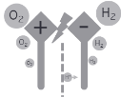
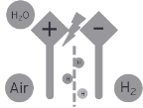
The hydrogen ecosystem and its value chain
Energy source H₂Generation Conversion Distribution End-use
Industry
PV Wind
Hydro
By-product Import
Liquefaction Compression
H_{2 H2}
Tanks
Caverns
Chemicals
Steel
Refineries
Power
+
Storage
LOHCs
Ammonia
Mobility
Power Grid
Electrolysis
Conversion
Car
Ship
Aviation
Hydrogen
Transport
Waste
Refinement
Truck Bus
Forklift
Biogas
Pyrolysis
Reforming
H₂Grid Gas Grid
Van
Train
Syn Fuels
Methanation
Green liquid
fuels
Biomass
Gas
Power & Heat
Ship
Trailer
CCS
CCU
Biomass
Gas
Turbines
Decentralized
Heating
Fuel Cells
Coal
Natural Gas
Oil
Sources: IRENA, IEA, EY analysis.
Note: 1. Mainly food & beverage, semiconductors and glass.
Page 6 | Draft

Slide 7
The hydrogen ecosystem and its value chain
Energy source H₂Generation Conversion Distribution End-use
Industry
H₂
Liquefaction Compression
Tanks
Caverns
Chemicals
Steel
Refineries
+
Storage
Mobility
LOHCs
Ammonia
Conversion
Car
Ship
Aviation
Hydrogen - H₂
Transport
Waste
Refinement
Truck Bus
Forklift
H₂Grid Gas Grid
Biogas
Van
Train
Pyrolysis
Reforming
Gas
Syn Fuels
Methanation
Green liquid
fuels
Power & Heat
Biomass
Ship
Trailer
CCS
CCU
Biomass
Fuel Cells
Gas
Turbines
Decentralized
Heating
Coal
Natural Gas
Oil
Sources: IRENA, IEA, EY analysis.
Note: 1. Mainly food & beverage, semiconductors and glass.
Page 7 | Draft

Slide 8
Hierarchy Overview
Operations
Company A
Value Chain
Hydrogen with SMR & Water-Gas Shift
Hydrogen with SMR
100% Dairy Biomethane SMR
Processes
Steam Methane Reformation
Steam Methane Reformation
Steam Methane Reformation
SMR + Water-Gas Shift
SMR + Water-Gas Shift
SMR + Water-Gas Shift
Water-Gas Shift Reaction
Water-Gas Shift Reaction
Water-Gas Shift Reaction
Hydrogen Liquification
Hydrogen Liquification
Hydrogen Liquification
Sequestration
Sequestration
Sequestration
Storage
Storage
Storage
Transport
Transport
Transport
Distribution
Distribution
Distribution
Page 8 | Draft

Slide 9
Key
Liquid
Gas
Process
Storage
Process Flow - Hydrogen with SMR & Water-Gas Shift
CH₄
SMR + Water Gas Shift
2 CO₂
Sequestration
2 H₂0
4 H₂
Storage
Hydrogen Liquefaction
2.4 LH₂
Transport (Ship)
Distribute (Pipeline)
Page 9 | Draft

Slide 10
Step 1: Obtain inputs for SMR + water-gas shift process (methane + steam)
Key
Liquid
Gas
Process
Storage
5 CH₄
10 H₂O
CH₄
SMR + Water Gas Shift
2 CO₂
Sequestration
2 H₂0
4 H₂
Storage
Hydrogen Liquefaction
2.4 LH₂
Transport (Ship)
Distribute (Pipeline)
Molecular Accounting
Process | CH4 | H2O | CO2 | H2 | LH2
SMR + Water-Gas Shift | 5 | 10 | - | - | -
Hydrogen Liquefaction | - | - | - | - | -
Sequestration | - | - | - | - | -
Storage | - | - | - | - | -
Transport | - | - | - | - | -
Distribution | - | - | - | - | -
Totals: | 5 | 10 | 10 | - | -
Page 10 | Draft

Slide 11
Step 2: Execute SMR & water-gas shift process
Key
Liquid
Gas
Process
Storage
5 CH4
10 H2O
Sequestration
CH4
SMR + Water Gas Shift
2 CO₂
2 H20
4 H₂
Storage
Hydrogen Liquefaction
2.4 LH₂
Transport (Ship)
Distribute (Pipeline)
Molecular Accounting
Process | CH4 | H2O | CO2 | H2 | LH2
SMR + Water-Gas Shift | 5 | 10 | - | - | -
Hydrogen Liquefaction | - | - | - | - | -
Sequestration | - | - | - | - | -
Storage | - | - | - | - | -
Transport | - | - | - | - | -
Distribution | - | - | - | - | -
Totals: | 5 | 10 | - | - | -
Page 11 | Draft

Slide 12
Key
Liquid
Gas
Process
Storage
Step 3:
Determine next process for outputs
CH₄
SMR + Water Gas Shift
CO2
2 CO₂
Sequestration
H2
H2
2 H₂0
H2
4 H₂
Storage
Hydrogen Liquefaction
2.4 LH₂
Transport (Ship)
Distribute (Pipeline)
Molecular Accounting
Process | CH4 | H2O | CO2 | H2 | LH2
SMR + Water-Gas Shift | - | - | 10 | 20 | -
Hydrogen Liquefaction | - | - | - | - | -
Sequestration | - | - | - | - | -
Storage | - | - | - | - | -
Transport | - | - | - | - | -
Distribution | - | - | - | - | -
Totals: | - | - | 10 | 20 | -
Page 12 | Draft

Slide 13
Key
Liquid
Gas
Process
Storage
Step 4:
Sequester CO2; store some H2 into gas storage; liquefy the remaining H2 for distribution
SMR + Water Gas Shift
Sequestration
CH₄
2 CO₂
CO2
2 H₂0
4 H₂
Storage
H2
Hydrogen Liquefaction
2.4 LH₂
Transport (Ship)
H2
H2
Energy expenditure = 12.5-15 kWh e/kg
CO2
Distribute (Pipeline)
Molecular Accounting
Process | CH4 | H2O | CO2 | H2 | LH2
SMR + Water-Gas Shift | - | - | - | - | -
Hydrogen Liquefaction | - | - | - | 10 | -
Sequestration | - | - | 10 | - | -
Storage | - | - | - | 10 | -
Transport | - | - | - | - | -
Distribution | - | - | - | - | -
Totals: | - | - | 10 | 20 | -
Energy
Emissions

Slide 14
Key
Liquid
Gas
Process
Storage
Step 4:
Sequester CO2; store some H2 into gas storage; liquefy the remaining H2 for distribution
SMR + Water Gas Shift
Sequestration
CH₄
2 CO₂
CO2
2 H₂0
4 H₂
Storage
H2
Hydrogen Liquefaction
2.4 LH₂
Transport (Ship)
H2
Energy expenditure = 12.5-15 kWh e/kg
Distribute (Pipeline)
H2
Molecular Accounting
Process | CH4 | H2O | CO2 | H2 | LH2
SMR + Water-Gas Shift | - | - | - | - | -
Hydrogen Liquefaction | - | - | - | 10 | -
Sequestration | - | - | 10 | - | -
Storage | - | - | - | 10 | -
Transport | - | - | - | - | -
Distribution | - | - | - | - | -
Totals: | - | - | 10 | 20 | -
Energy
Emissions
CO2
Carbon intensity= 14.0 kg CO2e/ GJ H2
Page 14 | Draft

Slide 15
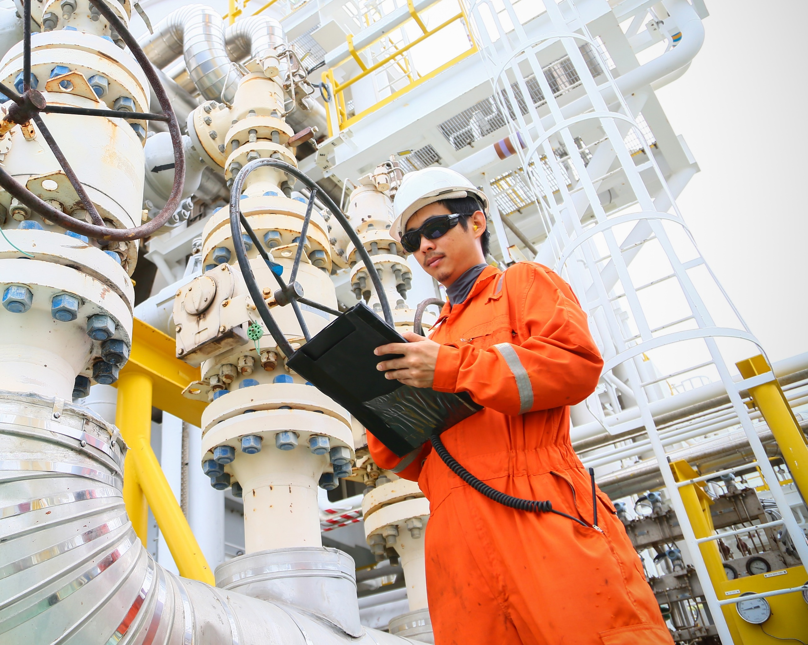
Core Demo Personas
Executive Darnell Tyson
CEO
Modeler
Jazmine Hernandez
Chemical Engineer
Operations Han Tao
Plant Manager
Business intelligence
Tax persona
Finance persona
Customer persona
Page 15 | Draft

Slide 16
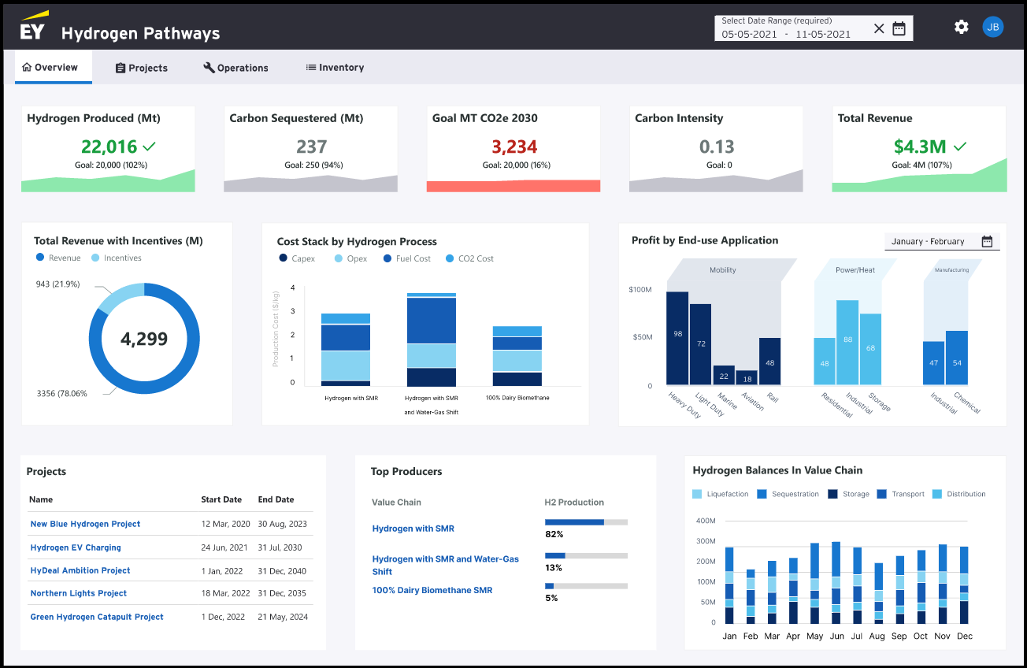
Executive Persona
Darnell Tyson
CEO of Dublin Energy
The role of an executive is to establish periodic sustainability and performance goals, analyze how operations compare to goals and provide direction for future initiatives
Key concerns:
Provide a high-level review of progress towards goals.
Where are we today? Are we on track? What do we need to change in order to reach our goals for this month/year?
Where can we invest more capital to produce cleaner energy and capture carbon?
In reviewing key sustainability metrics, where should we prioritize our capital and attention to increase revenue?
Key activities include:
Monitoring goal progress across all value chains
Approving modeler requests to update value chains
Providing details reports to other executives
Page 16 | Draft

Slide 17
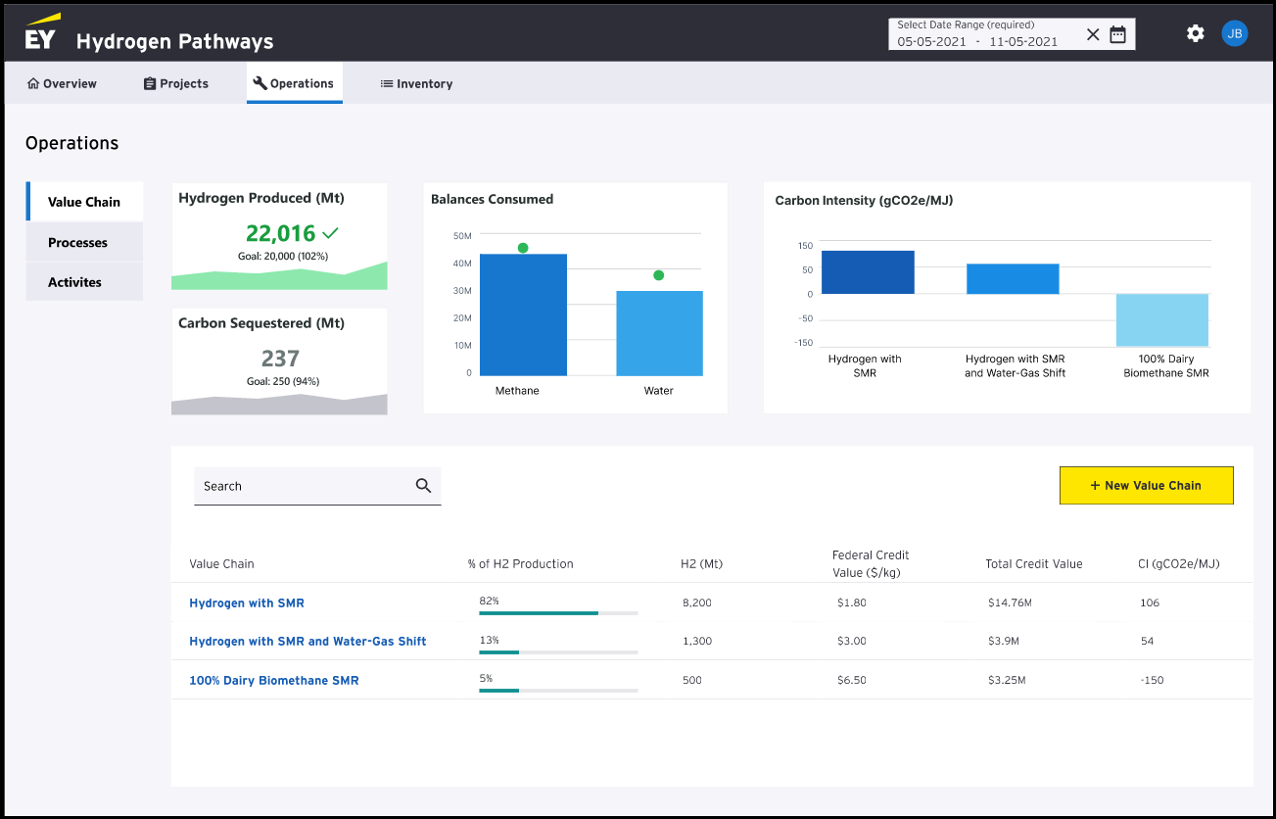
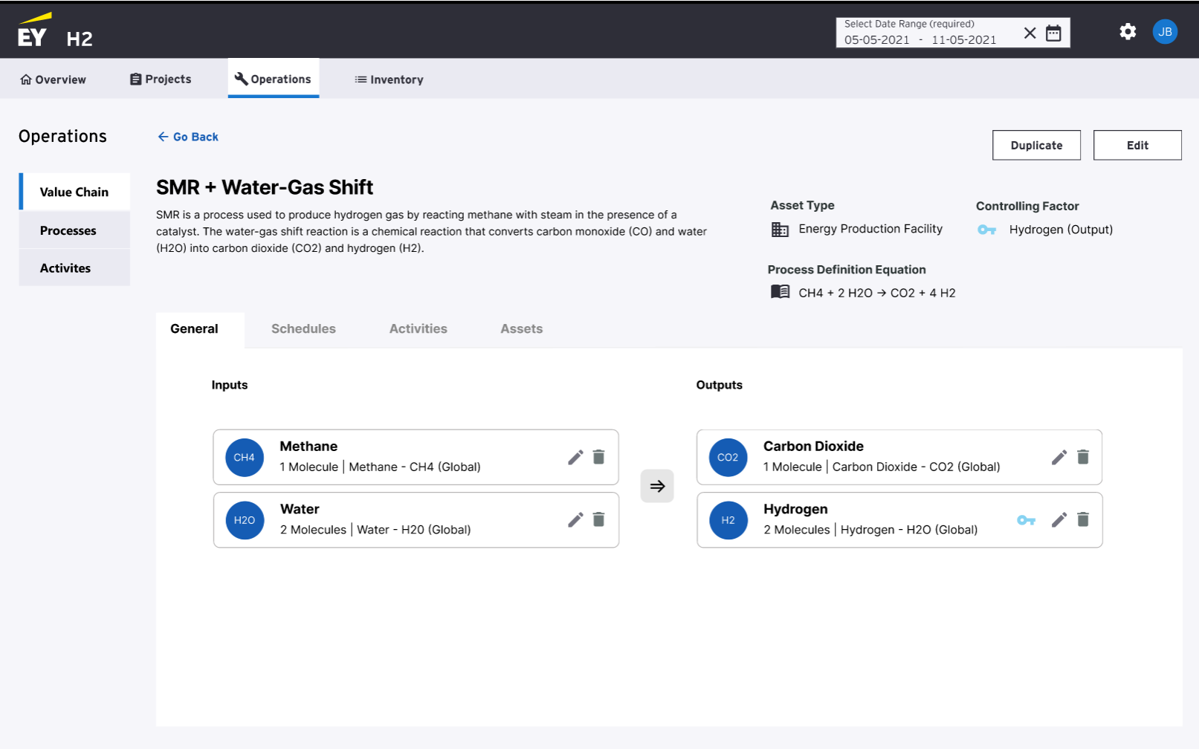
Modeler Persona
Jasmin Hernandez
Chemical Engineer at Dublin Energy
The role of a modeler is to identify and create models around new value chain opportunities to capture energy and drive additional revenue
Key concerns:
Where can I find opportunities in the value chain to generate additional revenue for the company?
How can I work to continuously improve the sustainability of the value chain across related operations?
How can I easily edit models as opportunities are identified and transition model additions to operations for scheduling?
Key activities include:
Building the model
Model maintenance
Advising on new projects
Page 17 | Draft

Slide 18
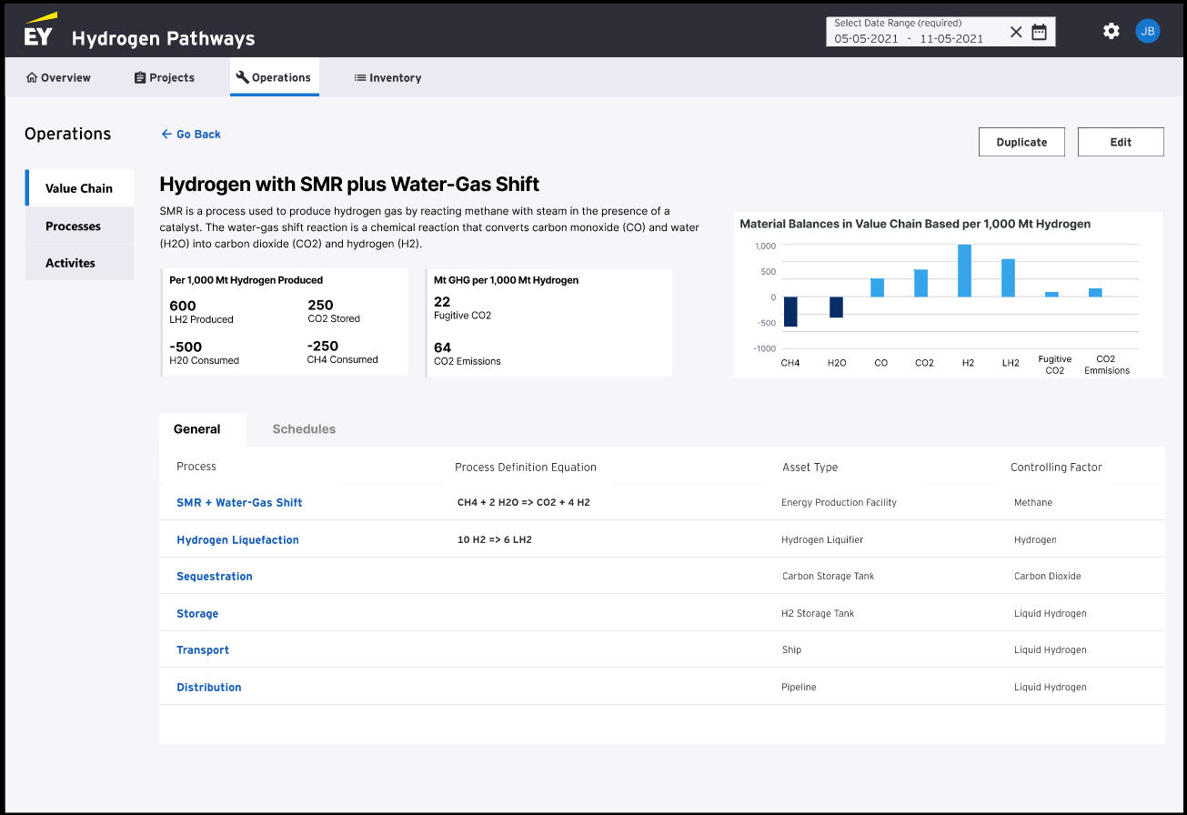
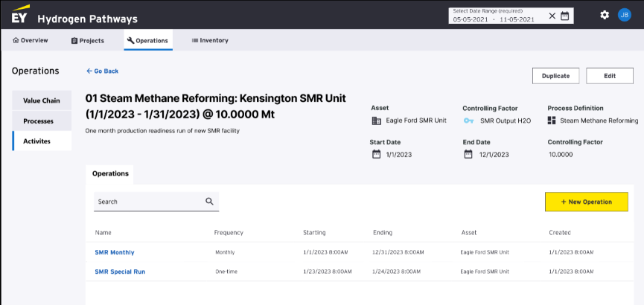
Operations Persona
Han Tao
Plant Manager at Dublin Energy
The role of operations is to have oversight over the asset(s), identifying potential issues, promoting resource efficiency, as well as inputting & tracking operational data
Key concerns:
How can I easily update schedules to promote resource efficiency across the value chains?
How might I review existing models then add or update the operational data to ensure proper forecasting for executive decision making?
How can I understand, at a molecular level, that we have what we need to satisfy the assets where our sustainable value chain processes have been implemented?
Key activities include:
Monitoring schedules and activities
Track and update operational data points - update forecasts
Improve revenue within current value chains or suggest new projects for additional revenue
Page 18 | Draft

Slide 19
Q&A
Page 19 | Draft

Slide 20
Security and control considerations
This molecular accounting solution is designed to overcome the challenges surrounding governance, process, and data with the same fidelity and rigor of a financial reporting and disclosure framework
Governance
Security
Protect against unauthorized intrusion and modification
Flexible and granular security design
Customizable security based on value chain, process and activity
Enforced segregation of duties and least privilege principle
Control
Designed to give you control over data integrity
Automated approval workflow and notification
Reduced manual intervention and enable rapid response to data modifications
Improved transparence through audit logs
Compliance
Improved adherence to compliance and quality reporting requirements
Minimal unforeseen issue related to data integrity, completeness and accuracy
Page 20 | Draft

Slide 21
EY | Building a better working world
EY exists to build a better working world, helping to create long-term value for clients, people and society and build trust in the capital markets.
Enabled by data and technology, diverse EY teams in over 150 countries provide trust through assurance and help clients grow, transform and operate.
Working across assurance, consulting, law, strategy, tax and transactions, EY teams ask better questions to find new answers for the complex issues facing our world today.
EY refers to the global organization, and may refer to one or more, of the member firms of Ernst & Young Global Limited, each of which is a separate legal entity. Ernst & Young Global Limited, a UK company limited by guarantee, does not provide services to clients. Information about how EY collects and uses personal data and a description of the rights individuals have under data protection legislation are available via ey.com/privacy. EY member firms do not practice law where prohibited by local laws. For more information about our organization, please visit ey.com.
© 2023 Ernst & Young LLP.
All Rights Reserved.
XXXXX-XXXGbl
ED MMYY
[Optional environmental statement — refer to The Branding Zone]
This material has been prepared for general informational purposes only and is not intended to be relied upon as accounting, tax, legal or other professional advice. Please refer to your advisors for specific advice.
ey.com

Slide 22
Appendix

Slide 23
Appendix 1: Personalizing the UI based on end-user personas
Personas | Executive leadership | Business intelligence | Operations | Compliance- tax | Business modelers | Finance
Role | The role of an executive is to establish periodic sustainability and performance goals, analyze how operations compare to goals and provide direction for future initiatives | The role of business intelligence is to leverage data from finance to propose solutions to increase efficiency and profit. | The role of operations is to have oversight over the asset(s) in identifying potential issues, promoting resource efficiency and inputting / tracking operational data | The role of tax is to ensure the necessary criteria is met for successfully receiving tax credits | The role of a modeler is to identify and create models around new value chain opportunities to capture energy and drive additional revenue | The role of finance is to calculate and verify performance metrics, such as revenue and incentives, on a periodic basis, and create forecasting financial models.
Uses | Assess the volume of the balance inventory, amount carbon sequestered, and amount of hydrogen produced Check progress towards quarterly/yearly goals Oversee sustainability and climate-related disclosures/reporting | Assess impact of our annual climate plan Report on financials Rank facilities based on carbon intensity use | Identify any potential issues at facilities, process, or supply chain Promote resource efficiency in facilities Track and input operation data | Verify tax related liabilities and benefits related to circularity Identify and assess potential areas of non-compliance and applicable penalties Assess the balance values for material compliance targets | Create value chains, processes and operations Create and maintain data to model: materials, assets, asset types, operations, operation types Monitor the model | Calculate the net benefit of our circular initiatives and create trend analyses Tracking KPIs against clean hydrogen investment tax incentives
UI screens | The overview page will be the most important for executive leadership, but they should also have access to the rest of the slides if want to dig deeper | Business intelligence will rely on the data present in the overview page, specifically the carbon intensity visual with the goals vs performance and the total revenue A new visualization will be added where it ranks facilities based on carbon intensity use | Operations view is customized depending on level of clearance/oversight. E.g., a facility manager in charge of a singular facility will only have access to that specific facility's data (operation and inventory), whereas regional managers will have visibility into all the facilities they oversee Will schedule activities and monitor progress Looking at potential for energy usage optimization Inventory pages will be built | Compliance will use the hydrogen balances visualization in the overview slide, as well as the hydrogen produced, and carbon sequestered metrics Compliance should have access to all the pages in the case they need to perform verifications of data | Business modelers will need access to the entire app, as they will use the operation pages to update and create processes and will need to verify that processes and edits are being correctly reflected throughout the app Process definition update | Finance will leverage the information provided in the overview page such as total revenue with incentives

