Slide 2

Annata 365
Annata 365 helps drive relevant, timely and personalized engagements with customers and prospects. Built on top of Microsoft Dynamics 365 for sales, the solution provides extended capabilities, business processes and functionality for sales and marketing teams.
Notes:
Annata helps business do the following:
1. Acquire new customers from quality leads
-Manage leads from multiple digital and physical channels in a single solution.
-Distribute and monitor leads across your organization, including central marketing teams and dealers.
-Continuously measure lead performance KPIs and adjust campaigns or follow-up where needed.
-Scale your ability to handle more leads by using automated and intelligent customer journeys.
2. Close sales efficiently
• Enable your sales teams to work on sales pipeline and follow-up with customers anytime, anywhere using web client or mobile app.
• Continuously monitor sales pipeline KPIs and reducing risk of opportunities left behind.
• Empower sales teams with intelligence and insights to offer the right products and services.
3. Retain and grow your customer base
• Automatically build customer profiles with information from multiple touch points across marketing, sales and after-sales.
• Provide intelligent reminders and next best actions to sales teams for strategic moments in the customer lifecycle.
• Drive automated, data-driven campaigns to offer the right products or services at the right time.

Slide 3
Solution Core Features
1
Lead Generation,
Nurturing & Qualification
Importer
Qualified Lead
Distribution
Test drive
appointment
Social
Media Content
Lead Unique
Information
Manage sales processes across multiple brands and locations
Capture and manage automotive and equipment specific information on leads
Automate processes for lead qualification and follow-up based on brand, location or type of interest
Manage and monitor test drive processes
Provide sales teams with easy-to-access, enriched customer 360° views
Trigger and automate engagements at selected points in the customer life cycle to increase customer satisfaction and retention
Online advertisement
Official webpage
Lead profile build
Lead performance feedback
Customer
Digital channel
touchpoint
Product Interest
Frequency & timings of
engagements
Name, contact details, demographic information, preferences, need
2
Sales Process + Delivery
Satisfaction survey
Delivery
Delivery Status Tracking
Digital
Signature
Receive
Offer
Local Engagement
With dealers
Customer
3
After-Sales Engagements
Digitalize
contract
Expiration
of warranty
Customer
Segmentation
Expiration
of contract
Renewed
Partnership
Purchase
Anniversary
Opportunity for
Sales-person
Customer
receive offer
Data driven
Campaign
Notes:
Annata's comprehensive solution for the automotive industry is built to cover a wide range of businesses involved in manufacturing, distribution, marketing, selling and maintenance of motor vehicles and its components.
-With seamless integration with Outlook, users have the power of Dynamics 365 in their email. Dynamics 365 will show up in a window next to an outlook message or meeting. Allowing users to see useful information about a customer.
-With Business insights and analytics through interactive dashboards and rich filtering options, users have a level of self-service BI they can use in their day to day.
-With the mobile app, users can complete tasks while on the go. This allows employees to carry out process and search for relevant information on a tablet of phone
-Tailored use interfaces and processes for automotive gives dealerships freedom to configure for their specific brand, devices and dealerships.

Slide 4
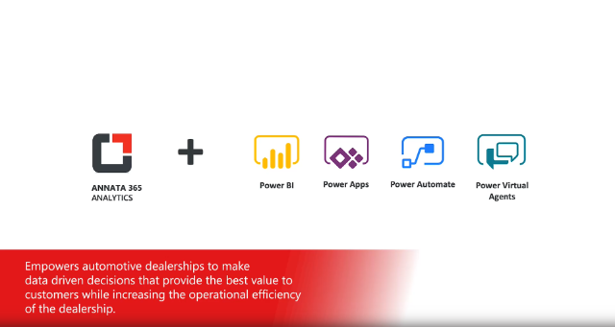
Notes:
Video deminstrating the Annata platform

Slide 5









Campaign Creation - Intelligent Workflow
Power App initiates a new campaign based on input criteria
Existing Customer - Device Table in A365
Azure Data Factory ETL
Fetching Data from
Data Lake
Power Apps
Power Automate
Power Automate
Power Automate
Customer email / SMS contains link to Virtual Agent
New campaign populated in D365 Marketing which initiates customer journey via email / SMS
Results returned from predictive maintenance accelerator
Call ML web service
Power Virtual Agent
Power Automate
Machine Learning
Machine Learning
Log activity in D365 Marketing
Power BI report visualising
all data captured
Power Automate
Power BI
Virtual Agent offers customer option to book service @ local dealer
Power Virtual Agent
Service order created in A365 Field Service
and work order in A365 F&O via dual write
Tablet based service Order Power App
for technicians in workshop
Power Automate
Power Apps

Slide 6







Microsoft 365
Azure Data Lakes
Dynamics 365 for Sales
Annata 365 provides extended capabilities for management of sales and marketing related processes. In return, increasing customer satisfaction and retention
Machine Learning
Power BI
Power Apps
Power Automate
Power Virtual Agents

