Slide 2
Dynamics 365 Fraud Protection
Microsoft Dynamics 365 Fraud Protection helps e-commerce, brick-and-mortar and omni-channel merchants protect their revenue and reputation by providing tools to decrease fraud and abuse, reduce operational expenses and increase acceptance rates. Adaptive AI technology works to combat purchase, account, and omni-channel return and discount fraud.

Slide 3

Dynamics 365 Fraud Protection
PURCHASE PROTECTION
ACCOUNT PROTECTION
LOSS PREVENTION
Help protect revenue by improving the acceptance rate of e-commerce transactions with insights and tools that help balance revenue opportunity vs fraud loss and checkout friction
Help protect online revenue and reputation and safeguard user accounts from abuse and fraud by combating fake account creation, account takeover and fraudulent account access
Help protect revenue by identifying anomalies and potential fraud on returns and discounts arising from omni-channel purchases, enabling store managers and loss prevention officers to quickly take action to mitigate losses

Slide 4

Dynamics 365 Fraud Protection with purchase protection capability
Help enhance shopping experience
Help protect your revenue
Help streamline automation and operational efficiency
Enable business intelligence
Help improve business reputation
Help decrease wrongful rejections and increase commerce transaction acceptance rates
Reduce frequency of challenges and friction in the shopping experience
Reduce fraud losses and manual review expenses
Help protect online revenue by improving commerce transaction acceptance rates while reducing checkout friction, and providing merchants with insightful tools to make decisions that appropriately balance revenue opportunity and customer experience vs fraud loss with Dynamics 365 Fraud Protection with purchase protection capability

Slide 5
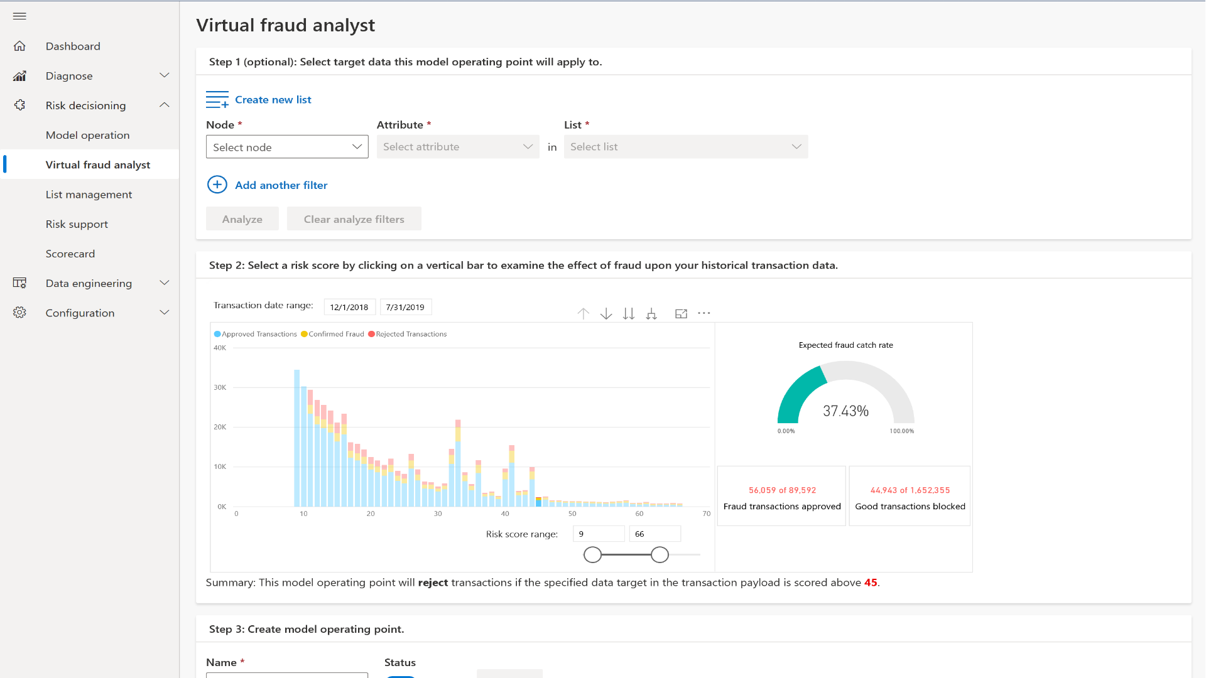
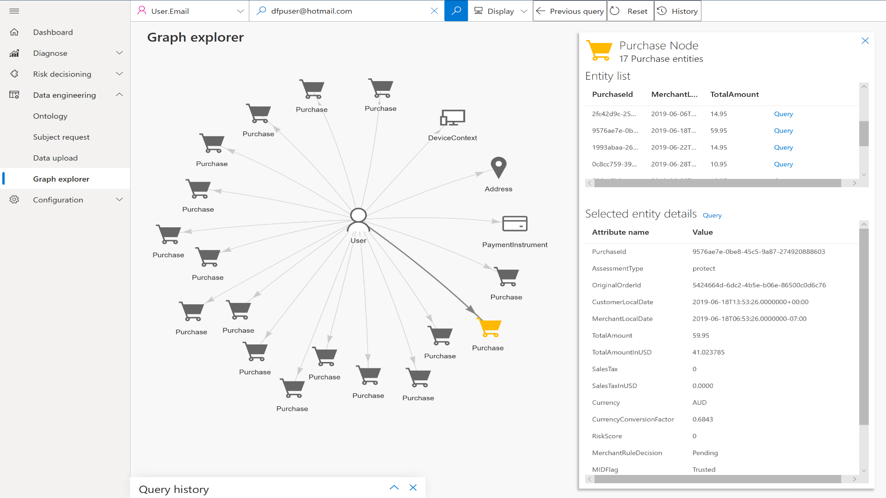
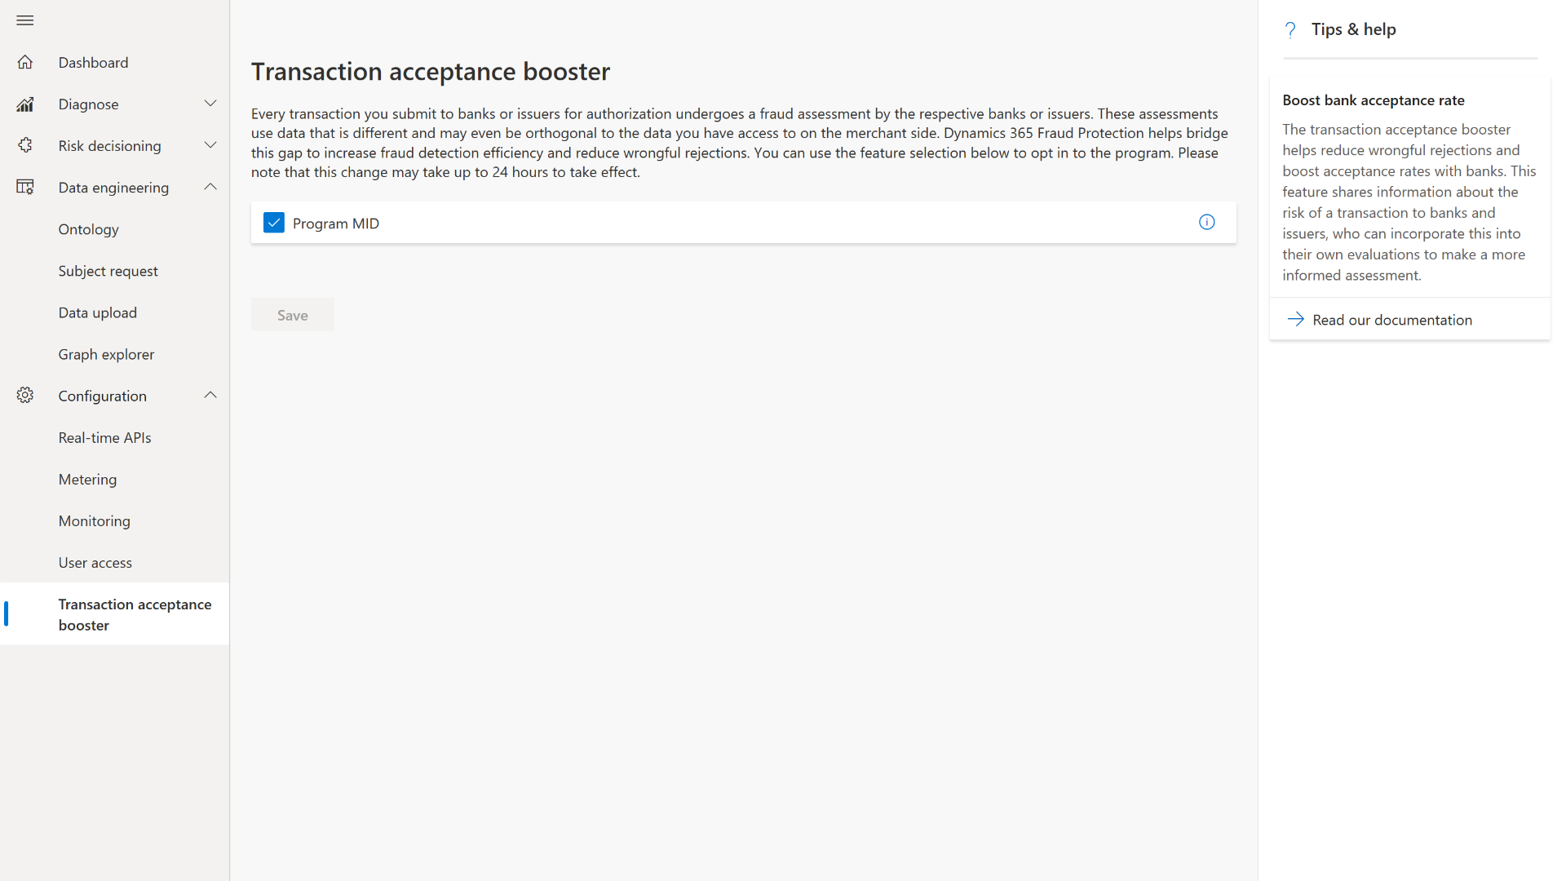
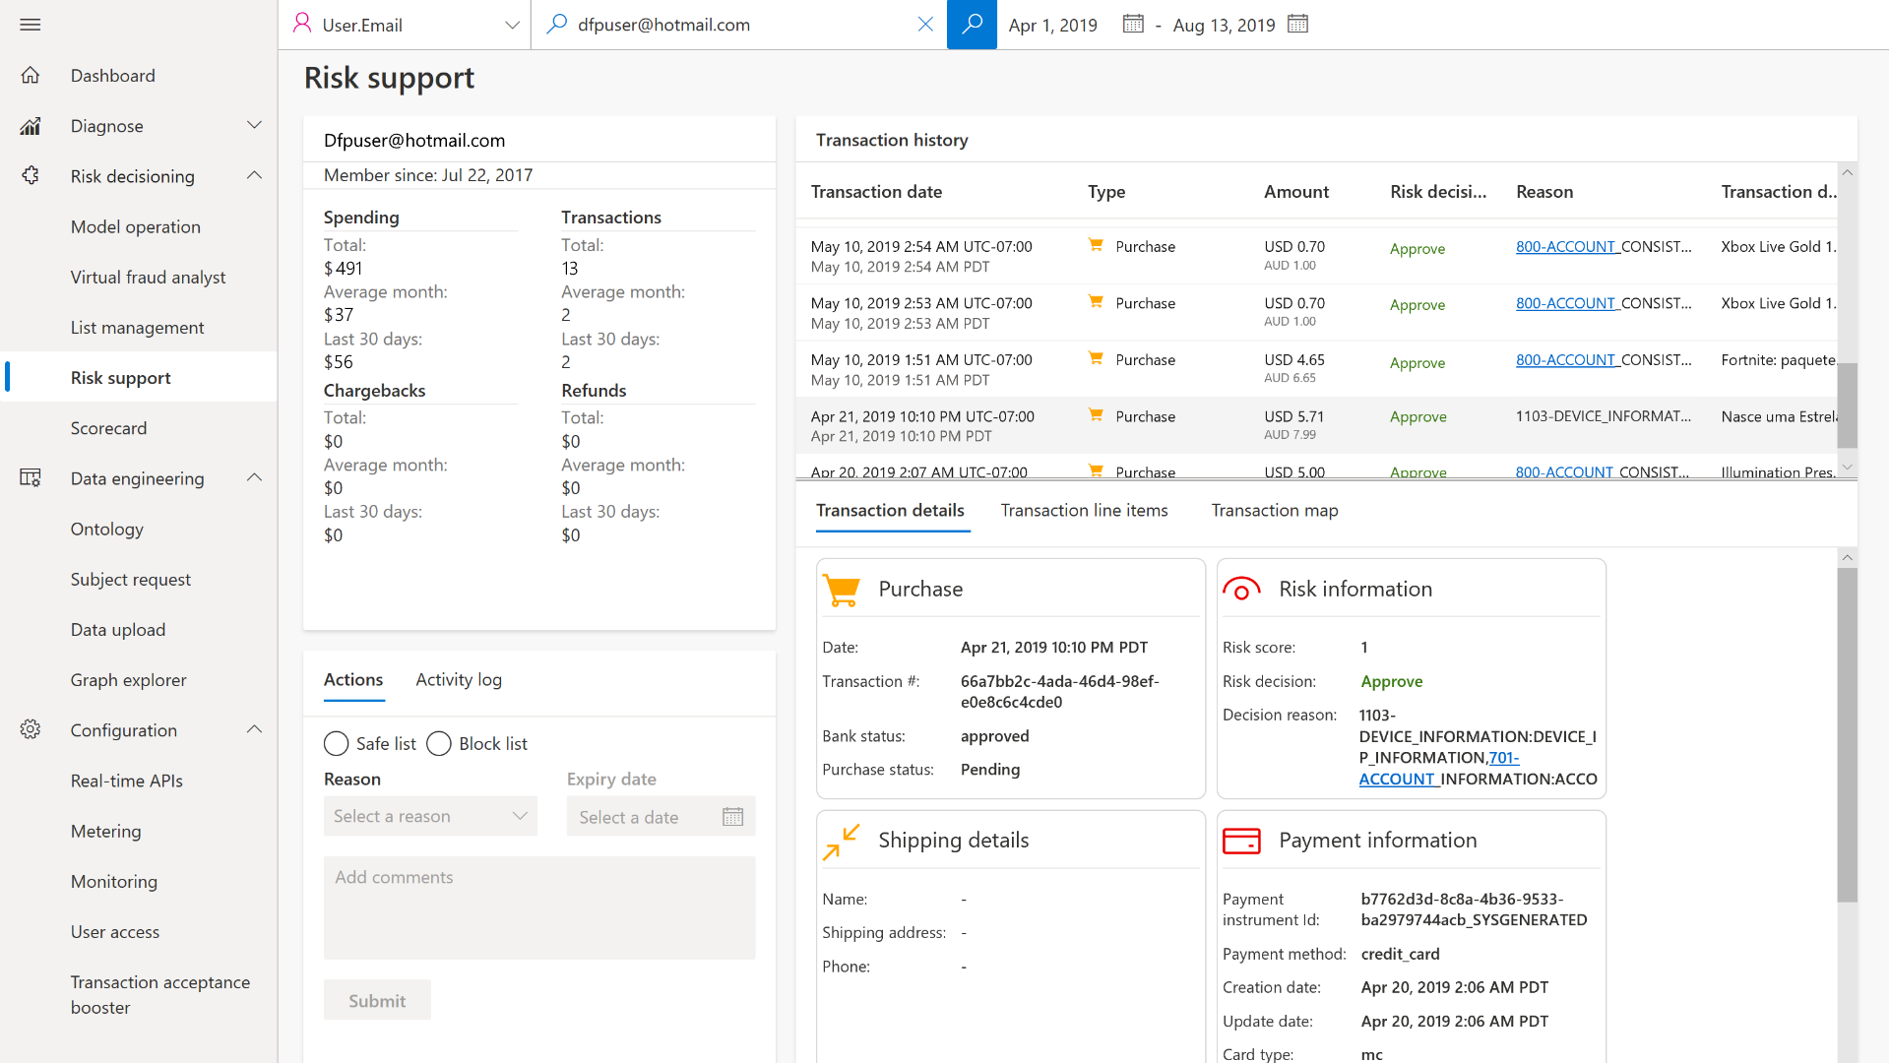
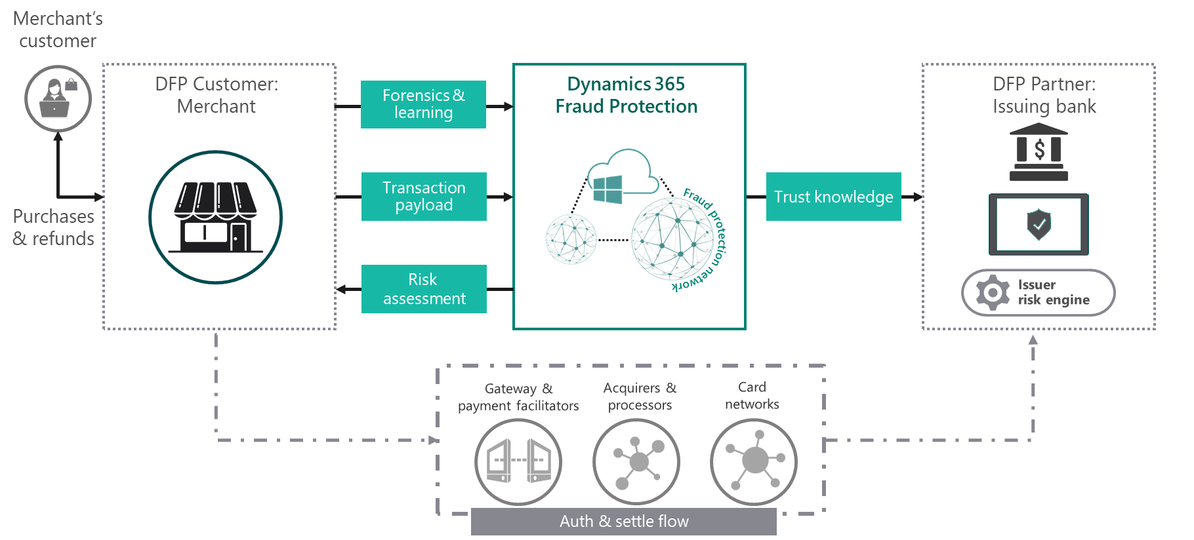
How does Dynamics 365 Fraud Protection with purchase protection capability work
Adaptive AI technology
Fraud protection network
Transaction acceptance booster
Customer escalation support tool
Continuously learns and adapts from patterns and equips store managers with tools to optimize fraud controls.
Connected knowledge gives broad awareness of fraud activity across the globe, while keeping the security of your confidential information and shoppers' privacy top of mind.
Share transactional trust knowledge with issuing banks to help boosts your authorization rates.
Improve customer service with the built-in escalation support tool displaying detailed context of the customer transaction including fraud insights provided by the service.

Slide 6






How Dynamics 365 Fraud Protection with purchase protection capability works?
Merchant’s customer
DFP Customer: Merchant
Forensics & learning
Dynamics 365 Fraud Protection
DFP Partner: Issuing banks
Transaction payload
Trust knowledge
Risk assessment score
Low-res location
Fraud protection network
Purchases & refunds
Risk engine
Risk
assessment
Scoring and rules
Gateway &
payment facilitators
Acquirers & processors
Card networks
Auth & settle flow
Notes:
Innovation – Shared intelligence with issuers: Deep bank partnerships and routing/retry recommendations help improve acceptance rates by increasing merchant’s successful sales completions with fewer good transactions blocked.

Slide 7
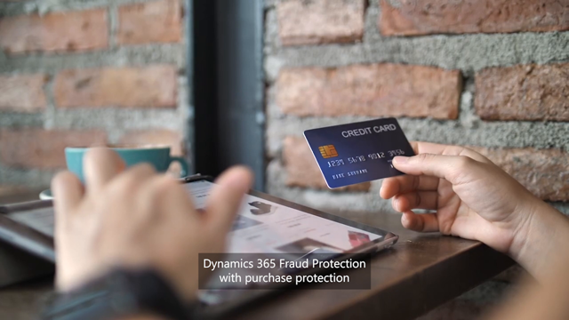
Notes:
D365 Fraud Protection - Purchase Protection Overview video

Slide 8
Dynamics 365 Fraud Protection with account protection capability
Help enhance shopping experience
Help protect your online revenue
Help streamline automation and operational efficiency
Help improve business reputation
Enable business intelligence
Reduce friction throughout the customer journey
Help protect your customers’ user accounts from abuse and fraud
Help reduce fraud activities
Enhance account protection
Help protect bottom line
Prevent negative exposure due to fraudulent activity
Help mitigate monetary and reputational damage
Help protect online revenue and reputation by counteracting fraudulent account access, fake account creation and account takeover, and safeguarding user accounts from abuse and fraud with Dynamics 365 Fraud Protection with account protection capability

Slide 9
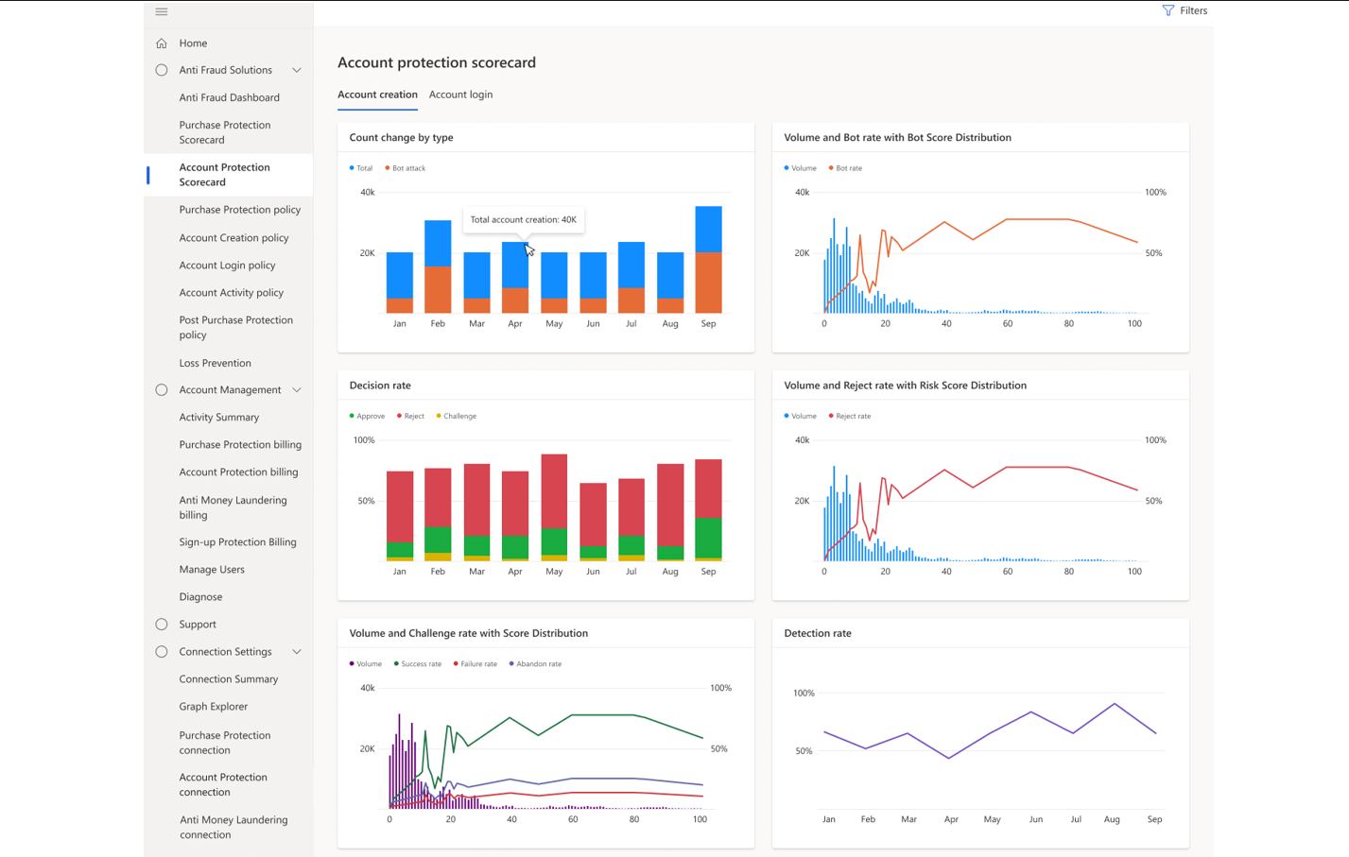

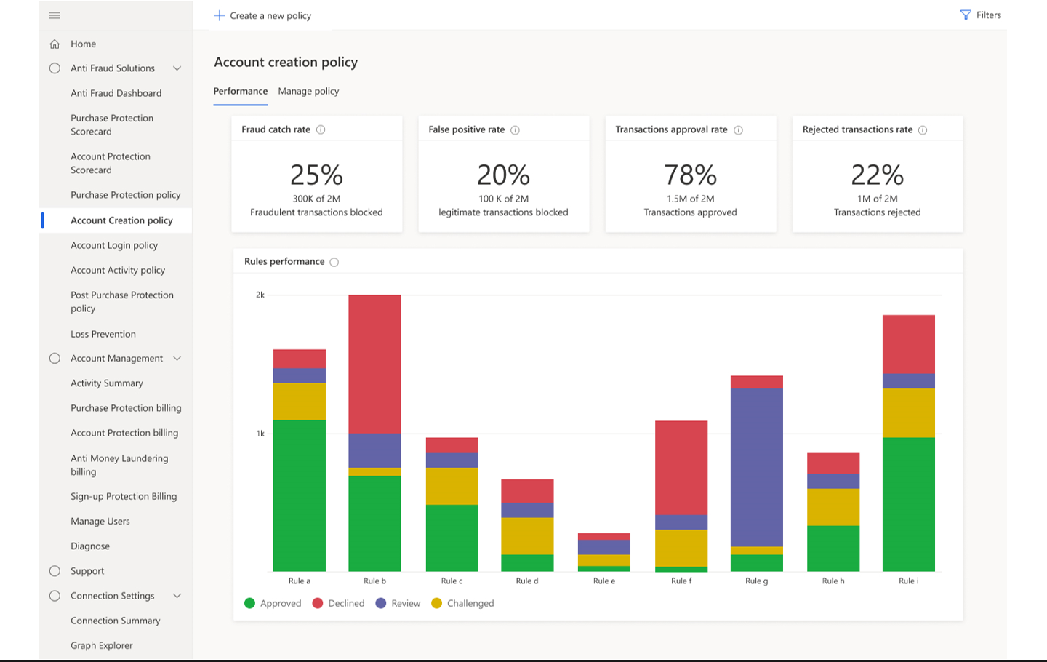


How does Dynamics 365 Fraud Protection with account protection capability work
Adaptive AI technology
BOT protection
Account creation protection
Account sign-in protection
Device fingerprinting
Continuously learns and adapts from patterns and equips store managers with tools to optimize fraud controls.
Helps protect your system against bots attempting to gain access to accounts with stolen credentials or to create fake accounts and transactions.
Helps avoid incurring losses due to fraudulent accounts by monitoring account creation and helping minimize abuse and automated attacks on customer accounts.
Helps protect customer accounts​, improving customer engagement and conversion by reducing friction​.
Dynamics 365 Fraud Protection’s device fingerprinting capability boosts the service’s fraud detection capabilities to help customers reduce fraud losses.

Slide 10
How Dynamics 365 Fraud Protection with account protection capability works?
Merchant’s customer
Dynamics 365 Fraud Protection account protection
Account activity & device forensics data
Account protection network
Account creation
Account login
Account activity
Fraud assessment
DFP Customer:
Merchant’s website

Slide 11
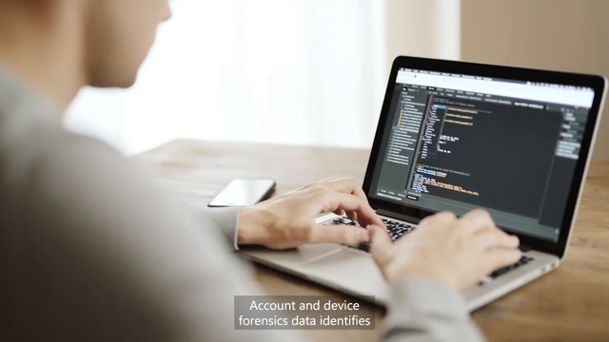
Notes:
D365 Fraud Protection - Account Prevention Overview video

Slide 12
Dynamics 365 Fraud Protection with loss prevention capability
Help protect your revenue
Help streamline automation and operational efficiency
Help enhance shopping experience
Enable business intelligence
Help improve business reputation
Help protect your revenue through reduction in losses related to fraudulent returns and discounts
Help reduce manual
efforts required to determine business entities and functions at risk for losses, and enabling readily consumable reports with actionable insights
Enable store managers and investigators to take action by providing them with insights on anomalies with merchandize discounting and returns
Help protect revenue by aiding merchants' identification of potential fraud on returns and discounts arising from omni-channel purchases, enabling store managers and investigators to quickly investigate potential fraud and take action to mitigate losses with Dynamics 365 Fraud Protection with loss prevention capability

Slide 13
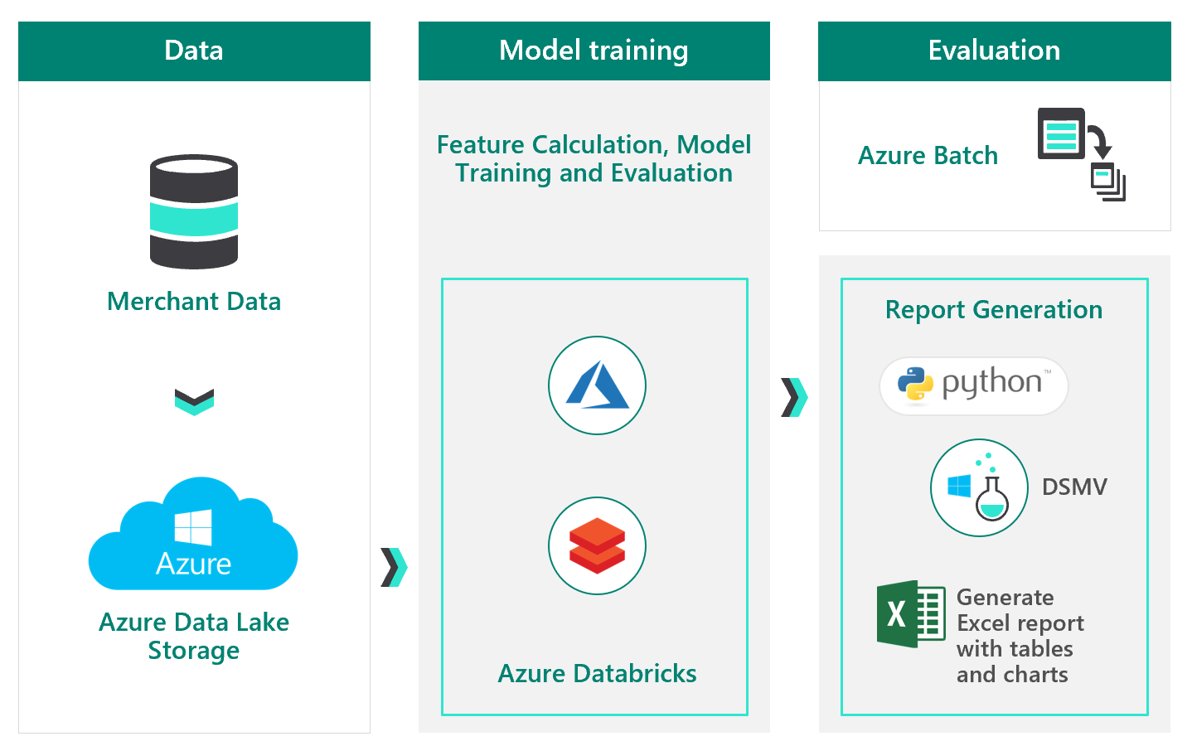
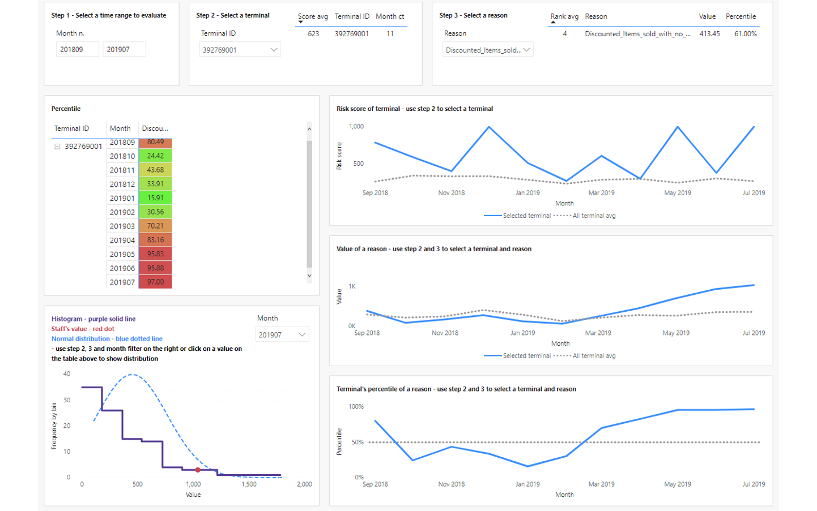


How does Dynamics 365 Fraud Protection with loss prevention capability work
Adaptive AI technology
Business intelligence reporting
Operational efficiency booster
Enhanced loss prevention system with analysis against fraud
Continuously learns and adapts from patterns and equips store managers with tools to optimize fraud controls.
Enables store managers and investigators to take action by providing them with insights on anomalies with merchandize discounting and returns.
Helps increase operational efficiency by reducing manual effort required to determine the business entities and functions that may be at risk.
Helps fraud management system react quickly to dynamic fraud and purchase patterns, providing actionable insights to help reduce fraudulent returns and discounts.

Slide 14
How Dynamics 365 Fraud Protection with loss prevention capability works?
Merchant’s customer
Dynamics 365 Fraud Protection loss prevention
Retail Employee/ Point of sale
Transaction & sales data
Fraud Protection loss prevention
Returns & Discounts
DFP Customer: Retail Merchant
Anomaly reporting
Fraud Investigation

Slide 15

Notes:
D365 Fraud Protection - Loss Prevention Overview video

Slide 16
Dynamics 365 Fraud Protection features
Standard features across all three capabilities
Adaptive AI technology
Fraud protection
network
Device
fingerprinting
Versatile decision engine
ACCOUNT PROTECTION features
PURCHASE PROTECTION features
LOSS PREVENTION features
Bot protection
Custom events
Transaction acceptance booster
Customer escalation support tool
Business intelligence reporting
Automated discovery

Slide 17
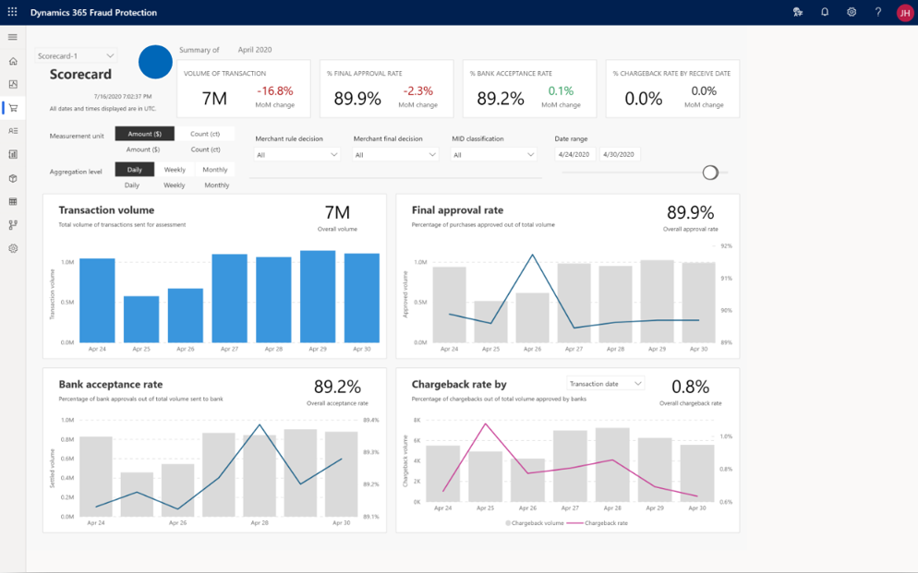
Interactive Demo
TBD
D365 Fraud Protection
(please ask a MTC architect for an interactive demo)

Slide 18

Microsoft Dynamics 365 Fraud Protection combines the capabilities of purchase protection, account protection, and loss prevention to enhance your customers’ shopping experience while improving your business intelligence and reputation, boosting revenue and operational efficiency, lower costs and helping protect your revenue while giving your customers a seamless shopping experience.
Dynamic 365 Fraud Protection
AI

