Slide 2

Blue Yonder: Luminate Control Tower
Blue Yonder’s Luminate Control Tower (LCT) is a next-gen SaaS solution powering end to end visibility of supply chains for faster, more accurate, and more informed decision-making.
LCT provides insights to see, understand, act and learn on real-time information from the entire digital ecosystem, including third-party data sources. With LCT, retailers and manufacturers can reduce expediting expenses, increase planning efficiency and reduce inventory investment.

Slide 3
Supply Chain
Control Towers
DISPARATE, SILOED
Visibility / Execution
Control
Tower
Planning / Collaboration Control
Tower
Cognitive
Control
Tower
TODAY
INFORMATION OVERLOAD
LACK OF UNIFORM INFRASTRUCTUE
LIMITATIONS ON PRESCRIPTIVE INSIGHTS
Notes:
Visibility / Execution Control Tower
Offers track and trace capabilities and event management for distributors, partners and suppliers
Provides extended visibility to transportation optimization, Suppliers and Trading Partners
Helps optimize transport lead times, and manage shipments within execution window
Planning / Collaboration Control Tower
Offers end-to-end planning visibility but is not real time, supports collaboration and breaks down siloes
Focus is on transactional collaboration, feeds data to planning response and optimization of decisions
Optimization is based on deterministic/static supply chain parameters
Cognitive Control Tower
Consumes digital signals (SNEW, IOT)
Leverages planning & data science to continuously learn, generate insights & recommendations
Allows Enterprises to leverage Cognitive intelligence to sense demand and intelligently adjusts supply in real time

Slide 4
Supply Chain
Control Towers
END-TO-END, AUTONOMOUS
Blue Yonder Approach
TOMORROW
Cognitive
Planning
Workflows
Execution
ORCHESTRATOR OF VALUE
Notes:
Control towers is sometimes an overloaded term. It’s an important way for enterprises to gain end-to-end visibility over their supply chains, and often a first step on the journey to modernize and digitize supply chains by providing the connective tissue to link planning and execution. At a basic level, control towers provide granular visibility into the details needed to execute. Not all control towers are built equally. With multiple complexities to be addressed in each industry, solutions are springing up left and right, with analytics solutions often marked as a control tower solution. We believe that Control Towers should provide actionable, granular visibility and operational control across the entire supply chain.
Blue Yonder’s approach is different: we’ve built a thoughtful design for Luminate Control Tower to achieve end-to-end visibility that enables our customers to effectively act on these insights to optimize their end-to-end supply chain. It’s solution-agnostic, providing end-to-end visibility across functions and trading partners, enabling collaboration, ML-empowered resolution capabilities and the ability to execute actions across the enterprise. We’ve built cognitive insights via machine learning to ensure supply chain decisions are supported by rich data sources. And its built cloud/SaaS-native with robust APIs and an intuitive and engaging user experience, including mobile. This end-to-end approach is designed to scale to the needs of the world’s largest companies.

Slide 5
Introducing Luminate Control Tower
VISIBILITY / MONITORING
End-to-end near real
time network visibility, alerts-based
1
4
ORCHESTRATION
Orchestrate response
and execution
NETWORK / EDGE
Sense external events & digital signals
5
2
RESOLUTIONS
Continuously learn, generate insights, predictions and prescriptive
resolution
Luminate
Control
Tower
3
ANALYTICS
Monitor and Improve Service Levels, lower costs, improve productivity
COLLABORATION
Collaborate internally & externally
6

Slide 6

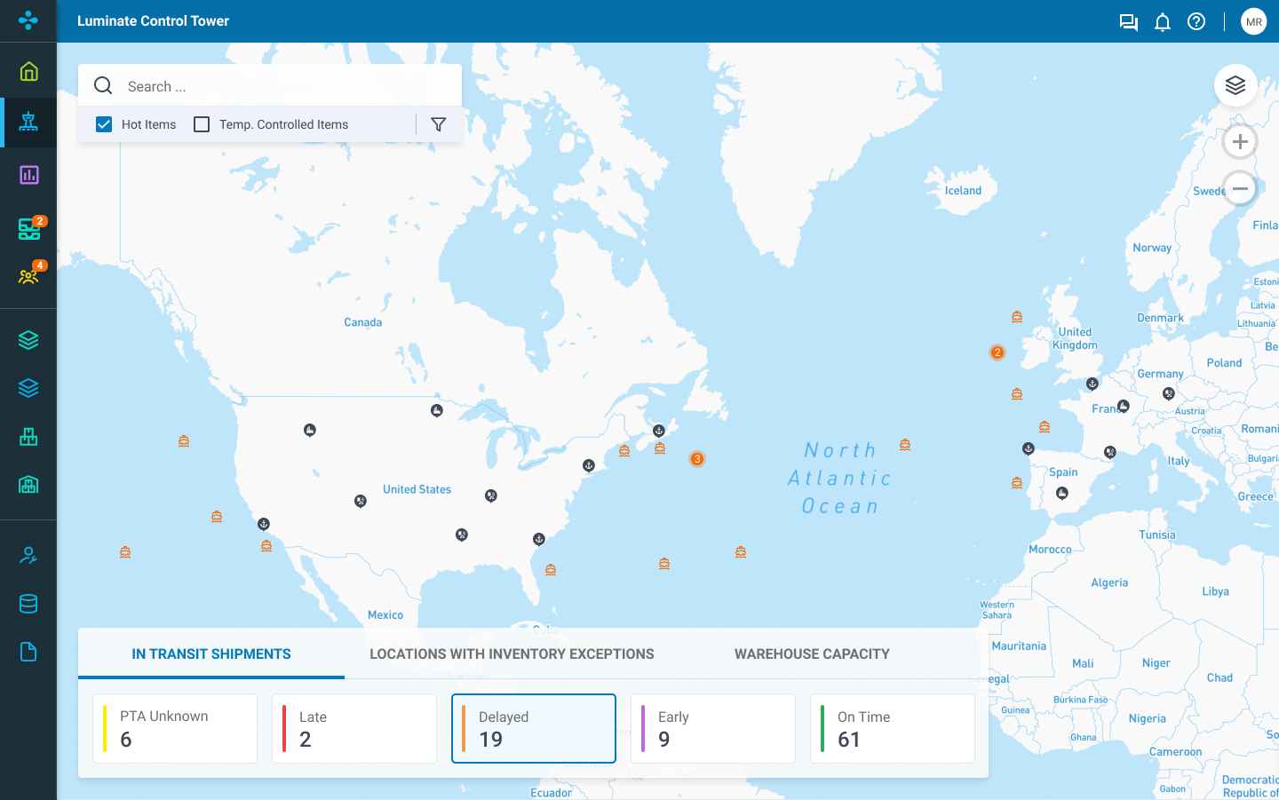
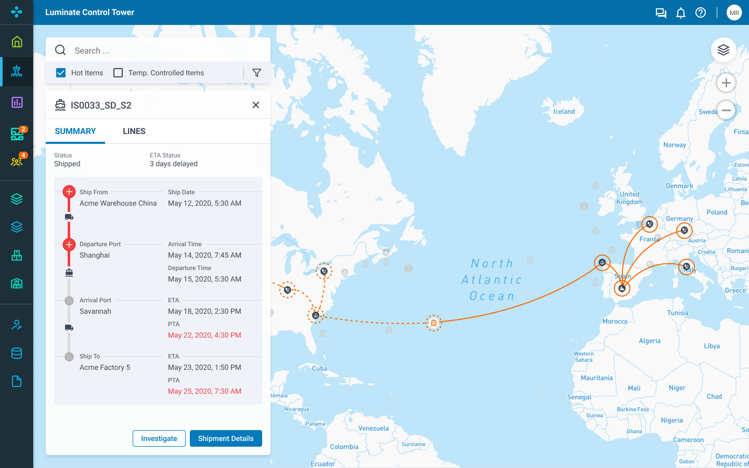
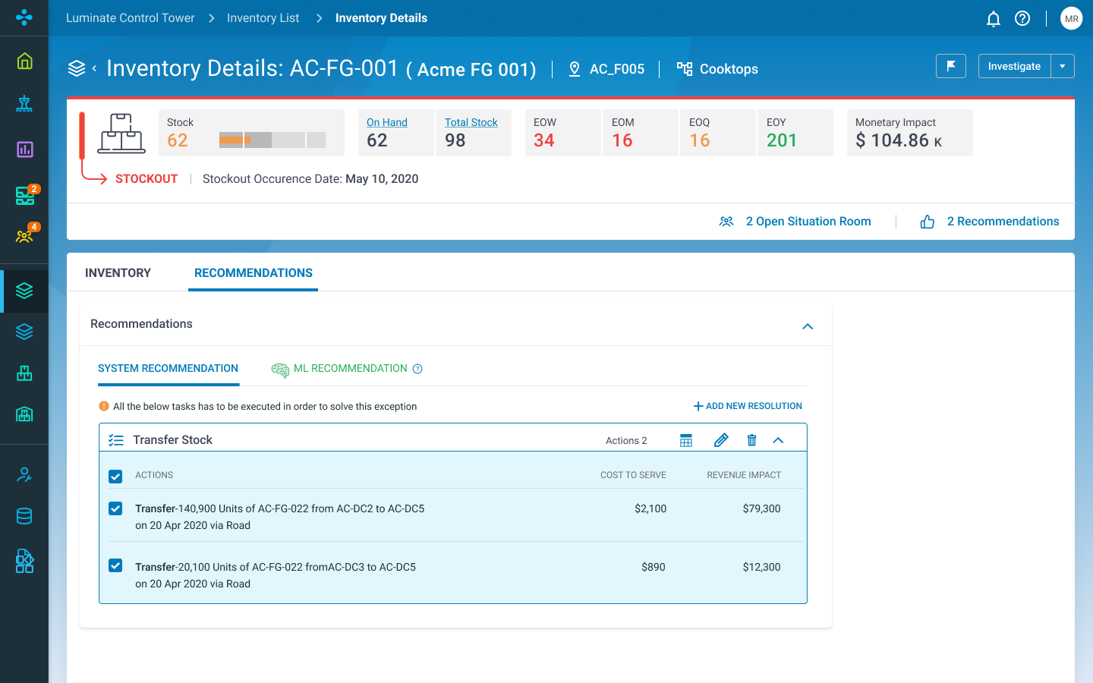

See
Understand
Act
Learn
CONDITIONS
TIMING
AI/ML
OUTCOMES
ACTIONS
Visualize the entire flow of goods across suppliers, factories, distribution centers, distributors, sales channels and customers
Single data model across the extended supply chain in real-time
Create more accurate views with alternate sources of data, like IoT or weather
  Identify addressable situations with end-to-end visibility
  View exceptions for handling, considering potential impacts
  Insightful decision support, empowered by machine learning
  Cross-functional collaboration with extended network of trading partners
  Decisions trigger corresponding actions throughout the enterprise
  Luminate Control Tower intelligence is continually evolving as situations, actions, and outcomes fuel the system's ability to recommend future actions that will yield the best results.
Notes:
See: Break down siloed views to enable end-to-end, real-time visibility into the supply chain to visualize the entire flow of goods upstream and downstream with a single, real-time version of the truth.
Understand: Planners can prioritize responses to current and predicted disruptions based on severity and impact, and predictive and prescriptive analytics enable what-if scenario analysis using real-time data to better understand trade-offs.
Act: Resolve exceptions within the execution window based on ML powered recommendations. This insightful decision support enables cross-functional collaboration with your extended network.
Learn: Continually evolving intelligence as situations, actions, and outcomes fuel the system’s ability to recommend actions in the future that are most likely to yield the desired outcome.

Slide 7
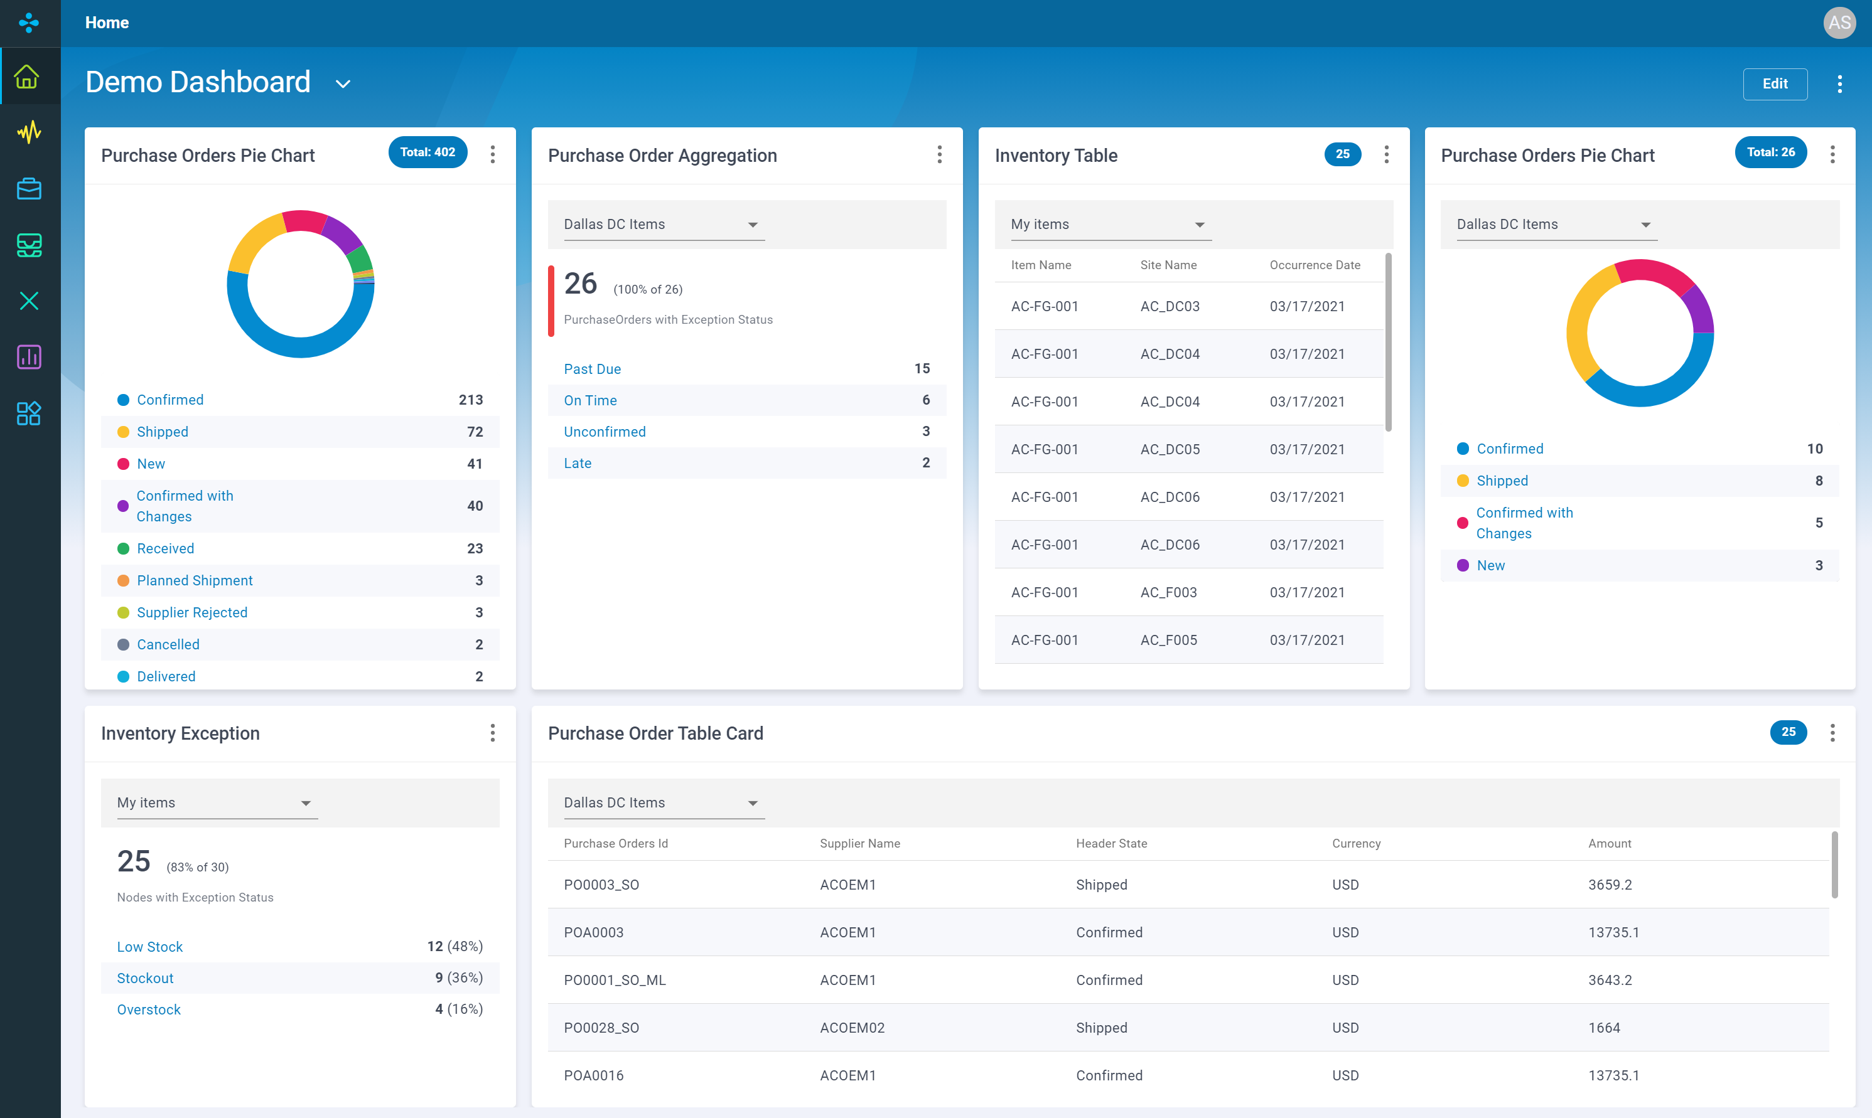
Personalized Dashboard
  Enhancement
Track object level KPIs from rich widgets gallery
Create and configure multiple dashboards
Configurable personalization settings
Supports saved filters
  Business Value
  Provides updated and easy access to the metrics that matter within a single page.
Notes:
Personalized dashboard allows LCT users to track object-level key performance indicators (KPIs) or metrics in a single display or interface. It provides updated and easy access to everything that matters, with powerful, configurable widgets that put important exceptions and transactions at their fingertips. The users can change their personalization settings at any time, and choice from the widgets from the gallery, and their changes are preserved. Users can create and configure multiple dashboards to help them focus on important things for the day.

Slide 8
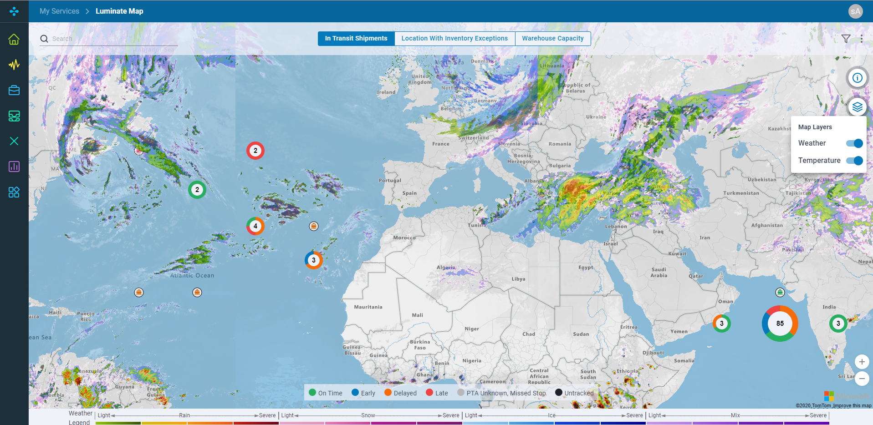
Map View
  Enhancement
Exceptions Clustering
Overlay weather and temperature
  Business Value
  Provides users with essential, up to date information to gauge weather impacts and inform decision making.

Slide 9
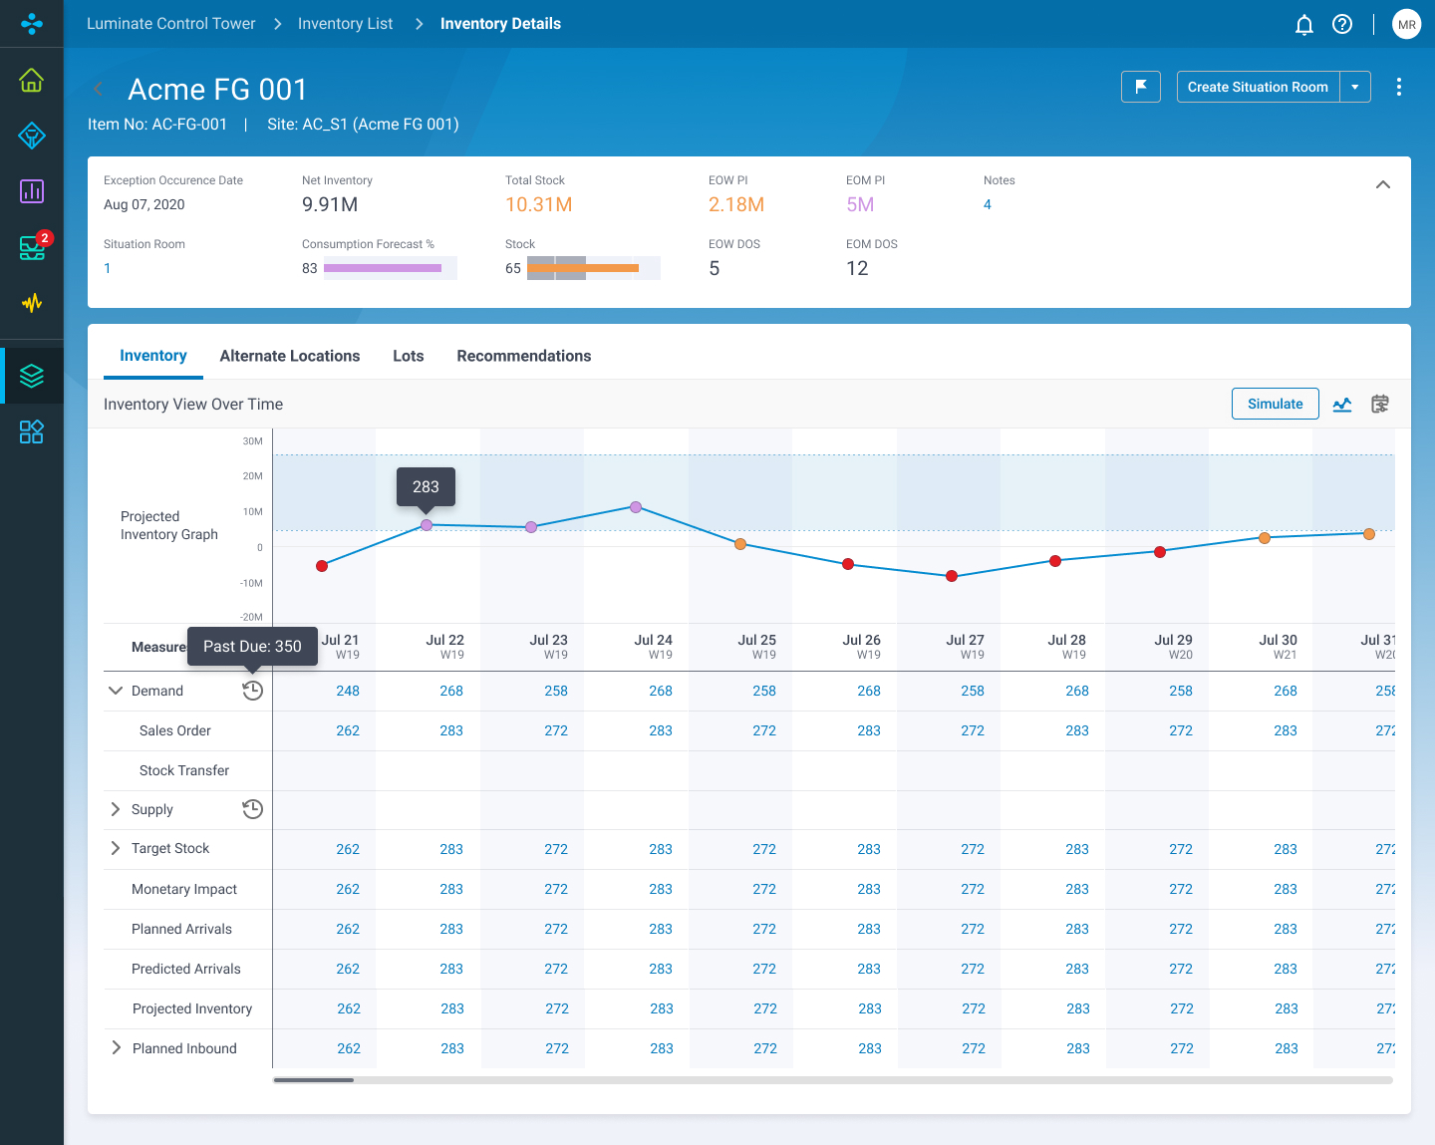
Refreshed Inventory Pages
  Enhancement
  Refreshed user experience to improve efficiency
  Context in single view
  Business Value
  Improved efficiency by streamlining experience and where information can be found.
Notes:
The LCT user experience has been enhanced to enable the users perform the same operations with more efficiency. In this release, only the Inventory list and details page have been enhanced but are not available for users until most of the user experience is enhanced.

Slide 10
Bill of Distribution
  Enhancement
  Supports item level sourcing network definition
  Business Value
  Boost effective planning with an understanding of the sourcing network.
Notes:
The application has been enhanced to support the sourcing options for the combination of an item and its ship-to and ship-from locations with relevant attributes and preferences. Authorized users can upload and download the Bill of Distribution (BOD) master data to onboard and analyze for further planning effectively.

Slide 11
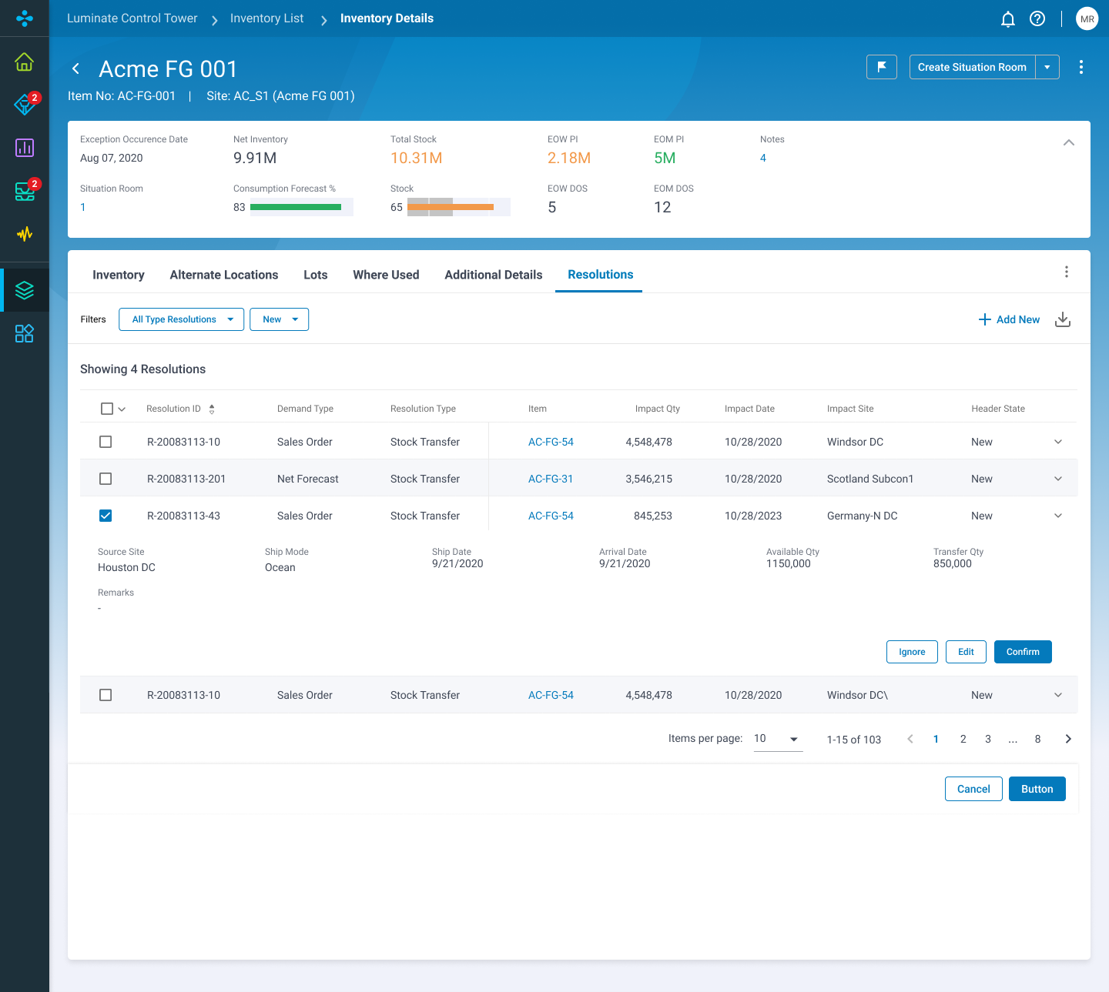
Resolutions
  Enhancement
  Refine stock transfer recommendation by considering:
  Delay tolerances and demand priority
  Cost and distance
  Material batch size in stock transfer recommendation
  Business Value
  More accurate stock transfer recommendations for planners to execute on.
Notes:
Resolutions enhancements
Refine stock transfer recommendation: The application has been enhanced to consider the tolerances and demand priority, cost, and distance before generating the recommendations to address demand shortages. The tolerances are configurable. This page is also enhanced to display the corresponding demand allocations.
Support material batch size in stock transfer recommendation: The application has been enhanced to consider the batch size for each material transfer recommendation instead of individual impact quantity. The left-over quantity from the earlier suggested transfer batch will be carried over to fulfill the requests from a later timeframe.
Support optional consolidation of stock transfer recommendation: The application has been enhanced to optionally consolidate the stock transfer recommendations of the same item from the same transfer origin and destination with the same shipment mode to minimize the shipment costs.

Slide 12
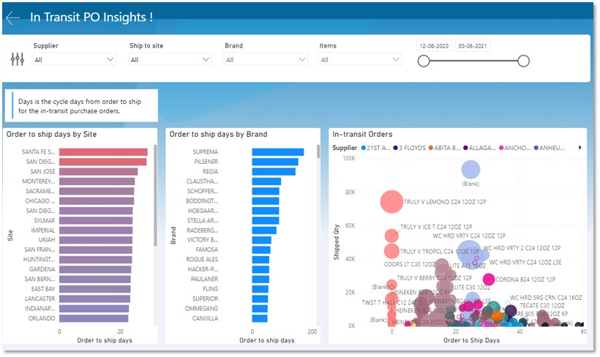
Out of the box Dashboards
  New out-of-the-box dashboards:
  Procurement Analysis
  Inventory Analytics
  Backorder Analysis
  Fulfillment Analytics
  Transportation Lead Time Analysis
  Business Value
  Preconfigured dashboards broken into historical, descriptive analytics to help users understand trends, patterns, root cause in addition to KPIs.
Notes:
Backorder analysis dashboard: insights into backorders and allows the users to understand the patterns, root cause, and monetary impact.
Inventory analytics dashboard: comprehensive insights to all things inventory and allows the users to understand their key performance measures, inventory exceptions and derive insights for better inventory management.
Fulfillment analytics dashboard: combination of descriptive, predictive, and prescriptive data insights that serve as a one-stop shop to identify abnormalities impacting the revenue or service levels, assess performance metrics, and analyze root cause.
Procurement analysis dashboard: end-to-end view on supplier performance around cycle days and delay and helps in better decision-making during procurement cycle by flagging any outliers or discrepancies.
Transportation dashboard: insights on lead time through visibility of performance metrics around carrier performance, outlier detection, forecasting, map outline across all sources and destinations for inbound shipments.

Slide 13
Microsoft Partnership
Luminate Control Tower Highlighted at Microsoft Inspire
Notes:
Luminate Control Tower Highlighted at Microsoft Inspire 2021 wCaptions

Slide 14
Video Demonstration
Blue Yonder Luminate Control Tower
Notes:
Blue Yonder Luminate Control Tower video

Slide 15

Introducing the Luminate Platform
One Data | One Experience | One Ecosystem
Planning
Execution
Commerce
Demand Planning | Supply Planning | Production Planning
Transportation Mgmt. | Logistics Network | Modeling
Assortment Mgmt. | Inventory & Order | Lifecycle Pricing
Network Design | Inventory Optimization | Allocation & Replenishment
Warehouse Mgmt. | Labor Mgmt. | Robotics Hub
Space & Floor Planning | Store Execution | Workforce Mgmt.
Sales & Ops Planning | Sales & Ops Execution | Merch. Financial Planning
Warehouse Tasking | Digital Fulfillment
Merchandise Operations
Integration
& APIs
User
Experience
Control
Tower
IoT
Data
Mgmt.
Workflow &
Orchestration
AI / ML
Analytics &
Insights
Luminate Platform
Notes:
Blue Yonder customers have been realizing value from proven BY solutions in the supply chain execution domain for retail, manufacturing and third-party logistics industries. The value of the solutions is greatly enhanced with the Luminate Platform, enhancing the business logic with new capabilities such as AI/ML, analytics, and workflow. (or Which is supported by BY’s SC platform, breaking organisational silos, delivering unification and automation via AI/ML, etc)
The Blue Yonder’s Supply Chain Execution solutions enables customers to seamlessly plan/optimize/orchestrate the foundational elements of logistics – orders, space, movement, inventory and resources – across all logistics nodes, leveraging human and machines to enable speed, effectiveness, and resiliency...through easy to consume services
Our Luminate™ Platform provides synchronized business planning, execution, delivery and labor solutions that optimize your business and people from end-to-end. Luminate leverages industry-leading artificial intelligence (AI) and machine learning (ML) capabilities and workflow-driven user experiences to help you better predict, prevent, and resolve disruptions across your entire business. With Luminate Platform you can optimize and automate business decisions, creating a more profitable supply chain while delivering seamless and superior customer experiences. Luminate runs on Microsoft Azure Cloud and delivers seamless integration via our partnership with MuleSoft, enabling us to extend and scale with you as your business grows.

Slide 16
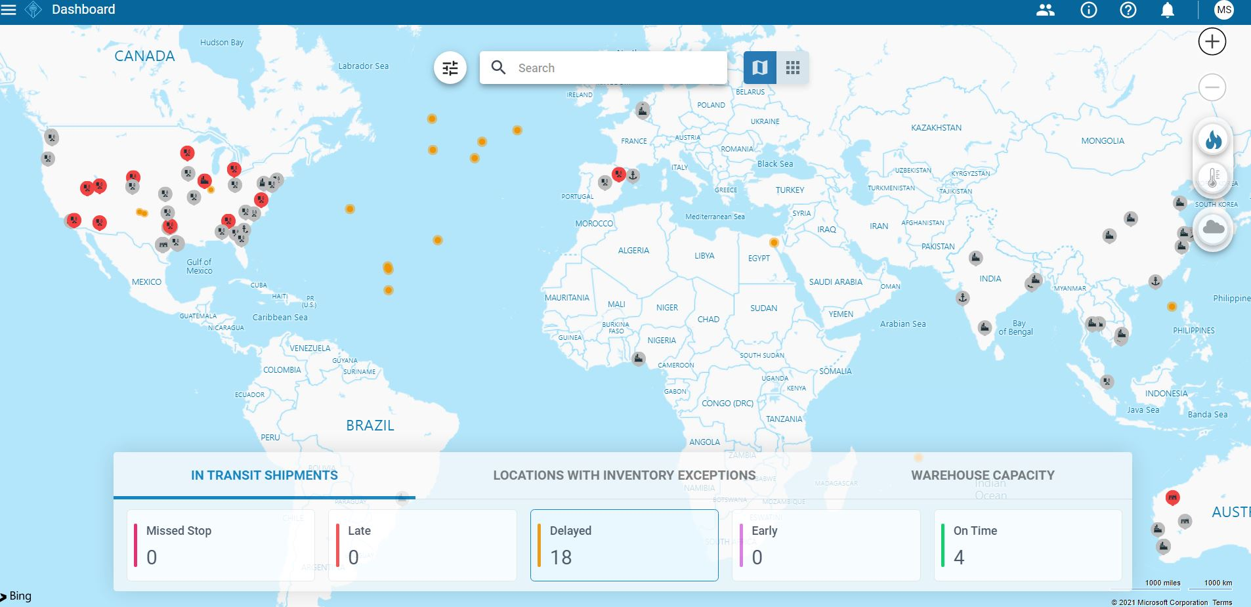
Interactive Demo
Luminate Control Tower
(please ask a MTC architect for an interactive demo)
Notes:
Interactive Demo:
To access the Blue Yonder LCT demo environment and leverage supporting enablement materials, each Microsoft associate must register for and access the Blue Yonder Partner Portal. The password will reset every 90 days.

Slide 17



Blue Yonder’s Luminate Control Tower harnesses the power of Microsoft Azure, AI and ML-based forecasting engines to provide companies with complete supply chain visibility.
Enabling collaboration while prescribing more automated, profitable business decisions.
Azure
Power BI
AI
Machine Learning

Slide 18

Blue Yonder: Luminate Demand Edge
Blue Yonder’s Luminate Demand Edge (LDE) is a next-gen SaaS solution that extends and enhances Blue Yonder’s industry-leading planning solutions to deliver game-changing, autonomous forecast accuracy.
LDE optimizes the end-to-end supply chain holistically, intuitively understanding the tradeoffs between each inventory movement and aligning these to customer demand and strategic objectives.

Slide 19
Luminate Demand Edge Delivers
PRECISION AT SCALE
Continuous measurement of customer demand via class leading AI
More granular processing level than humans are capable of
SELF-LEARNING
Model learns across all stores and all products
The forecast dynamically adjusts by comparing sales to forecast over multiple horizons
EXPLAINABLE AI
Real life complexity presented to the user in a meaningful way
Avoids human intervention as users under what the model has considered

Slide 20
Key Differentiators
DATA CORRELATIONS
Patented machine learning derived from CERN
Understands the correlations between demand influencing factors
Learns across all products and locations
Automatically adjusts to changing conditions
COMPLETE FORECAST
Capture demand uncertainty by forecasting a range of possible outcomes
Identifies inventory risks (likelihood of waste, out of stocks)
PRECISION AT SCALE
Forecast calculated natively at the most SKU-store-day level
Avoids inaccurate weekly disaggregation
Each forecast is unique – does not apply profiles
USER EXPERIENCE
Glassbox UI provides transparency and explainability
One algorithm for all products Increases planner productivity through automation of big data
Focuses attention on internal and external collaboration
Notes:
While other AI-enabled solutions might offer industry parity, LDE is the best solution to enable retailers to leapfrog their competition.
We are different, and the sum of differences delivers ongoing value and KPI improvement, where our competitors tend to produce an uplift then plateau. Remember: this is true SaaS.
But more fundamentally, an organisation looking for genuine digital transformation needs to look at their processes and structures differently. Are they looking to speed up the processes they built up over the last 5, 10 years, or do they want to re-wire themselves for a new era?

Slide 21
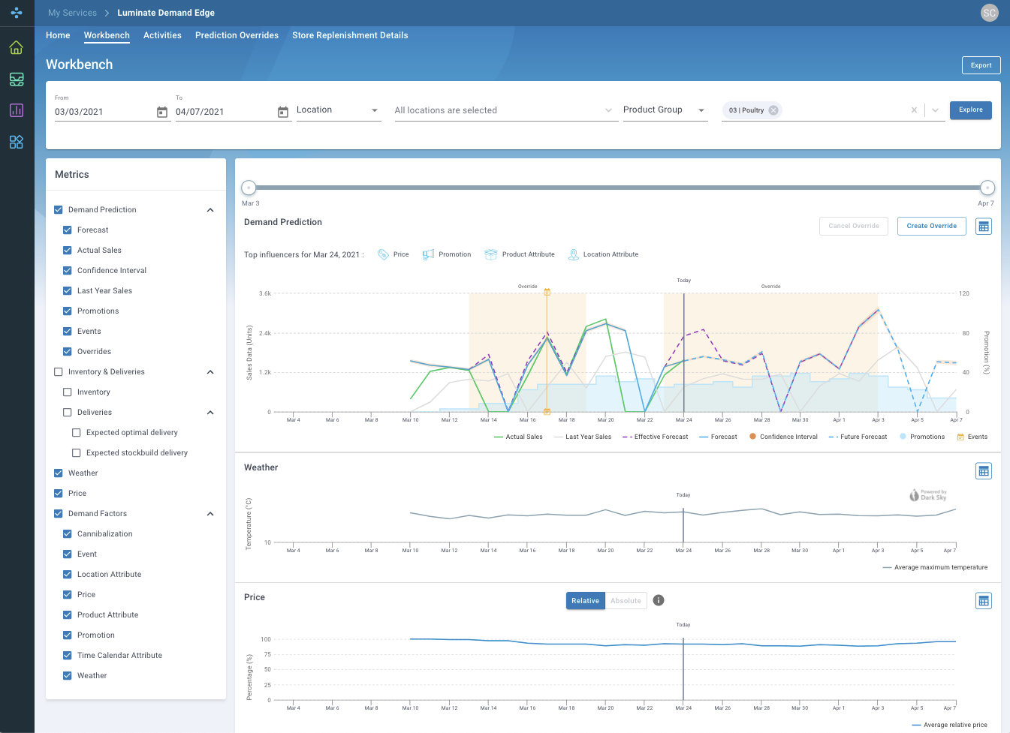
Luminate Demand Edge
Using patented class leading ML, it intuitively learns customer based on micro patterns observed in big data, which it uses as the basis of future predictions:
  Increases planner productivity by automating demand forecasting.
  Forecasts based on recurrence of data patterns rather than repeating history.
  Self-learns across product and location hierarchies.
UX to include LDE factors – expert view??
Notes:
To summarise …
Luminate Demand Edge optimizes the end-to-end supply chain holistically, intuitively understanding the tradeoffs between each inventory movement and aligning these to customer demand and strategic objectives. Its powerful scientific algorithms and statistical modelling drives highly automated replenishment processes designed to deliver self-orchestrating speed and accuracy in all its decisions.
It intuitively understands uncertain customer demand and uses this as a strategic asset to drive replenishment decisions across the supply chain that maintains the richness of the data learned from customer behavior to improve performance.
Ultimately this drives productivity, as humans are focused on strategic outcomes and ad hoc exception management rather than attempting to manually orchestrate the supply chain within complex and inflexible rules or existing organizational blockers.
Problems solved:
Considers uncertainty and all possible outcomes at most granular level while managing replenishment across the network
Recommends inventory movements that align volatile customer demand to strategic goals like availability or waste management
Automatically allocates store orders based on commercial tradeoffs where stock is high or low, ensuring consistency between exception management and category strategy
Automatically smooths orders across time to ensure that capacity constraints are factored into each inventory movement, and costly surges are prevented
Business Value:
increased Availability
Reduced waste
Higher productivity
Less human intervention / higher automation

Slide 22
Video Demonstration
Blue Yonder Demand Edge
Notes:
Blue Yonder Demand Edge video

Slide 23
Introducing the Luminate Platform
One Data | One Experience | One Ecosystem
Planning
Execution
Commerce
Demand Planning | Supply Planning | Production Planning
Transportation Mgmt. | Logistics Network | Modeling
Assortment Mgmt. | Inventory & Order | Lifecycle Pricing
Network Design | Inventory Optimization | Allocation & Replenishment
Warehouse Mgmt. | Labor Mgmt. | Robotics Hub
Space & Floor Planning | Store Execution | Workforce Mgmt.
Sales & Ops Planning | Sales & Ops Execution | Merch. Financial Planning
Warehouse Tasking | Digital Fulfillment
Merchandise Operations
Integration
& APIs
User
Experience
Control
Tower
IoT
Data
Mgmt.
Workflow &
Orchestration
AI / ML
Analytics &
Insights
Luminate Platform
Notes:
Blue Yonder customers have been realizing value from proven BY solutions in the supply chain execution domain for retail, manufacturing and third-party logistics industries. The value of the solutions is greatly enhanced with the Luminate Platform, enhancing the business logic with new capabilities such as AI/ML, analytics, and workflow. (or Which is supported by BY’s SC platform, breaking organisational silos, delivering unification and automation via AI/ML, etc)
The Blue Yonder’s Supply Chain Execution solutions enables customers to seamlessly plan/optimize/orchestrate the foundational elements of logistics – orders, space, movement, inventory and resources – across all logistics nodes, leveraging human and machines to enable speed, effectiveness, and resiliency...through easy to consume services
Our Luminate™ Platform provides synchronized business planning, execution, delivery and labor solutions that optimize your business and people from end-to-end. Luminate leverages industry-leading artificial intelligence (AI) and machine learning (ML) capabilities and workflow-driven user experiences to help you better predict, prevent, and resolve disruptions across your entire business. With Luminate Platform you can optimize and automate business decisions, creating a more profitable supply chain while delivering seamless and superior customer experiences. Luminate runs on Microsoft Azure Cloud and delivers seamless integration via our partnership with MuleSoft, enabling us to extend and scale with you as your business grows.

Slide 24
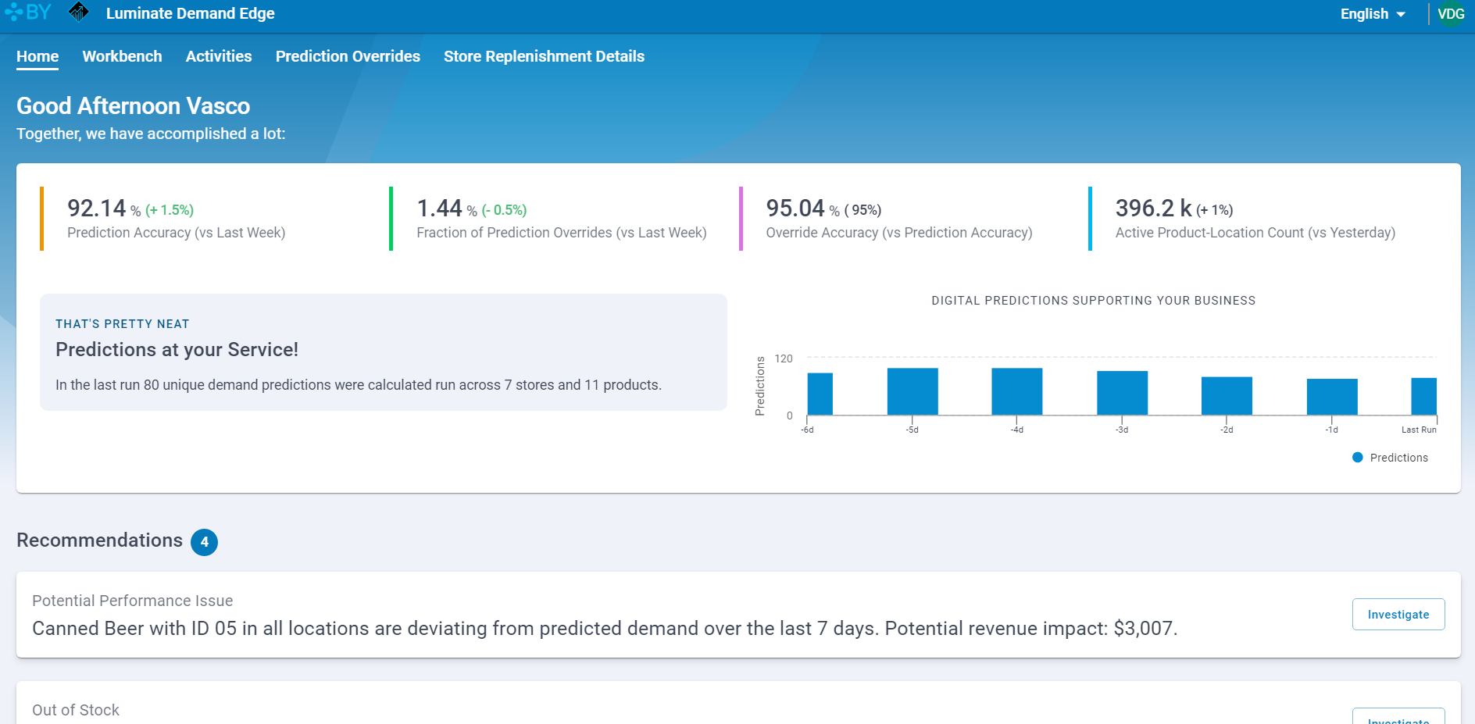
Interactive Demo
Luminate Demand Edge
(please ask a MTC architect for an interactive demo)
Notes:
Interactive Demo:
To access the Blue Yonder LDE demo environment and leverage supporting enablement materials, each Microsoft associate must register for and access the Blue Yonder Partner Portal. The password will reset every 90 days.

Slide 25

Blue Yonder’s Luminate Demand Edge harnesses the power of Microsoft Azure, AI and ML-based forecasting engines to help drive autonomous, probabilistic forecasts engines to provide companies with leading-edge, advanced forecasting with better insights.
Azure
Power BI
AI
Machine Learning

