Slide 1

AGENDA
Thursday | March 13th | 9:30 am - 4:00 pm
Check-In/Registration & Breakfast 9:30 – 9:50 AM
Join Us for Coffee & Pastries
Welcome! And Introductions 9:50 – 10:00 AM
Bryan Marx, Alliance Sales Manager, Logitech
Copilot Adoption, Updates & Roadmap for Public Sector 10:00 – 10:40 AM
Mark Hodge, Microsoft 365 Global Blackbelt, Microsoft
How Logitech Completes MSFT’s Copilot Vision in S&L, EDU and GOV 10:40 – 11:20 AM
Desiree Ortiz, Logitech, Head of Vertical Channel & Joel Murray, Head of Channel Engineering, Logitech
MTR AI, Showcase & Design, Logitech Deployment Strategies, NPIs 11:20 AM – 12:00 PM
Bryan Marx, Alliance Sales Manager & Will Nance, Sr. Solutions Engineer, Logitech
Lunch + Jeopardy + Raffle 12:00 – 1:00 PM
Catering from The Catering Company
Microsoft Innovation Hub Tour 1:00 - 2:00 PM
MSFT Team - Jay Leask
Happy Hour, Onsite Here at the Innovation Hub! 2:00 - 4:00 PM
Notes:
Byran: Product, PWS and TWS, demos, MSFT partner history

Slide 2

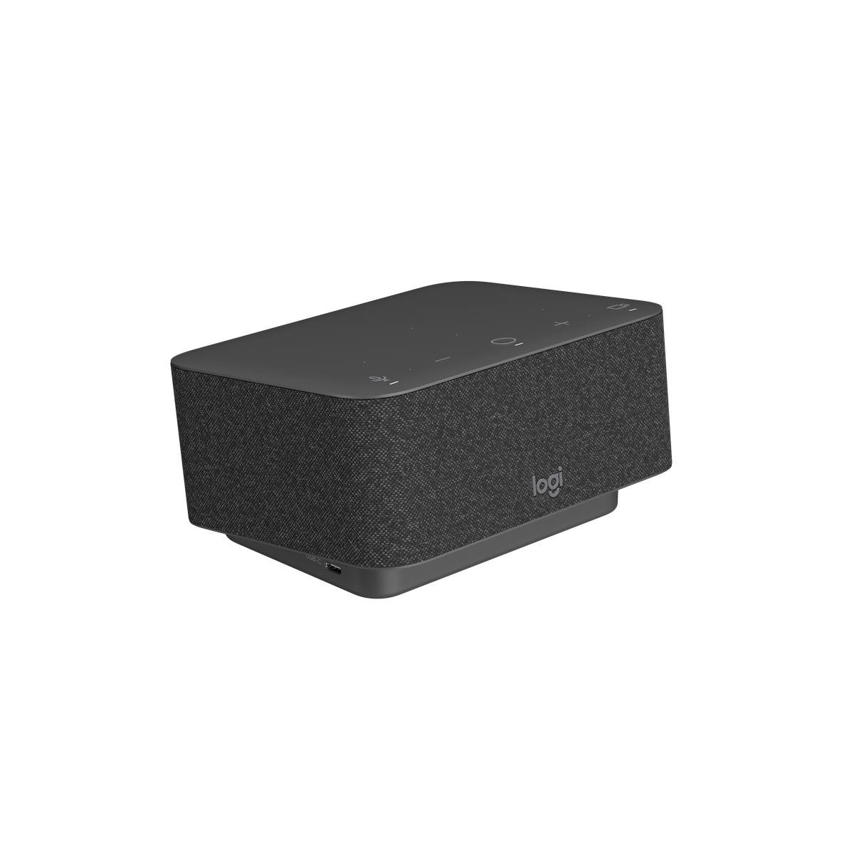
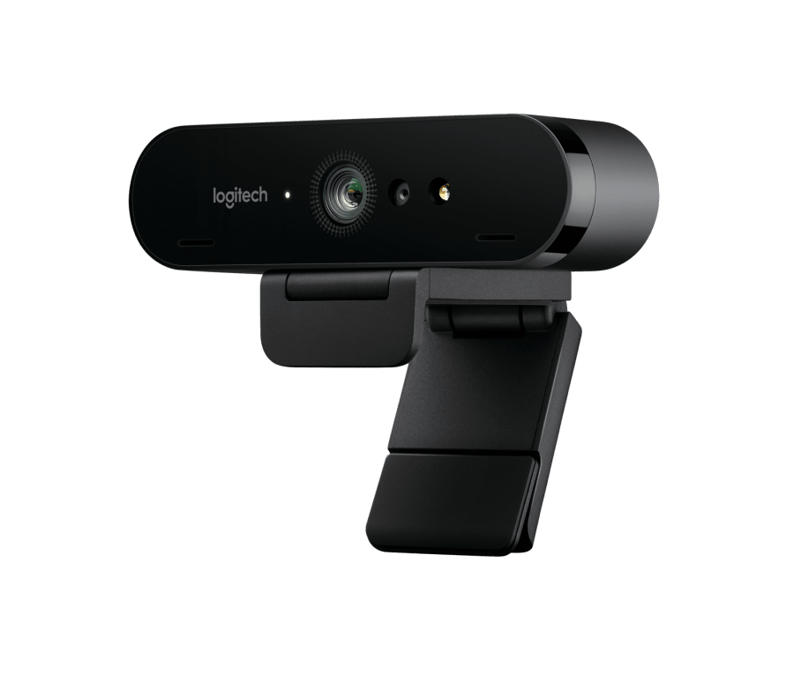
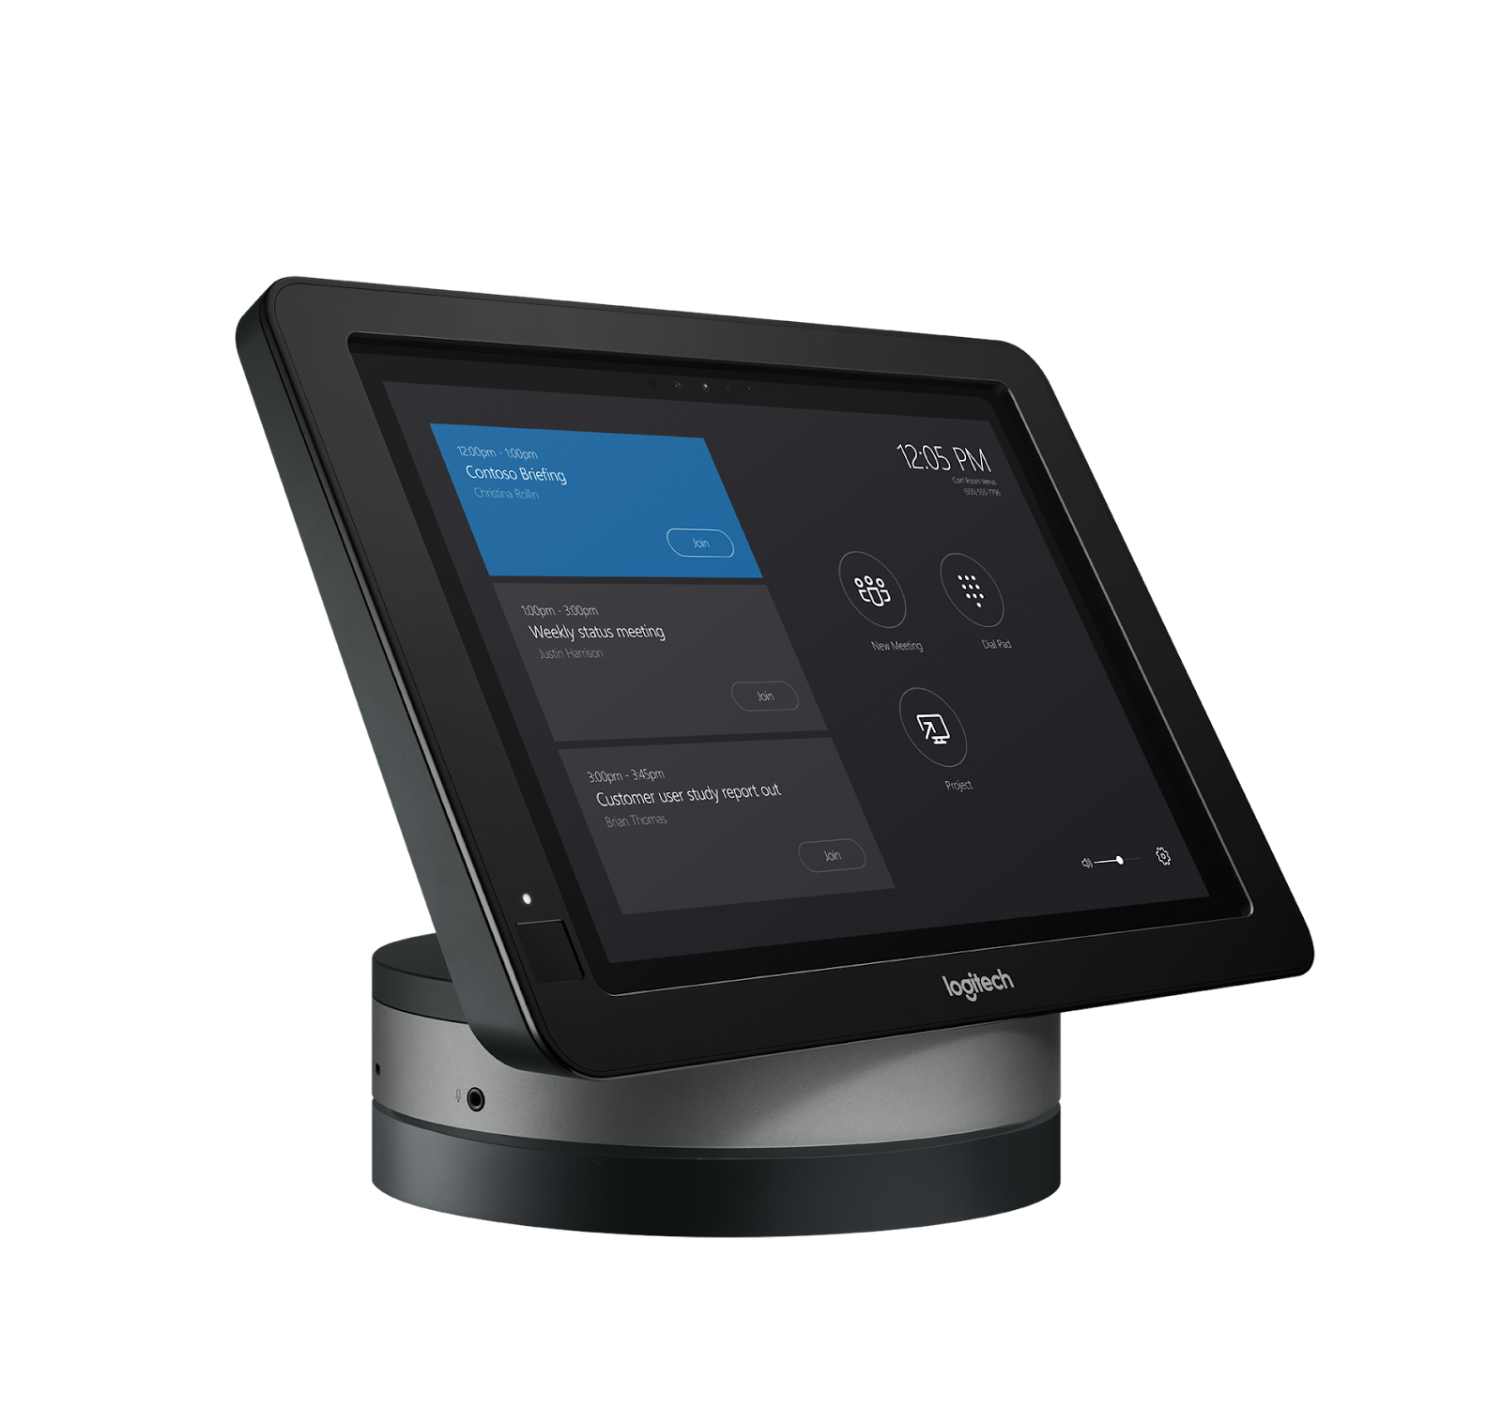
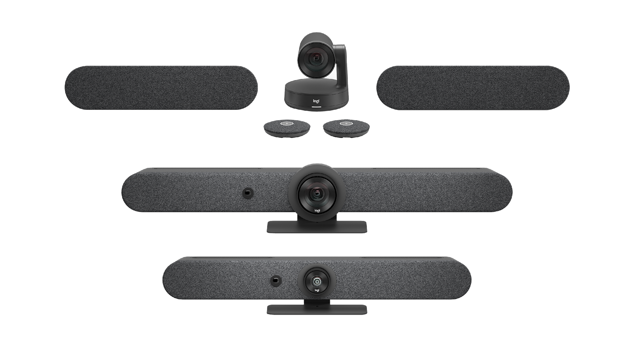
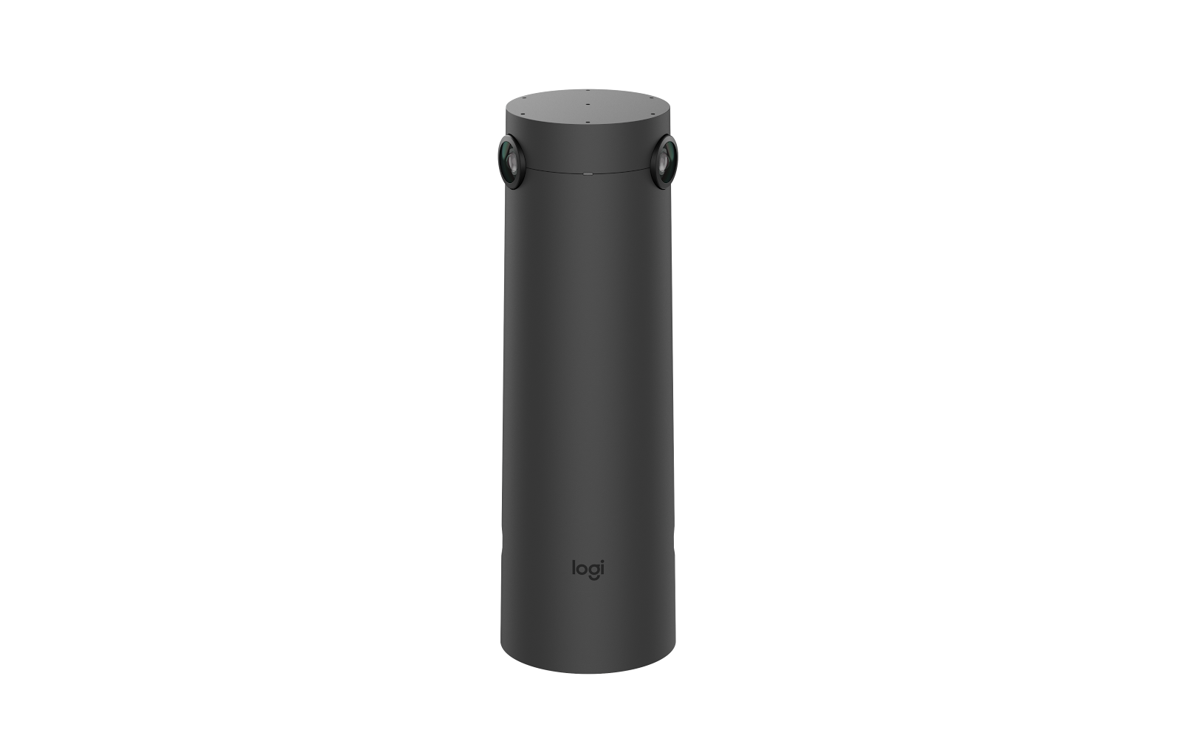
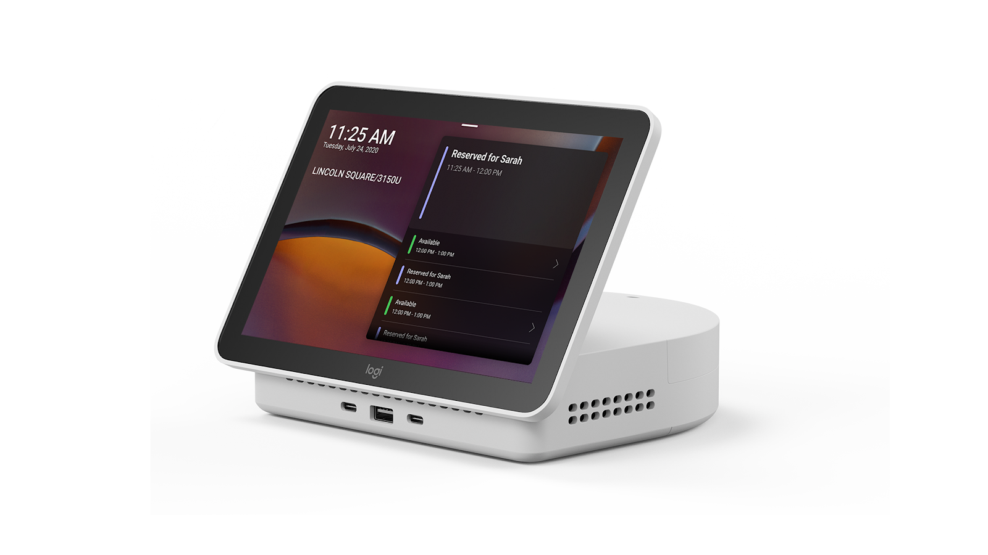
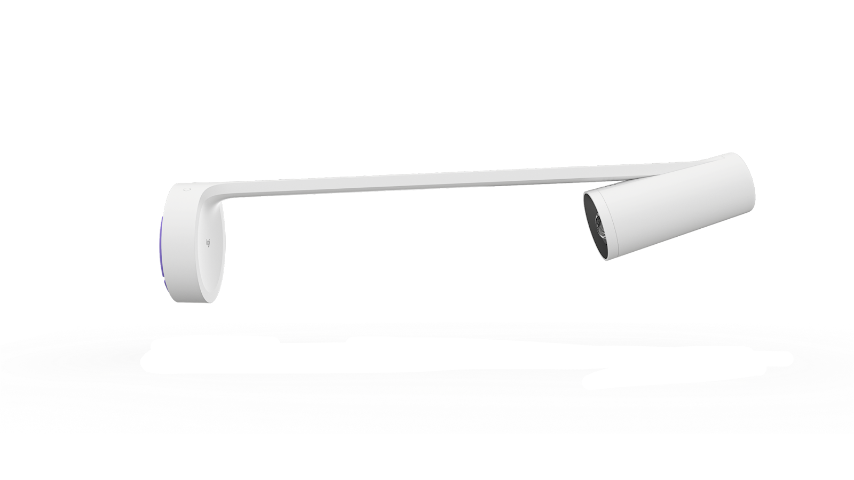

Co-Innovation Experience
BETTER TOGETHER
BRIO
First Windows® Hello webcam
New Rally Portfolio
First to support Teams Rooms on Windows and Android
RightSight™ 2
Collaboration equity for remote attendees
Sight
First front and center of room camera certified for Teams
SmartDock
First Skype Room System v2
Scribe
First purpose-built Teams Rooms certified whiteboard camera
Logi Dock
First docking station with a Teams certified speakerphone and meeting controls
Logi Dock Flex
First to introduce Teams panel scheduling experience from rooms to desk
Notes:
With 41+ years in business, there’s a lot we’ve accomplished together. What started as the mouse that built the house… shipping 3 million cloud peripherals per week
so when we talk about dependable inventory and supply chain on a global scale, we’re the most dependable. That will help your procurement agents sleep well at night.
Here is a snapshot of some of our accomplishments over just that last 10. From a co-innovation perspective
Important to understand that nothing we build is done alone.
We don’t innovate by ourselves and throw it at MSFT and pray for a certification.
Mutual path
Let me tell you a little story. For example, back in 2018, MSFT came to us with a reimagined vision of the COT center of table camera experience for meeting rooms… and we said, yeah but when in room participants are looking at the screen, nobody wants to hear see their ear lobe, so what if we included the front of room and center?
now known as the newly released Logitech Sight. which was a brain child of both Logitech and Microsoft
Our current portfolio is designed to make it easy to create a single global standard that powers all spaces and all people, from the desk to the largest meeting spaces with rich audio and video, that ultimately powers your Microsoft Experience. From Teams-certified docks, headsets and webcams at the desk, to MeetUp and the Rally Family in meeting rooms, we have all your workspaces covered.
In 2023, certified more devices than all 19 competitors combined. Might sound superlative but that doesn’t make it untrue.
Too many superlatives i know:
Since Covid, we haven’t raised our prices on a single product
First OEM to certify and hit the market with a center of room + front of room experience
Brio, still the best family of webcams. Period
Havent raised out prices since covid
First to bring one touch join since the beginning of this journey
Scribe, in a space where every device was a webcam on a selfie stick screwed to the wall, we thought there was a better way to bring AI, process it at the edge, and have a purpose built white board camera to bring all these spaces into a virtual meeting
Logi Dock: First ever docking station, speakerphone and Teams meeting controls bringing one touch join to the desktop
First ever teams certified earbuds
First ever NBT Certified Headsets
First OEM to introduce custom / removable faceplates:
Only vendor supporting MTR-W & MTR-A on the same device, across the flagship rooms portfolio.
Fully support SPEAKER RECOGNITION AND ATTRIBUTION TO UNLEASH THE POWER OF COPILOT
Only OEM using more than 50% recycled materials in ALL new products… 100% Carbon Neutral as of 2021
With an ESG score of 93. Our nearest competitor in the room space sits at a score of 5
No longer a hardware company, NOW a AI-infused cloud peripherals company, software company, and services company… twice as many software engineers as we do hardware engineers
Logitech has the largest portfolio of Teams Certified devices and experiences.
In CY23 Logitech certified more devices than all other MFRs combined; and that’s in the same year a couple new OEMs entered the MSFT space. There are 19 certified OEMs… and with all of them combined, we still certified more devices. Now i know what you’re thinking. That cant be true.
Well, for a company that tripled in size during covid, completely reinvested the entire surplus in ourselves, doubled down on our B2B strategy, invested in full portfolio category refreshes (From boardroom to desktop), and released an astronomical amount of new inventions, yeah its a bit hyperbolic, but that doesnt make it untrue. So i’ll say it again.
It hurts my soul to be this humble

Slide 3
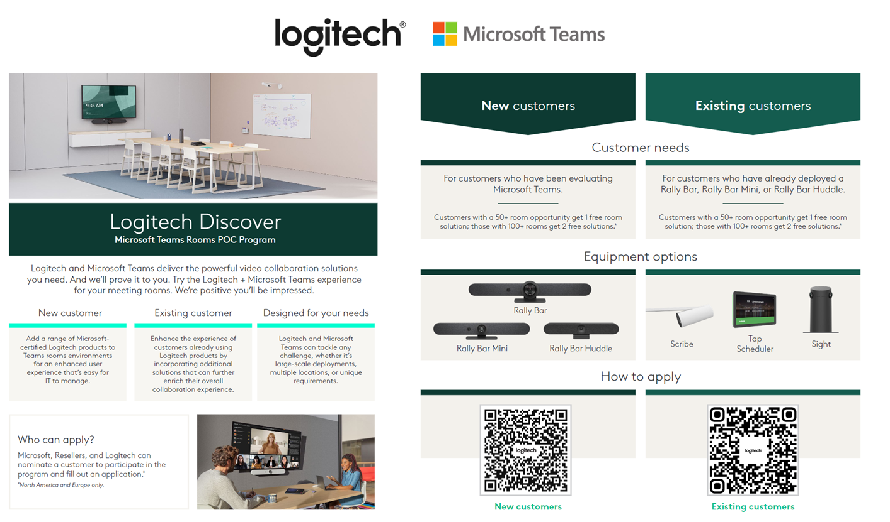
Notes:
INTRODUCING “LOGITECH DISCOVER”
Discover is the new fast track
Best way to sell a puppy
‘
The purpose of this POC program is to help progress and close high potential opportunities.
This program should not be used for lead generation. - its an ace in the pocket
POC workflow updates for SFDC: current website workflow
Please ensure that an opportunity is properly vetted and created in SFDC, while also cross referencing POC program criteria to validate pre-approval.
As next steps, you’ll want to create a POC task following ALL Steps referenced on slides 9-11 on the program overview deck.

Slide 4
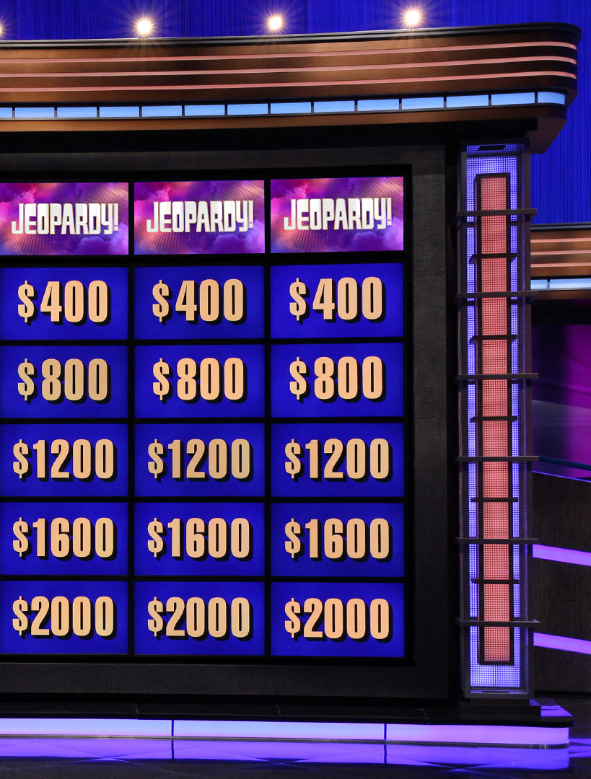
JEOPARDY!
Thank you for attending our event! Now, let’s put your knowledge to the test—who’s feeling lucky?
PRIZES TO BE WON
12:00 PM
Entry is free, voluntary, and open to all attendees. If you wish to participate, please confirm with your agency that you are eligible to enter and can accept the prize if you win.

Slide 5
MICROSOFT INNOVATION TOURS
HAPPY HOUR
1PM-2PM | Tour the Microsoft Innovation Hub and see Logitech tech in action!
2PM-4PM | DC MICROSOFT INNOVATION HUB (that’s right, you don’t have to move, hooorrayyy)

